Slide 1

April 12, 2018
Collect PDN from basket
Turn off or silence Cell Phone NOW!!!
Sharpen Pencil
Sit in assigned seat
Complete PDN on own

Slide 2
Agenda
7th Grade
PDN
2. Human Use of Water Web Quest
3. DOL
6th Grade
PDN
Finish Nervous System Foldable
Endocrine System Video
DOL

Slide 3
LO’s
7th Grade
We will identify different ways human actions can affect our watershed.
6th Grade
We will identify the structures and functions of the nervous system.

Slide 4
DOL’S
7th Grade
I will complete 5/5 written assessment questions over watersheds.
6th Grade
I will complete 5/5 questions over the nervous system.

Slide 5
TEK’S
7th Grade
7.8C (C) model the effects of human activity on groundwater and surface water in a watershed
6th Grade
7.12B (B) identify the main functions of the systems of the human organism, including the circulatory, respiratory, skeletal, muscular, digestive, excretory, reproductive, integumentary, nervous, and endocrine systems

Slide 6
7th Grade Science
1. Collect Water Web Quest, chrome book (1 per table)
2. Login to www.coachpease.com
3. Click on 6th 6 Weeks
4. Scroll to right side of screen, 7th grade column
5. Click on Water Web Quest Link
6. Use information from the web quest to complete handout for a grade

Slide 7
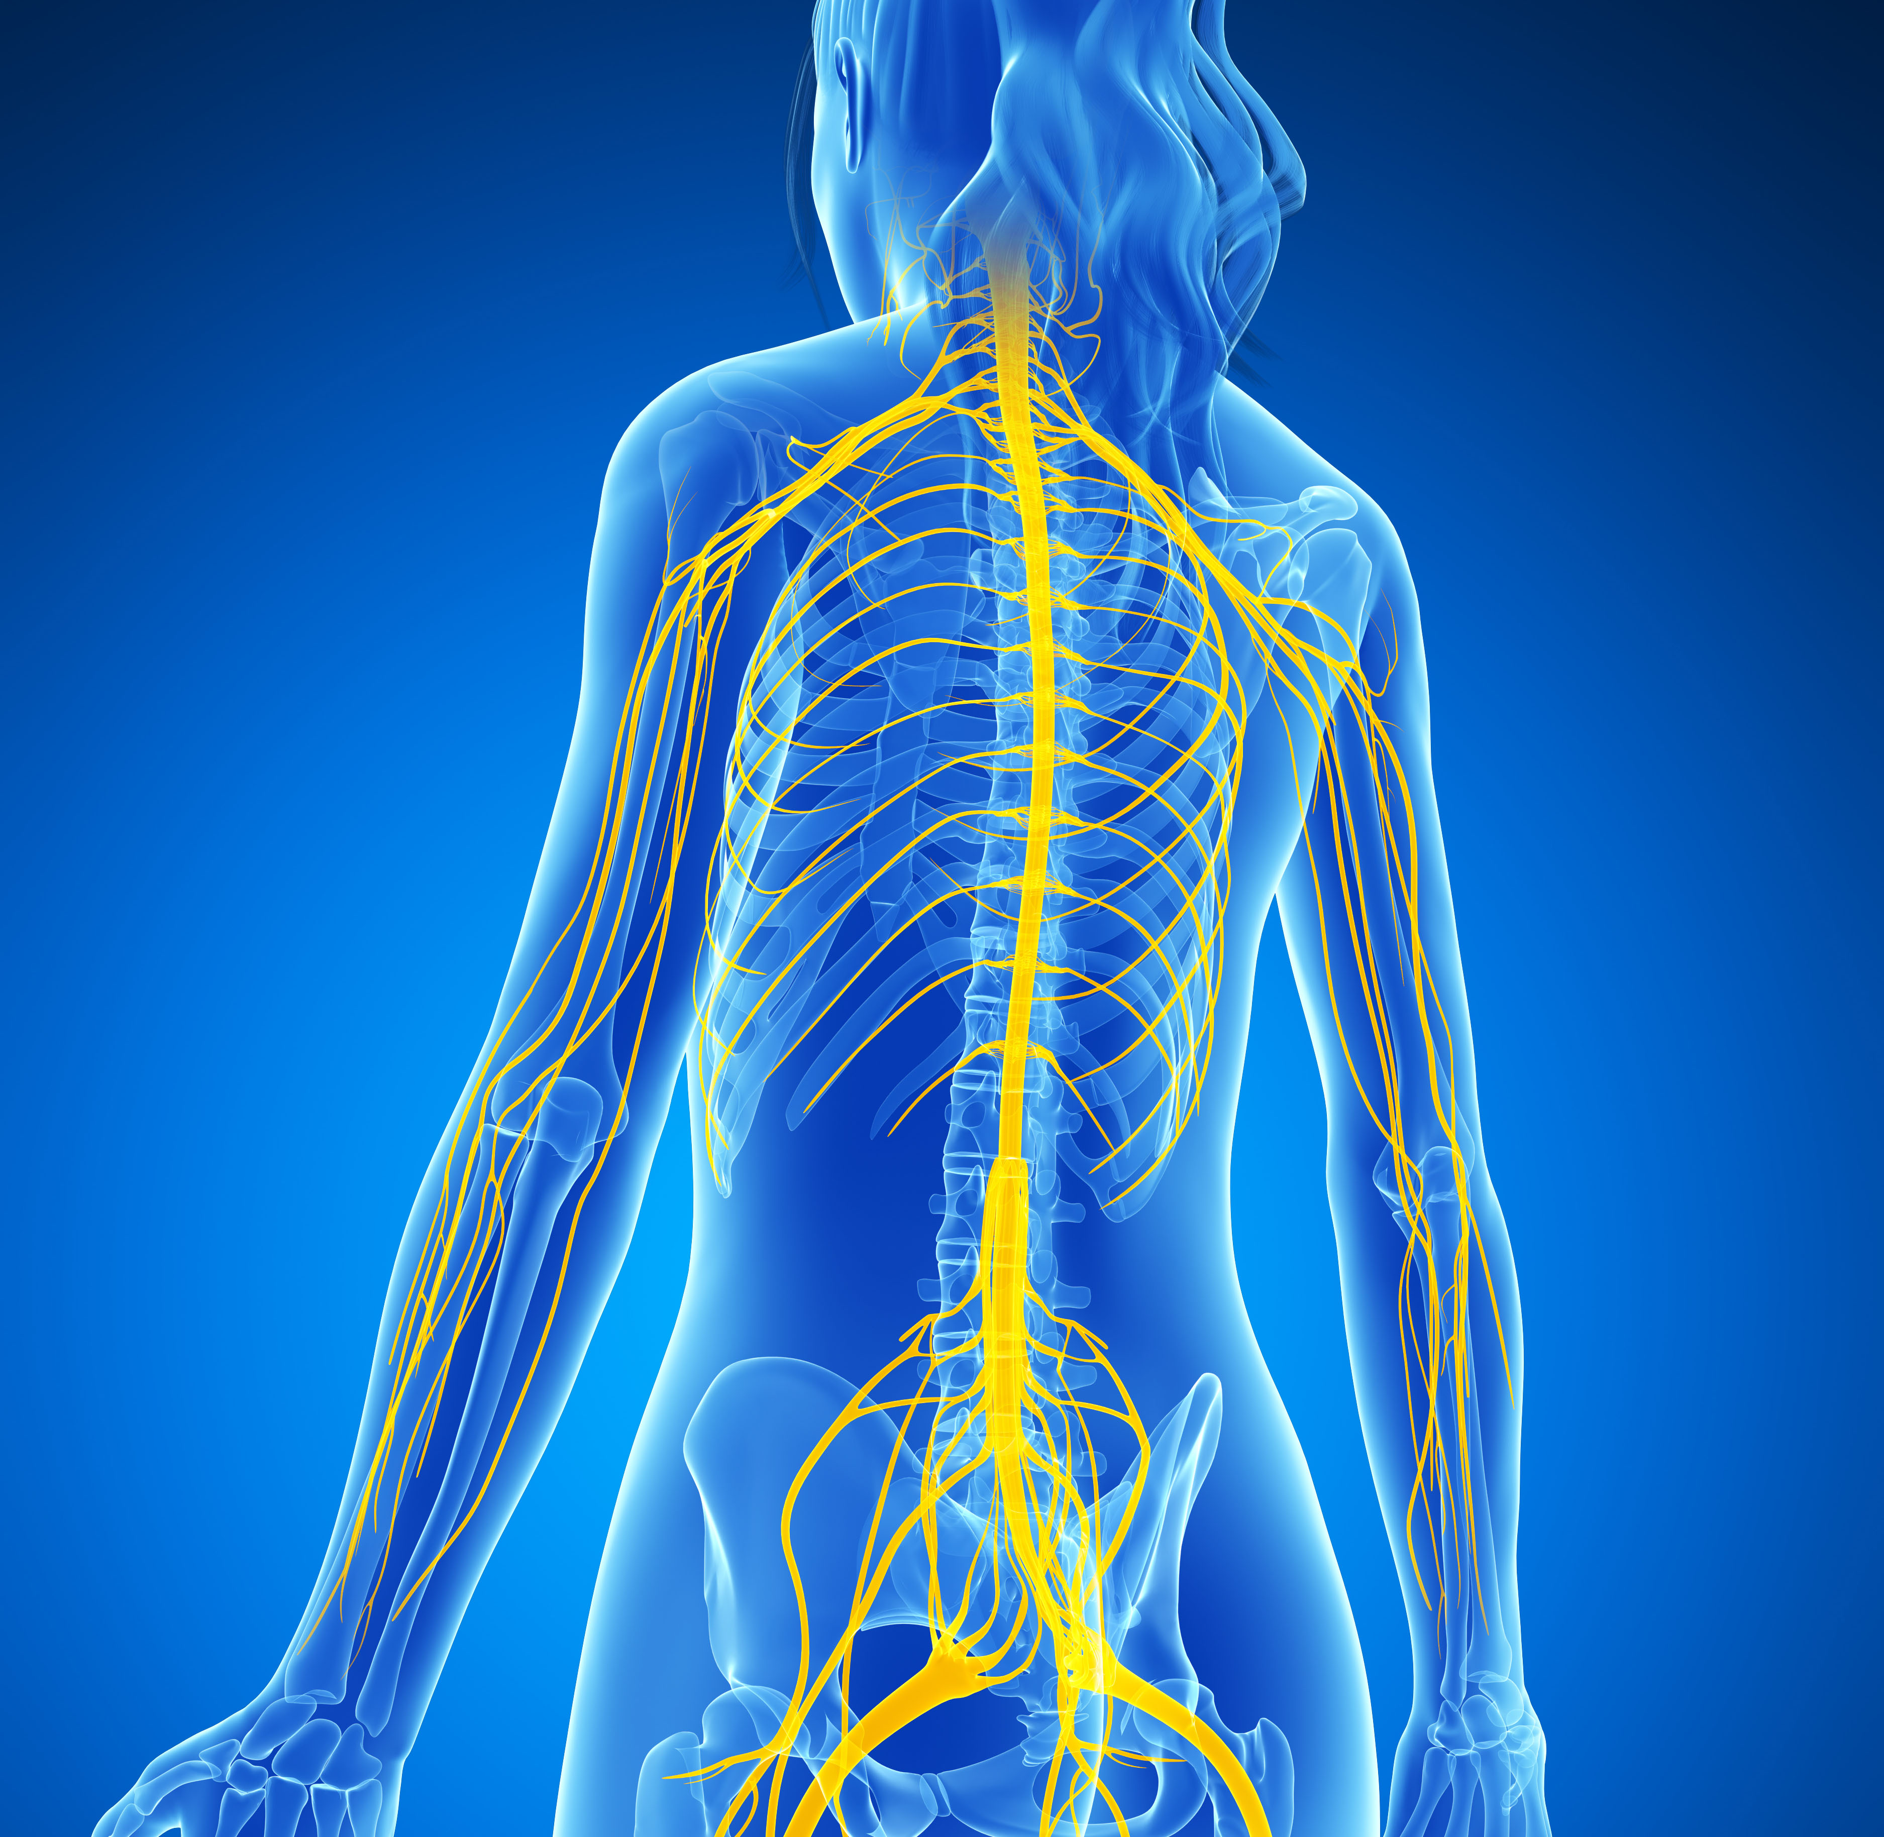
6th Pre-AP Science
Review 5th 6 Weeks Test
Take out your Nervous System Foldable (in journal
Complete Journal as follow along with nervous system power point

