Slide 1
April 12, 2017
Sharpen Pencil
Study Review Packet
Sit 1 boy / 1 girl per table
Be sure name is at top of review packet to be turned in once attendance is taken.

Slide 2
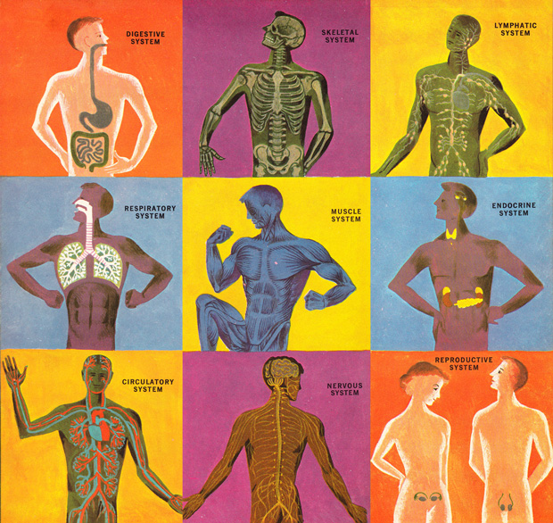
7th Grade Agenda
1. Study Review Packet
2. 5th 6 Weeks Test
3. Vocabulary Card Sort
3. DOL Exit Ticket

Slide 3
7th Grade TEK
TEK 7.6 (6) Matter and energy. The student knows that matter has physical and chemical properties and can undergo physical and chemical changes. The student is expected to:
(A) identify that organic compounds contain carbon and other elements such as hydrogen, oxygen, phosphorus, nitrogen, or sulfur;
(B) distinguish between physical and chemical changes in matter in the digestive system
7.7 (B) illustrate the transformation of energy within an organism such as the transfer from chemical energy to heat and thermal energy in digestion
7.12 (B) identify the main functions of the systems of the human organism, including the circulatory, respiratory, skeletal, muscular, digestive, excretory, reproductive, integumentary, nervous, and endocrine systems
(E) compare the functions of a cell to the functions of organisms such as waste removal

Slide 4
7th Grade LO
We will apply our knowledge of the structure and function of the human body systems to complete the 5th 6 weeks test.

Slide 5
7th Grade DOL
I will complete an exit ticket to explain 2 things I can start doing now to prepare for the Spring ACP test in 5 weeks.

Slide 6
7th Grade Card Sort Options
Once finished with the test…
Turn in test to basket on back long table
Turn in scan-tron to basket on back long table
Collect card sort over 6th 6 weeks curriculum
Return to seat and silently complete card sort

Slide 7
6th Grade Agenda
1. Study Review Packet
2. 5th 6 weeks Test
3. Card Sort
4. DOL Exit Ticket

Slide 8
6th Grade TEK
7.5 (A) recognize that radiant energy from the Sun is transformed into chemical energy through the process of photosynthesis
7.5 (C) diagram the flow of energy through living systems, including food chains, food webs, and energy pyramid
7.7 (A) contrast situations where work is done with different amounts of force to situations where no work is done such as moving a box with a ramp and without a ramp, or standing still;
7.8 (8) Earth and space. The student knows that natural events and human activity can impact Earth systems. The student is expected to:
(A) predict and describe how different types of catastrophic events impact ecosystems such as floods, hurricanes, or tornadoes;
(B) analyze the effects of weathering, erosion, and deposition on the environment in ecoregions of Texas; and
(C) model the effects of human activity on groundwater and surface water in a watershed.

Slide 9
6th Grade LO
LO: We will apply knowledge learned over photosynthesis, flow of energy in an ecosystem, human impact on watersheds, weathering, erosion, deposition and catastrophic events to complete a 6-week district test.

Slide 10
6th Grade DOL
I will complete an exit ticket to explain 2 things I can start doing now to prepare for the Spring ACP test in 5 weeks.

Slide 11
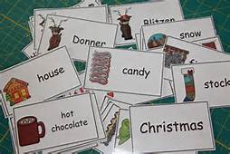
6th Grade Vocabulary Card Sort
Once finished with the test…
Turn in test to basket on back long table
Turn in scan-tron to basket on back long table
Collect card sort over 6th 6 weeks curriculum
Return to seat and silently complete card sort

