Slide 1

April 11, 2017
Sharpen Pencil
Take out Review Packet
Sit in seat assigned to you yesterday
Study review packet

Slide 2
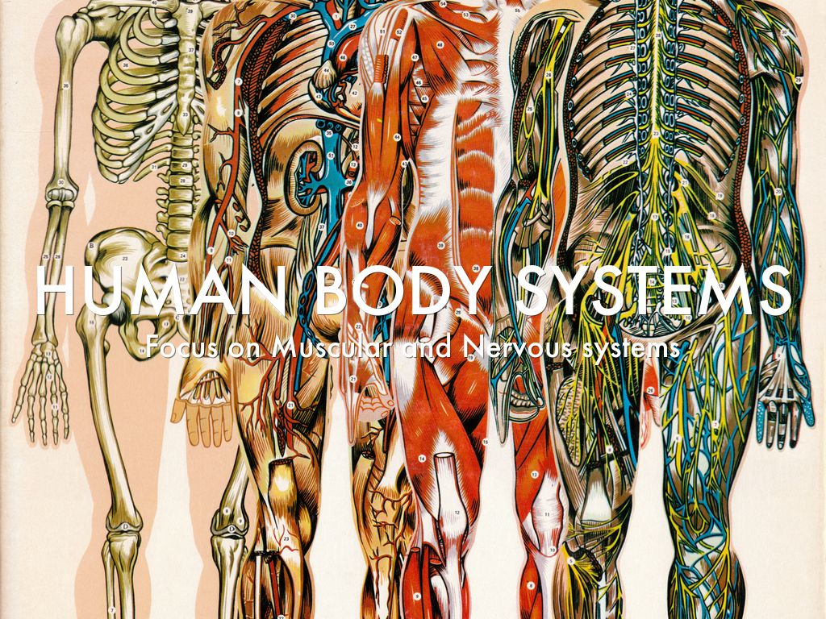
7th Grade Agenda
1. Review Packet Study
2. 5th 6 weeks Review Game (behavior allowing)
3. DOL Exit Ticket

Slide 3
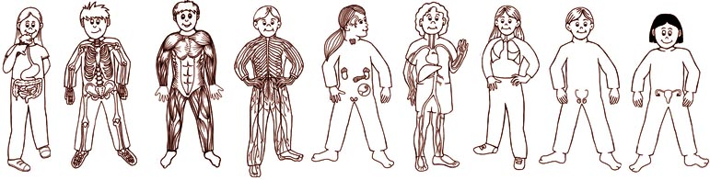
7th Grade TEK
TEK 7.6 (6) Matter and energy. The student knows that matter has physical and chemical properties and can undergo physical and chemical changes. The student is expected to:
(A) identify that organic compounds contain carbon and other elements such as hydrogen, oxygen, phosphorus, nitrogen, or sulfur;
(B) distinguish between physical and chemical changes in matter in the digestive system
7.7 (B) illustrate the transformation of energy within an organism such as the transfer from chemical energy to heat and thermal energy in digestion
7.12 (B) identify the main functions of the systems of the human organism, including the circulatory, respiratory, skeletal, muscular, digestive, excretory, reproductive, integumentary, nervous, and endocrine systems
(E) compare the functions of a cell to the functions of organisms such as waste removal

Slide 4
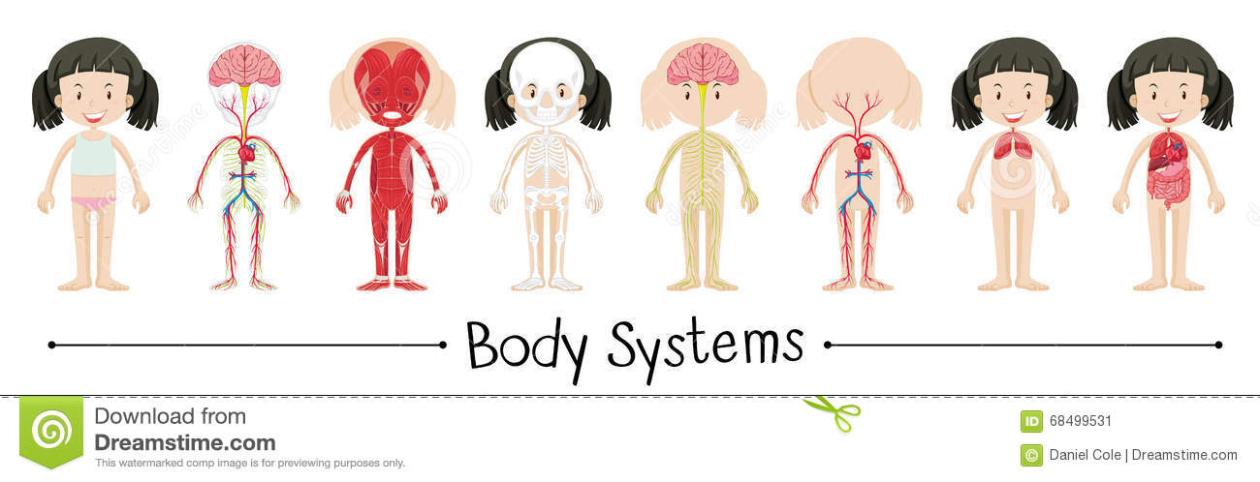
7th Grade LO
We will review the structure and function of the human body systems to prepare for the 5th 6 weeks test via a class game that assist with completing a written review assessment.

Slide 5
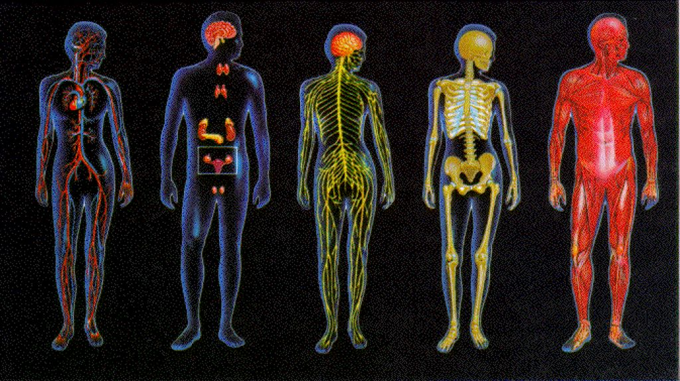
7th Grade DOL
I will complete an exit ticket to explain 3 things that I will do to prepare for the 6 week test on Wednesday.

Slide 6

7th Grade Review Game Link
https://app.edu.buncee.com/buncee/87ec4d086ec14bf6ad9b1151561dd64d
It might be in your best interest to study then…

Slide 7

6th Grade Agenda
1. Review Packet Study
2. 5th 6 weeks Review Game (behavior allowing)
3. DOL Exit Ticket

Slide 8

6th Grade TEK
7.5 (A) recognize that radiant energy from the Sun is transformed into chemical energy through the process of photosynthesis
7.5 (C) diagram the flow of energy through living systems, including food chains, food webs, and energy pyramid
7.7 (A) contrast situations where work is done with different amounts of force to situations where no work is done such as moving a box with a ramp and without a ramp, or standing still;
7.8 (8) Earth and space. The student knows that natural events and human activity can impact Earth systems. The student is expected to:
(A) predict and describe how different types of catastrophic events impact ecosystems such as floods, hurricanes, or tornadoes;
(B) analyze the effects of weathering, erosion, and deposition on the environment in ecoregions of Texas; and
(C) model the effects of human activity on groundwater and surface water in a watershed.

Slide 9

6th Grade LO
LO: We will apply knowledge learned over photosynthesis, flow of energy in an ecosystem, human impact on watersheds, weathering, erosion, deposition and catastrophic events to complete a 6-week district review to prepare for the 6-week district test.

Slide 10

6th Grade DOL
DOL: I will complete an exit slip to explain 1 thing I know I will do well on the test and 2 things I will be studying extra hard tonight to prepare for the test and how I will do this.

Slide 11
6th Grade Review Game Link
https://app.edu.buncee.com/buncee/5211c7512c4d4320beede58e3be9fff9
It might be in your best interest to study then…

