Slide 1
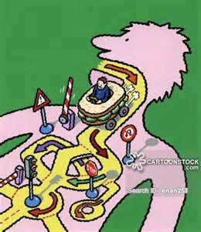
April 1, 2016 / Please Do Now
Sharpen Pencil
Collect Please Do Now from blue basket, chrome book, pen/pencil that works
Take out Planner, write in homework: Finish Mechanical/Chemical Digestion Foldable
Complete the Please Do Now on Own, Please be honest.

Slide 2
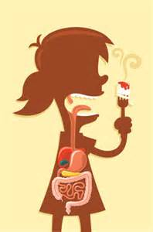
Agenda
1. Please Do Now
2. Essential Question
3. Cracker Lab
4. Mechanical/Chemical Digestion Foldable / Note Outline
As students work on foldable, teacher will call back small groups to experience digestive system organs

Slide 3
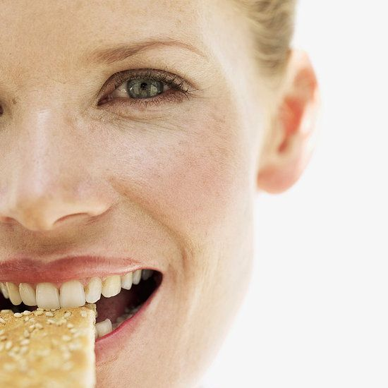
Essential Question
Have you ever noticed that when you eat things eventually become a glob that you swallow. Why is this? Isn’t our teeth smashing it up alone, enough to make it into small easy to swallow pieces.? What type of digestion are our teeth causing on a cracker? Is this the only type of digestion that takes place on the cracker when it is in the mouth? Explain.

Slide 4
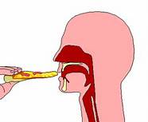
Video Clip to assist Essential Question
https://www.youtube.com/watch?v=yspHzEwOdb4
Teacher will pass out mechanical vs. chemical digestion foldable.
Teacher will explain/model expectations for the foldable
Student will use the video clip and actual lab results to complete the foldable above

Slide 5
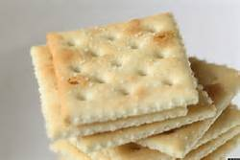
Cracker Lab
Students will follow along with directions in foldable to complete the lab
Students will also have a power point with step by step directions to assist with lab.
Teacher will assist small groups as they do the cracker lab
Once all students have completed the actual lab part, teacher will call back small groups to investigate real digestive system organs
Students not called back will continue to complete the rest of the foldable on their own

Slide 6
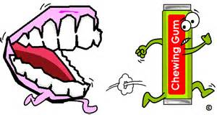
Exit Slip
Students will complete DOL

Slide 7
Dissection Diagrams

Slide 8
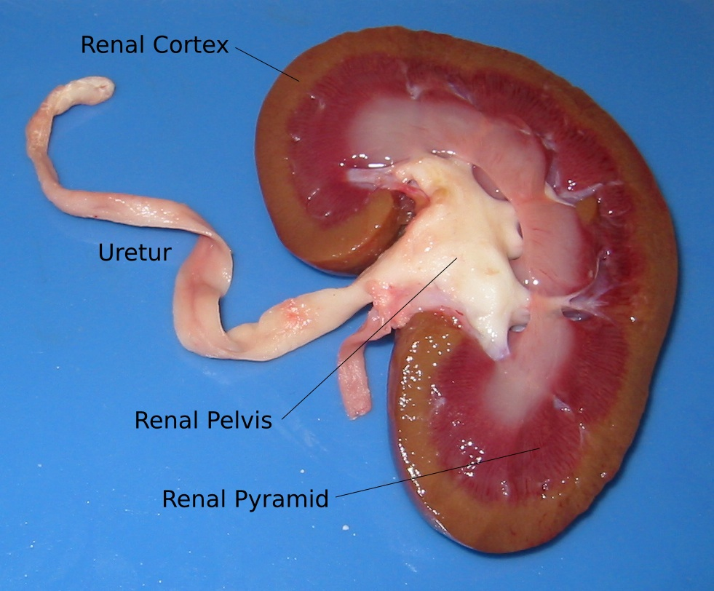
Diagram of a Liver

Slide 9
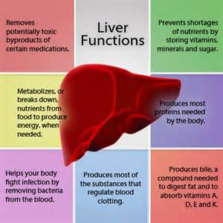

Slide 10
