Slide 1
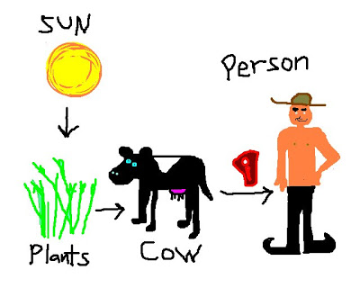
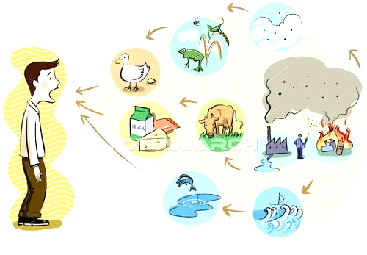
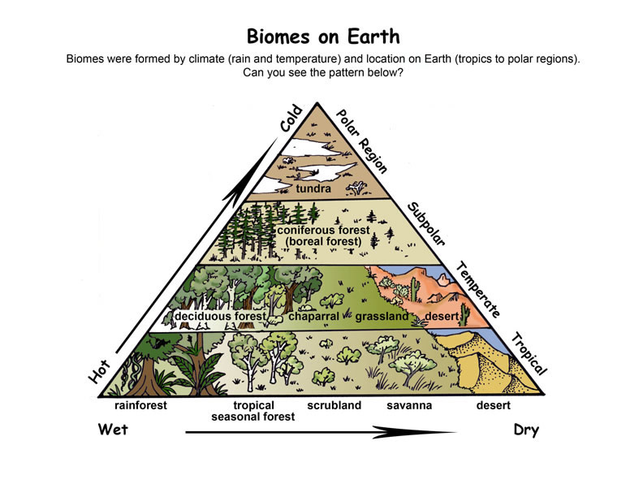
Animal in Ecosystem Informational Advertisement Extra Credit
7th Grade 5th 6 Weeks Extra Credit Project = 1 Major Grade
Due: March 23rd, 2018
Student will create an advertisement that’s purpose to inform people about a specific animal, not a human.
(may be done as a poster, 2 full page magazine advertisement, or brochure)
Advertisement must include:
Name of Animal (example: human) =5pnts.
Scientific Name of Animal (example: Homo Saipan) =5pnts.
Type of Ecosystem they live in (describe it) = 10 pnts
Where are they found in the world (Biome, show location on map) = 5pnts.
Animals Niche in ecosystem/habitat = 5 pnts.
Producer or Consumer / Explain why =5pnts
Food Chain / Food Web =10pints
Role it plays in the Carbon Cycle, Nitrogen Cycle =20
3 or more pictures (may be printed off internet, cut out of magazines, or hand drawn) =10

Slide 2
Grading Rubric Student Name: _____________ Class Period: __
Item Being Graded | Points Possible | Points Earned
House Hold Name of Animal | 5
Scientific Name | 5
Type of Ecosystem Found In | 10
Biome | 5
Producer or Consumer , explained why/how | 5
Food Chain (show flow of energy) / Food Web | 10
Niche | 5
Role in Carbon Cycle | 10
Role in Nitrogen Cycle | 10
3 or More Pictures | 10
Creative (color) | 5
Neatness | 5
Organized | 5
Name / Class Period | 10
Total Points Possible | 100 pnts.
Total Points Earned
Grade Earned
Pnts. Earned | % |  | Pnts. Earned | %
+100 | 100 |  | +59-55 | 50
+99-98 | 95 |  | +54-50 | 45
+97-95 | 90 |  | +49-45 | 40
+94-90 | 85 |  | +44-40 | 35
+89-85 | 80 |  | +39-35 | 30
+84-80 | 75 |  | +34-30 | 25
+79-75 | 70 |  | +29-25 | 20
+74-70 | 65 |  | +24-20 | 15
+69-65 | 60 |  | +19-10 | 10
+64-60 | 55 |  | +9-5 | 5

