Slide 1
Adopt an Element Advertisement
6th Grade Pre-AP 1st 6 Weeks Extra Credit = 1 Major Grade
DUE: September 23, 2016
Information Sheet is attached / Example of advertisement is attached (may NOT use the element Arsenic)
Requirements:
Complete an Adopt An Element information sheet.
You may use a variety of reference sources. Possible ideas are encyclopedias (book
or CD Rom), science encyclopedias, science catalogs, magazines, and/or Internet sites*.
Information sheets must be neat, written in own handwriting, and contain all the information
requested.
2) Create an advertisement for your element.
The advertisement must include the element’s name, symbol, atomic number,
atomic mass, cost, and an advertising slogan that describes one or more of its important
uses.
Advertisements must be neat, colorful, and contain all the information listed
above. It can done as a poster, magazine ad, power point, or video (power point / video can be sent via email to
teacher)
Please add 2 or more pictures that relate to your advertisement theme. (pictures can printed from
internet, hand drawn, cut out of magazine, and so forth)

Slide 2
Adopt an Element Information Sheet
Student Name ____________________________________
Element Name ____________________________ Symbol _______
Cost = __________ for __________ Classification: __ Metal / ___ Non-metal / ___ Metalloid
My element belongs to the ___________________________ family.
Origin of Name ____________________________________________________________________
Discovered by __________________________________________________________ in ________
Interesting Info: May include important uses, interesting facts, common compounds, etc.
1.
2.
3.
4.
5.
6.
Symbol Atomic
Number Atomic
Mass
# of Protons
# of Neutrons
# of Electrons
Melting Point
Boiling Point
Normal Phase

Slide 3
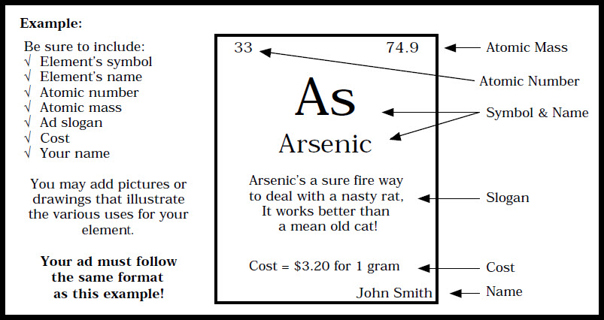
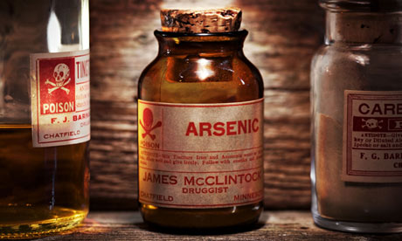
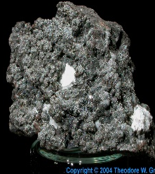
Adopt an Element Advertisement Example

Slide 4
Adopt an Element Advertisement Grading Rubric
Advertisement
Atomic Symbol = 1
Element Name = 1
Atomic Mass = 1
Cost =1
Slogan =1
Pictures (2 or more) =2
Student Name =1
Information Sheet
Name of Element =1 Family = 1
Symbol =1 Origin of Name =1
Atomic # =1 Discovery and Date =1
Atomic Mass =1 Interesting Information/Uses =1
Classification =1 Cost =1
# Protons =1 Normal Phase =1
#Neutrons =1 Melting Point =1
#Electrons =1 Boiling Point =1
Miscellaneous
Creative =2
Neat =2
Name / Class Period =2
_____ point out of 6 possible
_____ point out of 8 possible
_____ point out of
16 possible
+30 | 100% | +27 | 73% | +16 | 50%
+29 | 97% | +22 | 70% | +15 | 47%
+28 | 93% | +21 | 67% | +14 | 43%
+27 | 90% | +20 | 63% | +13 | 40%
+26 | 87% | +19 | 60% | +12 | 37%
+25 | 80% | +18 | 57% | +11 | 33%
+24 | 77% | +17 | 53% | +10 | 30%
Total Points Possible : 30
Total Points Earned = ______
Final Grade: ________%
GRADES

