Slide 1
September 1, 2016
Sharpen Pencil
Collect Please Do Now (6th white basket) 7th Grd. PDN = Finish Photosynthesis Diagram (see white board on right)
Collect Textbook and Clicker
Please sit at assigned seat
Open Textbook and begin working on PDN silently.

Slide 2
Count Down for PDN
http://www.online-stopwatch.com/countdown-timer/

Slide 3
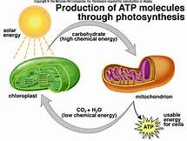
7th Grade PDN
PDN: Photosynthesis vs’ Cellular Respiration
Please use pg. 168 in your textbook to complete the table below
 | Word Bank
A | Radiant Energy
B | Chloroplast
C | Mitochondria
D | Oxygen
E | Carbon dioxide
1. __
5. __
2. __
Wednesday PDN
4. __
3. __

Slide 4
6th Grade PDN

Slide 5
6th Grade Essential Question
You were given a bag full of items and your job was to sort them out. How would you go about doing it? Explain

Slide 6
7th Grade Essential Question
Why do humans have to eat plants and/do animals who ate plants to keep our energy levels up? What do these plants have that we need? Explain

Slide 7
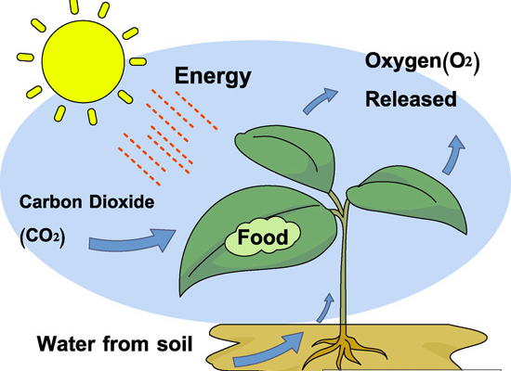
DOL: 7.5A Photosynthesis
Directions: Read each question carefully and select the correct answer. Mark the correct answer on your answer sheet.
Use the Diagram to the right to answer questions 1 /2 below.
A plant uses energy form the sun to…
A: Collect Groundwater
B: Produce its own food
C: release carbon dioxide into the air
D: Produce usable nitrogen
2. For photosynthesis to occur, a producer must have the following three things..
A: nitrogen, water, and soil
B: oxygen, water and nitrogen
C: sunlight, water, and carbon dioxide
D: carbon dioxide, soil, and worms
3. Green plants produce their own food during photosynthesis. Which of these statements about photosynthesis is true?
A: Water is one product of photosynthesis
B: Oxygen is one product of photosynthesis
C: Chlorophyll is one product of photosynthesis
D: Carbon Dioxide is one product of photosynthesis
Name: ____________________________________ Class Period: ____

Slide 8
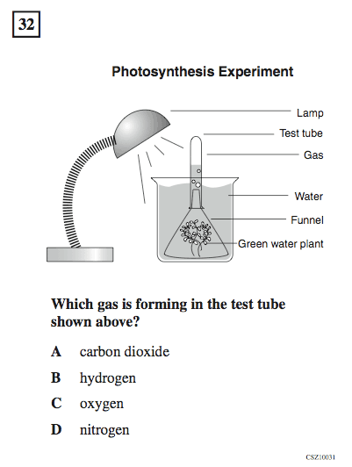
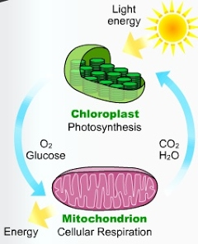
4.
5. Plants produce Oxygen and Glucose that Consumers use to produce energy. Consumers produce Carbon Dioxide and Water to assist plants to produce energy.
What is the name of the process that consumers use to assist the plants called?
A: Photosynthesis
B: Digestion
C: Cellular Respiration
D: Breathing

Slide 9
6th Grade
Dol Quiz over Properties of Matter
Playlist stations

Slide 10
7th Grade Cellular Respiration / Photosynthesis
DOL Quiz over Photosynthesis
Playlist Stations

