Slide 1
August 31, 2016
Sharpen Pencil
Collect Please Do Now (6th white basket / 7th green basket)
Collect Textbook
Please sit at assigned seat
Open Textbook and begin working on PDN silently.
http://www.online-stopwatch.com/countdown-timer/

Slide 2
Count Down for PDN
http://www.online-stopwatch.com/countdown-timer/

Slide 3
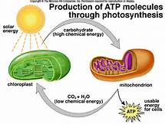
7th Grade PDN
PDN: Photosynthesis vs’ Cellular Respiration
Please use pg. 168 in your textbook to complete the table below
 | Word Bank
A | Radiant Energy
B | Chloroplast
C | Mitochondria
D | Oxygen
E | Carbon dioxide
1. __
5. __
2. __
Wednesday PDN
4. __
3. __

Slide 4
6th Grade PDN
Please read pg. 130/ 142-145 and use information collected to complete questions below.
# | Question / Statement | Answer
1 | In a burning candle, the chemical energy converts to heat and light energy. This reaction proves that a chemical change took place because we see a _____________________.
2 | When come chemical changes happen in a liquid a solid substance is formed. This new substance is know as a _____________.
3 | When you combine vinegar and baking soda you will see bubbles form. This shows that a chemical reaction is taking place because the bubbles represent a production of _____.
4 | When milk starts to turn sour and is no longer safe for human consumption it gives off a rotten smell. This shows that a chemical reaction has taken place because it produces an ___________________.
5 | _____________________ describes a substance’s ability to change into a new substance with different properties.
 | Word Bank
A | Chemical Property
B | gas
C | odor
D | Precipitate
E | Change in Energy

Slide 5
6th Grade Essential Question
You were given a bag full of items and your job was to sort them out. How would you go about doing it? Explain

Slide 6
7th Grade Essential Question
Why do humans have to eat plants and/do animals who ate plants to keep our energy levels up? What do these plants have that we need? Explain

Slide 7
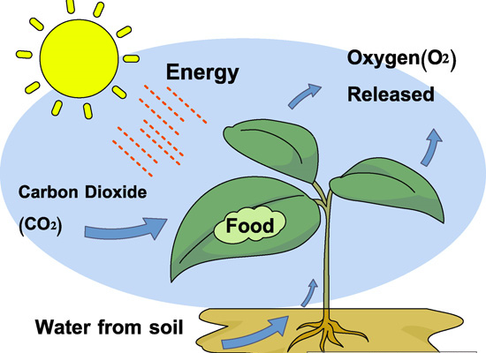
DOL: 7.5A Photosynthesis
Directions: Read each question carefully and select the correct answer. Mark the correct answer on your answer sheet.
Use the Diagram to the right to answer questions 1 /2 below.
A plant uses energy form the sun to…
A: Collect Groundwater
B: Produce its own food
C: release carbon dioxide into the air
D: Produce usable nitrogen
2. For photosynthesis to occur, a producer must have the following three things..
A: nitrogen, water, and soil
B: oxygen, water and nitrogen
C: sunlight, water, and carbon dioxide
D: carbon dioxide, soil, and worms
3. Green plants produce their own food during photosynthesis. Which of these statements about photosynthesis is true?
A: Water is one product of photosynthesis
B: Oxygen is one product of photosynthesis
C: Chlorophyll is one product of photosynthesis
D: Carbon Dioxide is one product of photosynthesis
Name: ____________________________________ Class Period: ____

Slide 8
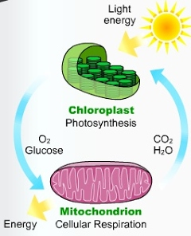
4.
5. Plants produce Oxygen and Glucose that Consumers use to produce energy. Consumers produce Carbon Dioxide and Water to assist plants to produce energy.
What is the name of the process that consumers use to assist the plants called?
A: Photosynthesis
B: Digestion
C: Cellular Respiration
D: Breathing

Slide 9
6th Grade Schoology Login
http://dallasisd.schoology.com
Teacher will check student work from the flipped classroom assignment / if everyone completed it go to task cards / If not due to not having computers in room, finish as a class. / those that are finished will be aloud to do a folder game on topic

Slide 10
7th Grade Cellular Respiration / Photosynthesis
Students will complete diagram on Cellular Respiration / Photosynthesis
Teacher will grade photosynthesis foldable

