Slide 1
7th Grade 1st 6 Week District Test Review
Typed By: Katherine Pease
2016-2017

Slide 2
1. What is the correct equation for photosynthesis?

Slide 3
2. Which side of the produce arrow are the reactants and the products in a chemical equation?
Reactants are Before the arrow
Products are after the arrow
Reactants
Products

Slide 4
3. What type of energy is the sun giving off?
Radiant energy

Slide 5
4. How does energy move through the process of photosynthesis?
Sun (radiant energy) transforms into Glucose (chemical energy)

Slide 6
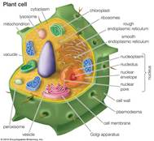
5. Energy is produced in the mitochondria for an organism but where is it produced for a plant?
Chloroplast

Slide 7
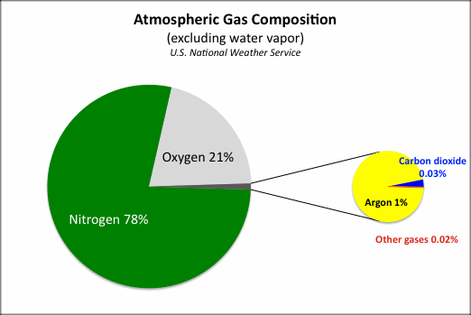
6. What is the main ingredient in the Earth’s atmosphere?

Slide 8
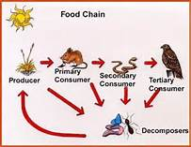
7. What order does the items/organisms in a food chain go? Who comes first, next and so forth?

Slide 9
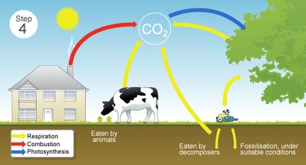
9. What are the steps in the carbon cycle?

Slide 10
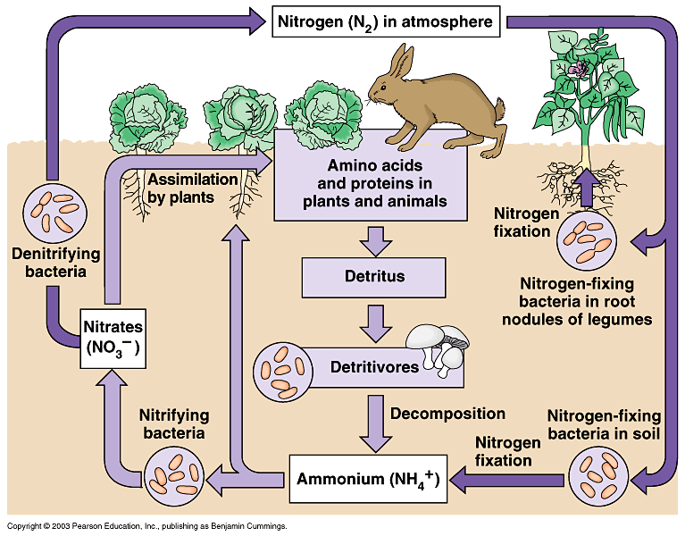
10. What are the steps in the Nitrogen Cycle?

Slide 11
11.What is the job of the bacteria in the nitrogen cycle?
Assist with Nitrogen Fixation

Slide 12
12. What is the difference between organic and non-organic?
Organic – nature / natural / living or once living
Non-Organic – not natural / man made

Slide 13
13. Which equation is organic?
1. NaHCO3
2. C6H12O6
3. CO2
4. O2

Slide 14
Please Study Hard. When you do the work (STUDY), good things will happen (Pass the Test). I believe you can do this!

