Slide 1
6th Grade Pre-AP 1st 6 Week District Test Review
Typed by: Katherine Pease
2016-2017 School year

Slide 2
What is a substance that cannot be broken down into simpler materials by ordinary ways called?
Elements

Slide 3
Look at the pictures below. Explain which one represents an element, compound, or/and atom.
Answers:
I elements
II elements
III compounds
IV atoms

Slide 4
Look at the pictures below. Explain if the examples are a pure substance or not
Answers:
I not a pure substance
II pure substance
III pure substance
IV pure substance

Slide 5
What does chemical properties mean? List the chemical properties of elements.

Slide 6
What does physical properties mean? List the physical properties of elements.

Slide 7
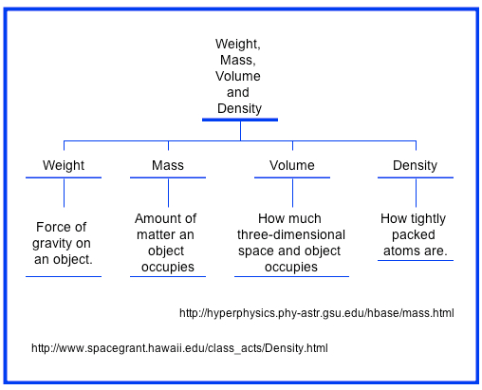
What are density , mass, volume, and weight?
Density:

Slide 8
What property is the same in a substance no matter the amount of the substance available called?
Density

Slide 9
If you are to compare objects by color what skill would you use?
Observation
Look at the sample and record the color you see

Slide 10
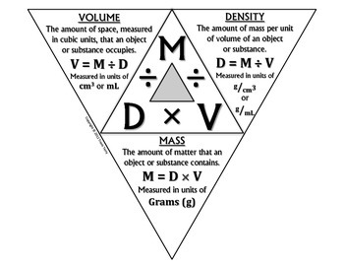
What is the equation for solving for density?
Density = Mass / Volume

Slide 11
An unknown substance has a mass of 25g and a volume of 5cm3. What is the unknown substances density?
25g
25g
5g/cm3
5cm3
?
X
5cm3

Slide 12
How do you know if a chemical reaction has or is occurring?

Slide 13
What is the Mohs hardness scale?

Slide 14
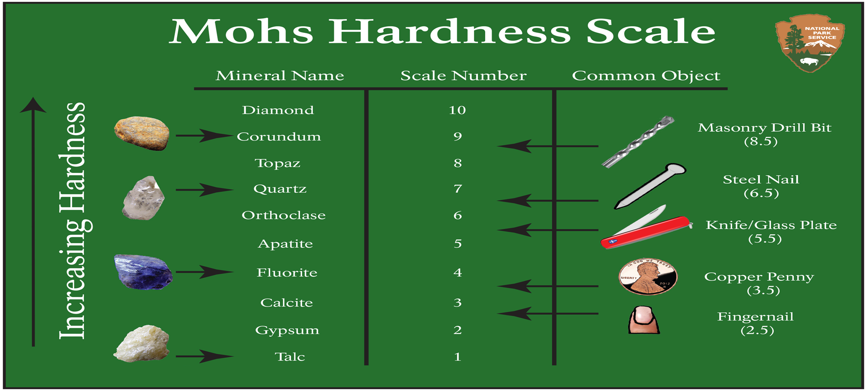
If a mineral sample can leave a scratch on two samples but not the third what does this tell us about the sample?
It is harder then the two it left scractches on but not as hard as the one it did not leave a scratch on.

Slide 15
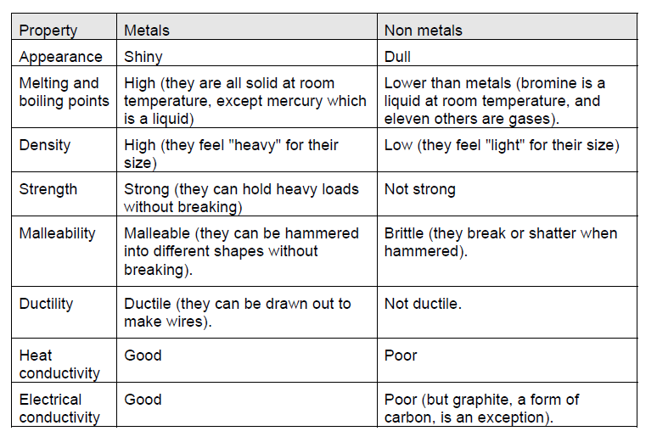
What are the properties of metals and non metals?

Slide 16
If I need to find the density of an object what tools would I use?
Graduated Cylinder (volume of irregular shape)
Ruler (volume of regular shape
Triple Beam Balance
calculator

Slide 17
Please Study Hard. When you do the work (STUDY), good things will happen (Pass the Test). I believe you can do this!

