Slide 1
?) What is the integumentary system?

Slide 2
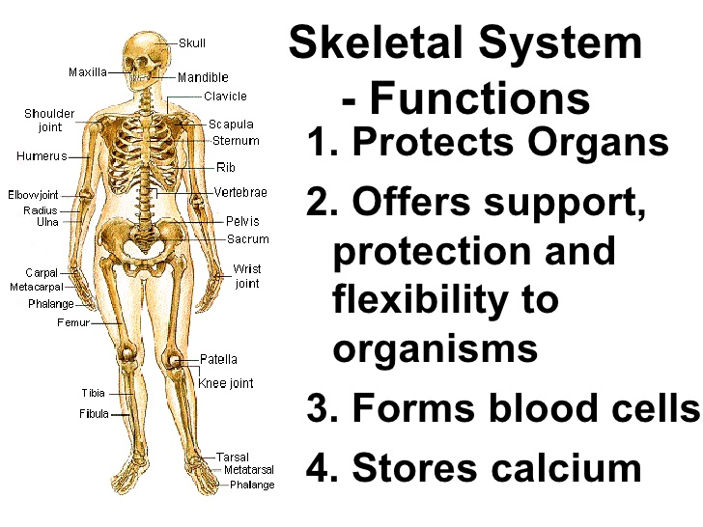
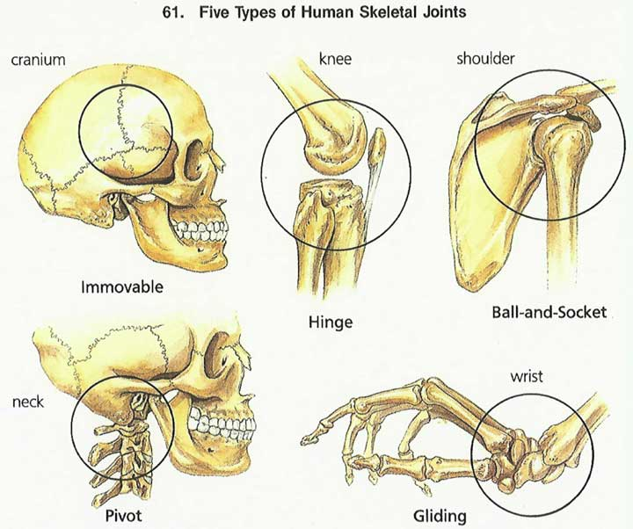
?) What is the skeletal system?

Slide 3
?) What is the muscular system?

Slide 4
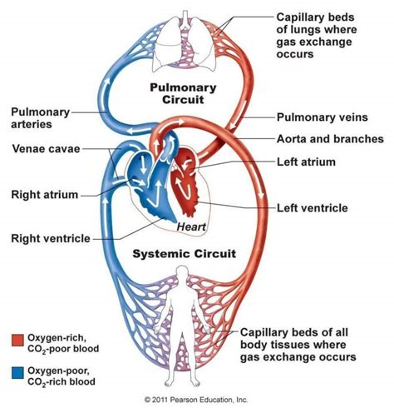
?) What is the circulatory system?

Slide 5
?) What is the respiratory system?

Slide 6
?) List the levels of organization from least to greatest.
1. Cell animal cell
2. Tissue skeletal muscle
3. Organ eye
4. Organ System muscular system
5. Organism dog

Slide 7
?) What is an organic compound?

Slide 8
?) What are inorganic compounds?

Slide 9
?) What does CHONPS stand for in regards to an organic compound?

Slide 10
?)Describe the function of the cell organelles listed below.
Organelle | Function | Plant / Animal / Both
Cell Wall | Gives structure and support to the cell | Plant Only
Cell Membrane | Controls What goes in and out of the cell | Both
Cytoplasm | Jelly like fluid that supports/ holds all the other organelles together within the cell | Both
Nucleus | The control center of the cell Where DNA is stored | Both
Chloroplasts | Where cholorphyll is made (green color for plant) and where energy is produced for the cell | Plant Only

Slide 11
?) Describe the function of the cell organelles below.
Organelle | Function | Plant / Animal / Both
Mitochondria | Produces energy for the cell | Both
Endoplasmic Reticulum | Breaks down lipids, packages protiens | Both
Ribosomes | Makes ribosomes | Both
Golgi Bodies | Process and transports materials out of the cell | Both
Vacuole | Stores water and other materials | Large in Plant Small in Animal
Lysosomes | Digest food particles and Gets rid of waste | Both

Slide 12
? What is Blood?

Slide 13
?) Compare/ Contrast Veins, Arteries and Capallaries

Slide 14
?) What are voluntary and involuntary muscles?

Slide 15
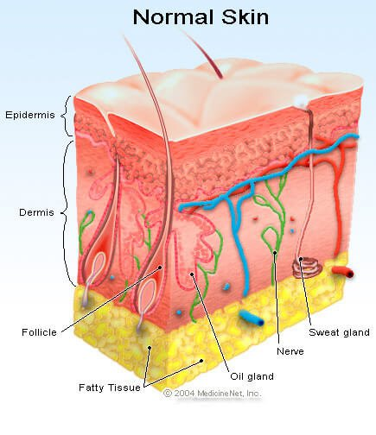
?) What are the dermis and epidermis layers?
Epidermis: The outer, protective, nonvascular layer of the skin of vertebrates, covering the dermis.
Dermis : the thick layer of living tissue below the epidermis which forms the true skin, containing blood capillaries, nerve endings, sweat glands, hair follicles, and other structures

Slide 16
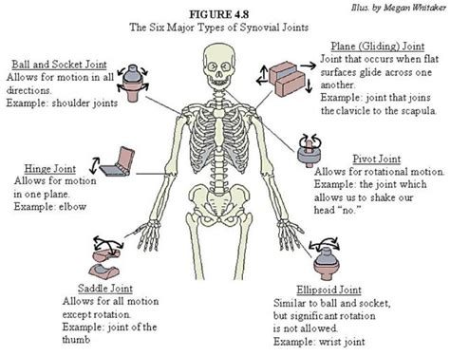
?) Compare/Contrast the Joints of the skeletal system below

Slide 17
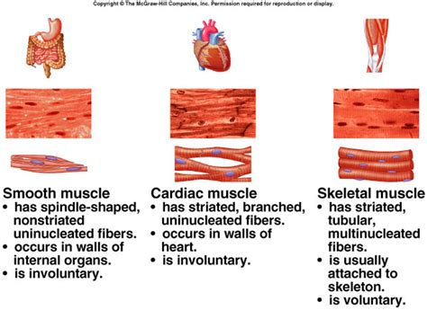
?) Describe the three main types of muscles found in the body.

Slide 18
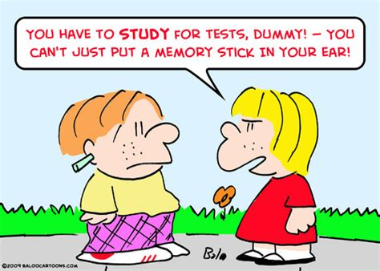
Be Smart! Please Study for this TEST!

