Slide 1
5th 6 Weeks District Test Review 2017-18 7th Grade
Typed by K. Pease

Slide 2
?) What Happens to the shoreline during a tropical Storm?
A) strong winds create huge waves
As the waves come in they erode (take back out) portions of the beach/shoreline along with it.
Erosion is the movement of sediment from one location to another.

Slide 3
?) Explain some the possible effects a catastrophic event can have on an ecosystem.
A) Destroy habitats
Pollution
Destroy Man Made Objects / $$$$ costly economics
Erosion of topsoil
Kill animals and plants

Slide 4
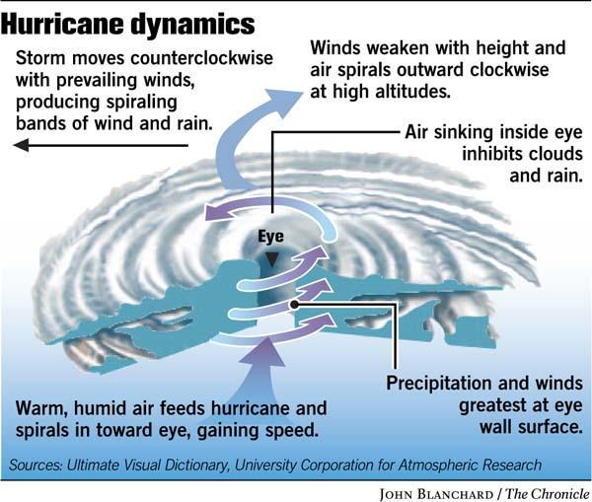
?) Explain what a hurricane is and what it can do to an ecosystem?
A)

Slide 5
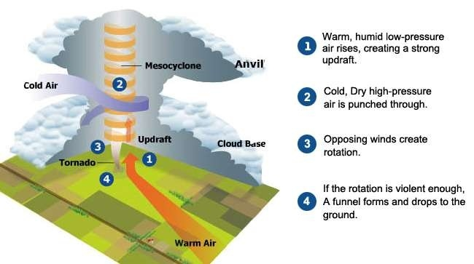
?) What is a tornado and what can it do to an ecosystem?

Slide 6
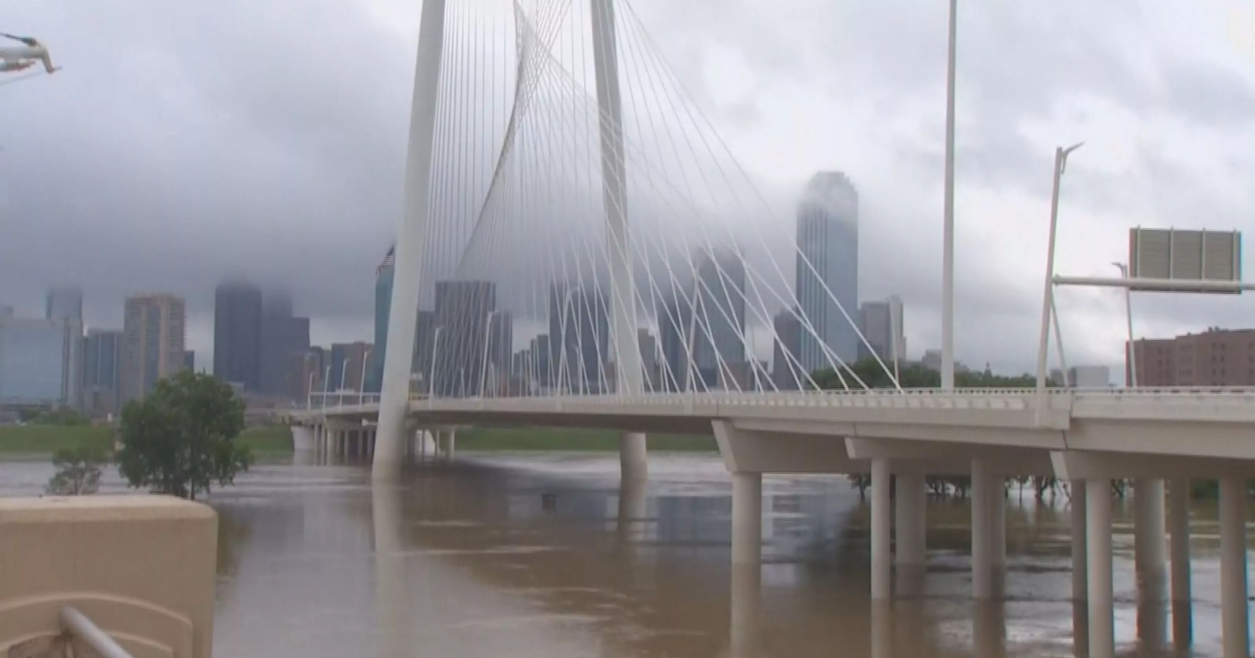
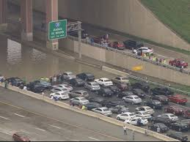
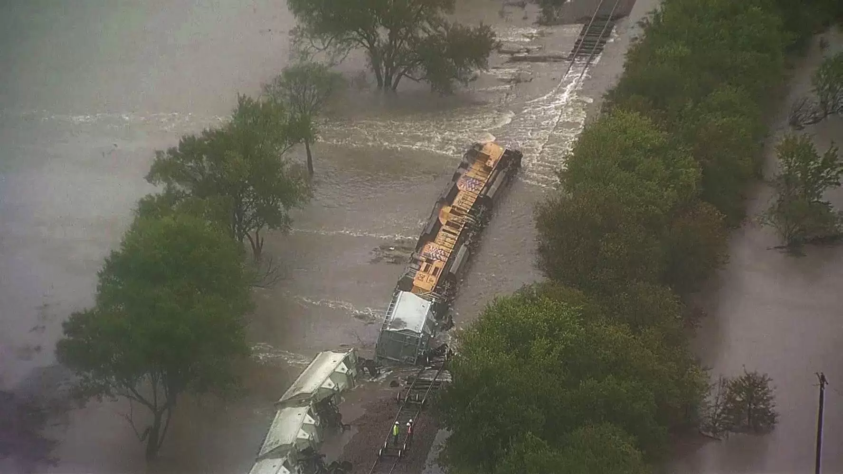
?) What is a flood and what can it do to an ecosystem?

Slide 7
?) Does land development increase or decrease the effect of a catastrophic event? Why?
Increase

Slide 8
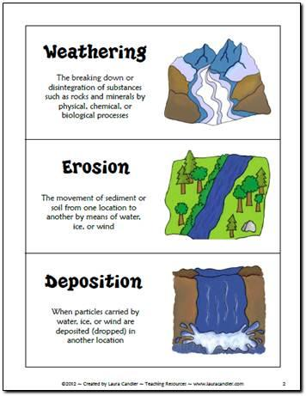
?) Explain what weathering, erosion, and deposition are.
Breaking down and wearing
away for rock
Movement of rock and sediment from one place to another
Where rocks, sediments are deposited, dropped off

Slide 9
?) Explain how mechanical (physical) weathering and chemical weathering are different.

Slide 10
?) Explain what a Coastal Prairies and Marshes are in TX.

Slide 11
?) Explain what the Piney Woods Eco-Region is in Texas.

Slide 12
?) Explain what the coastline eco-region in Texas is.

Slide 13
?) Explain what the desert eco-region in Texas is.

Slide 14
?) What makes life sustainable in the Tundra?

Slide 15
?) What make life sustainable in the Taiga?

Slide 16
?) Explain what the Deciduous Forest Biome is.

Slide 17
?) Explain what the Tropical Rain Forest Biome is.

Slide 18
?) What is the Grassland Biome?

Slide 19
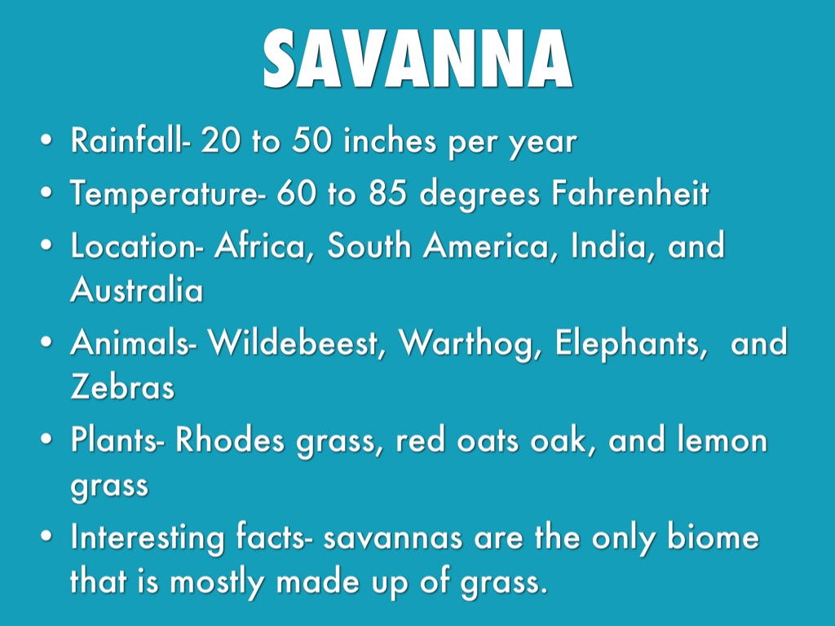
?) What is the Savanna Biome?

Slide 20
?) What is the Desert Biome?

Slide 21
?) Explain what Biodiversity means…

Slide 22
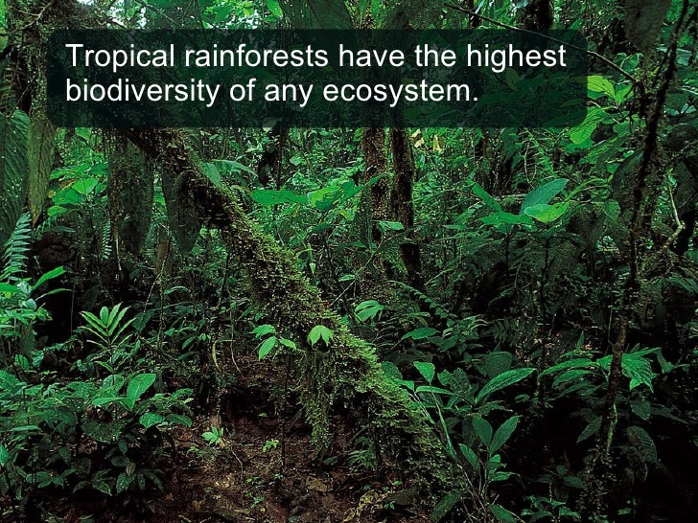
?) Which biome has the most biodiversity? Explain Why.

Slide 23
?) What is ecological succession?

Slide 24
?) What is Primary Succession?

Slide 25
?) What is secondary succession?

Slide 26
?) What is a Climax Community?

Slide 27
?) What are a pioneer species?

Slide 28
Is this an example of primary or secondary succession and how can you tell this?
Primary Succession because it starts with bare rock.

Slide 29
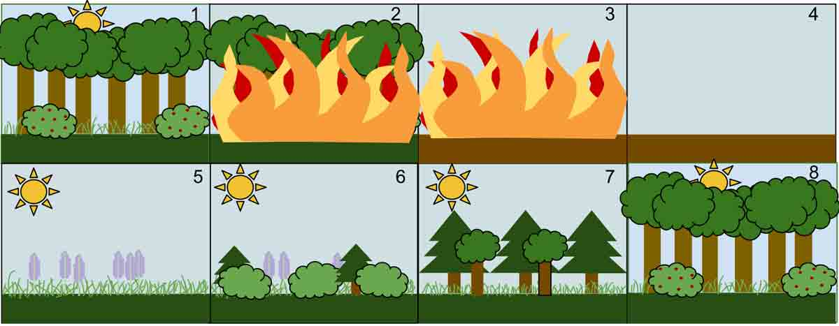
Is this an example of primary or secondary succession and how can you tell this?

Slide 30
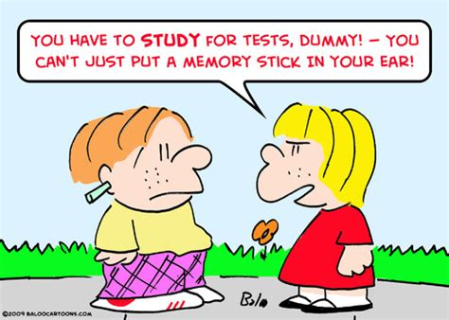
Be Smart! Please Study for this TEST!

