Slide 1
5th 6 Weeks District Test Review
2015-2016 / 6th Grade Pre-AP Science
Typed By: Katherine Pease

Slide 2
Use the information below to complete review handout for the 5th 6 week district test.
Numerous Slides are repeat of information but worded differently.
Additional Information available at..
  Login to www.coachpease.com
  Click on the “5th 6 Weeks” link
  Click on the 5th 6 Weeks Test Review Folder

Slide 3
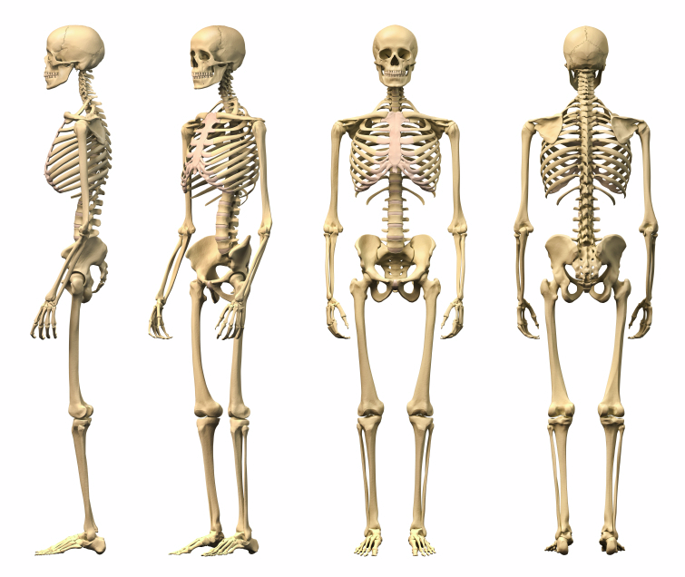
What is function of the Skeletal System?
To Support the Body
To Protect internal Organs in the body
Produce White and Red Blood Cells
Assist with Structure in the Body

Slide 4
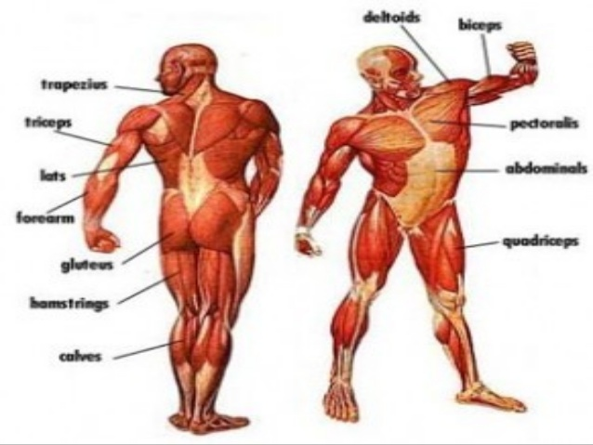
What type of muscles can you control? A type of muscle you can control is called a ______________ muscle.
Skeletal Muscle
Voluntary Muscle

Slide 5
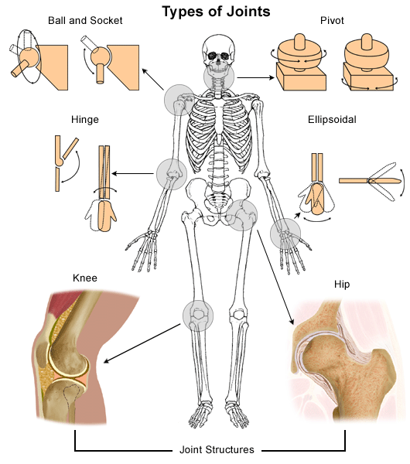
What type of joint would find at your elbow, neck, or hip?
Elbow = Hinge Joint
Neck = Pivot Joint
Hip= Ball and Socket Joint

Slide 6
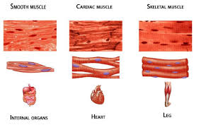
What type of tissue contracts and relaxes to cause movement in the body?
Muscle Tissue

Slide 7
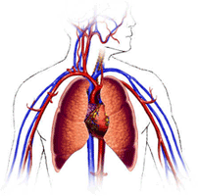
What is the function of the circulatory system?
To pump blood through out the body
To pick up waste and deliver oxygen to all the cells through out the body

Slide 8
What is the difference between pulmonary and systemic circulation?
Pulmonary means direct connection to the heart
Systemic means all the arteries, veins and capillaries that take blood through out the body
https://www.youtube.com/watch?v=QIEIH6_mC1Q

Slide 9
When your body takes in oxygen which part of the circulatory system does it enter, pulmonary or systemic?
Pulmonary because it enters the heart from the lungs and then the heart pumps it out into the body, systemic

Slide 10
What is respiration?
When the body obtains oxygen and releases carbon dioxide.
This happens in the alveoli's; oxygen enters the blood through the capillaries and carbon dioxide leaves the blood stream and enters the alveoli's.
https://www.youtube.com/watch?v=TK-b-Ri7IsY

Slide 11
Why is the circulatory system important to the respiratory system?
The circulatory system transports the blood to all parts of the body picking up waste from the cells and delivering oxygen to the cells.
The respiratory system filters the waste out of the blood and refills it with oxygen as it flows through the lungs.

Slide 12
What is the function of the respiratory system?
To help an organism breath by taking in oxygen and getting rid of carbon dioxide

Slide 13
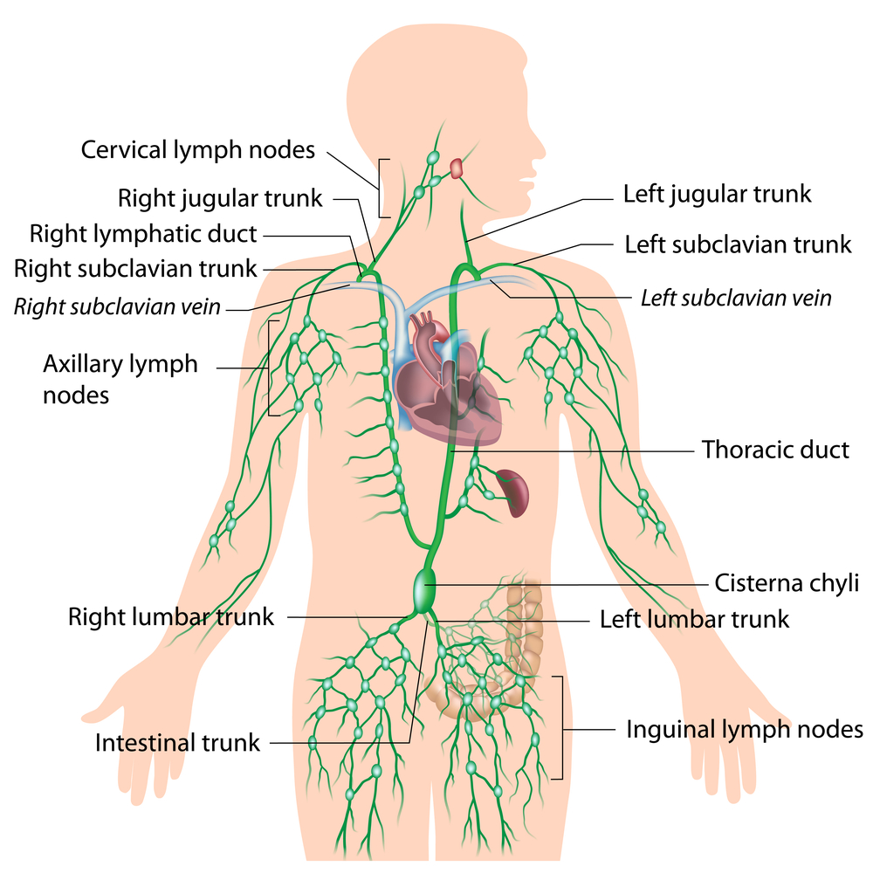
What body system does the picture represent?
Lymphatic System

Slide 14
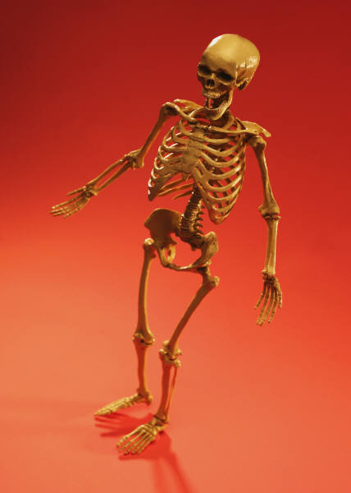
Systems directly related to walking
The skeleton
is connected
to the ___________
so you can
move
MUSCLES

Slide 15
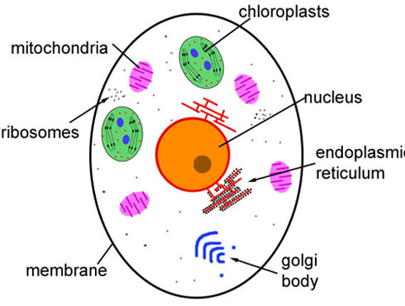
Function of these cell parts
Organelles that release energy from food = powerhouse
Mitochondria
Cell wall
Cell membrane
Chloroplast
Lysosome
Green organelles that make food- only in plant cells
protects the cell and gives shape- only in plant cells
Outer covering, protective layer around ALL cell
Removes cell waste just like our kidneys

Slide 16
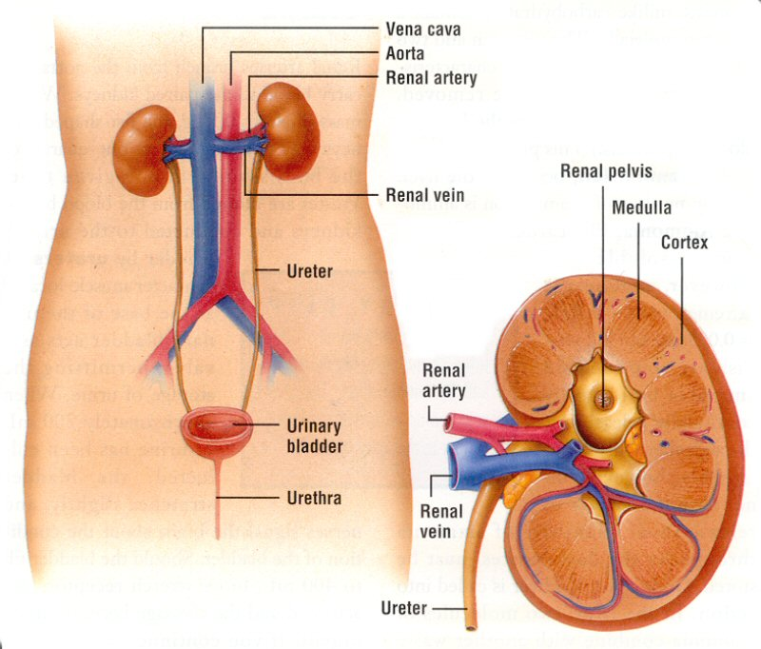
Function of the kidneys
The kidneys are part of the urinary system. This system excrete liquid wastes from the
body

Slide 17
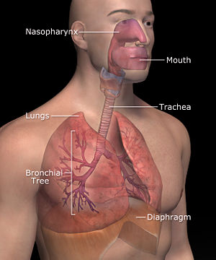
Function of the parts:
Diaphragm
Bronchial tubes
Epiglottis
Alveoli
Thin muscle used to push the lungs upward during exhaling
Two passageways from the trachea to the lungs
Flap of skin that prevents food from entering the trachea
tiny, delicate air sacs deep within the lungs where the gas/blood
exchange occurs

Slide 18
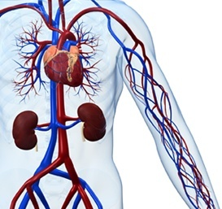
Function of blood vessels and their description
Arteries are pipelines that generally carry blood away from the heart. They carry oxygen-rich blood. (red)
Veins generally carry oxygen-poor blood back to the heart from the rest of the body. (blue)
Capillaries are microscopic blood vessels that connect arteries to veins. They are where oxygen & waste exchange occur.

Slide 19
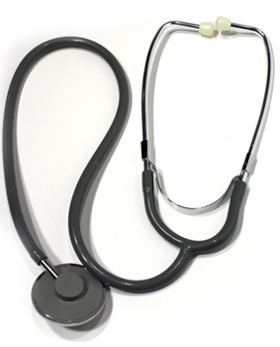
Describe what blood pressure is
The force of the blood on the walls of the blood vessels.

Slide 20

Energy required for peristalsis
The wavelike muscular contractions
of the esophagus by which contents are physically forced down from the mouth to the stomach.

Slide 21
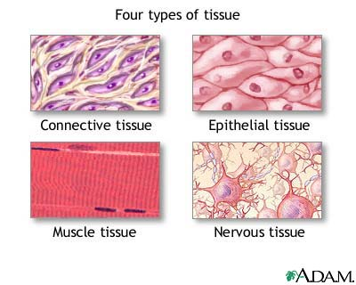
What does a group of cells working together create?
Tissues

Slide 22
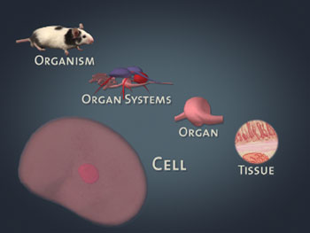
Sequence these words from most complex to most simple: cell, organism, organ, organ system, tissue,
Organism > organ system > organ > tissue > cell

Slide 23
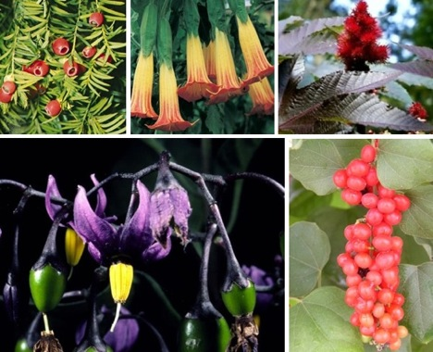
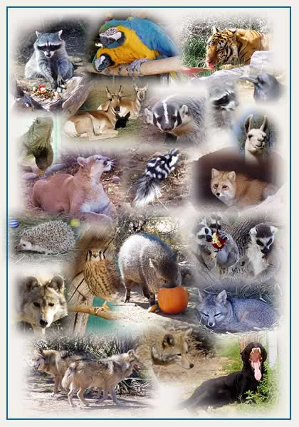
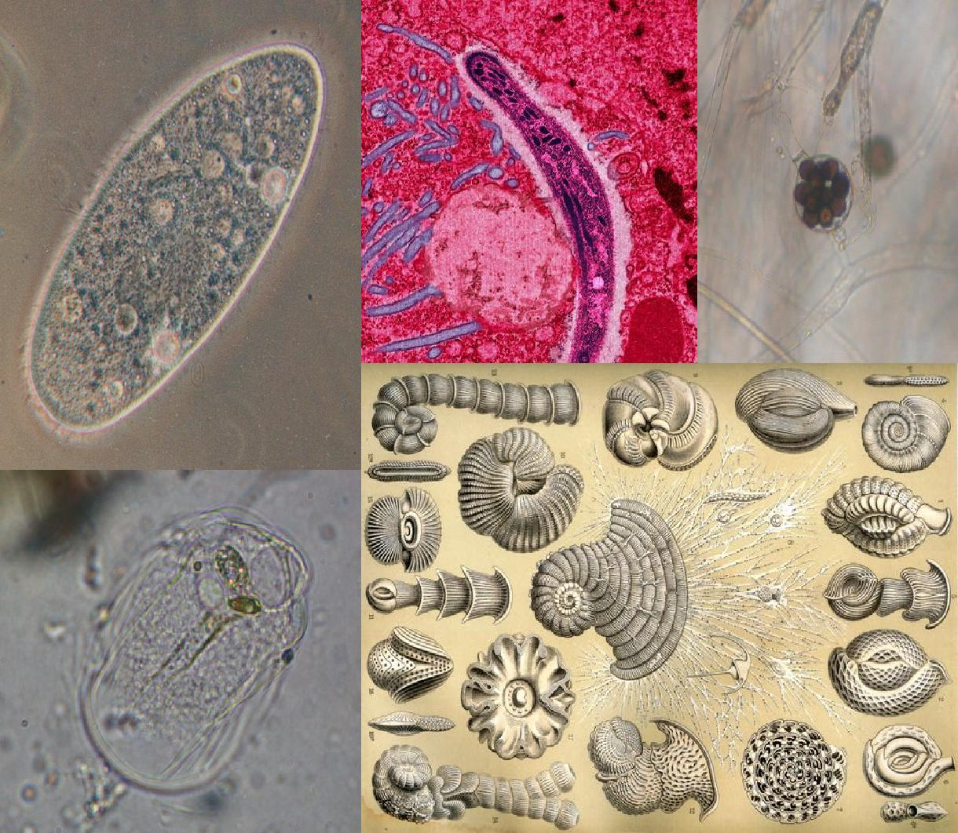
What do plants, animals, and protist all have in common?
All are made up of cells

Slide 24
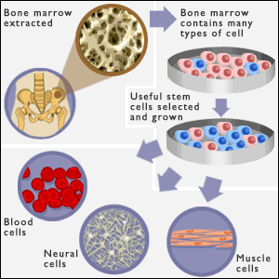
What are some similar functions that all cells carry on?
Reproduce
Have a nucleus
Can move
Grow

Slide 25
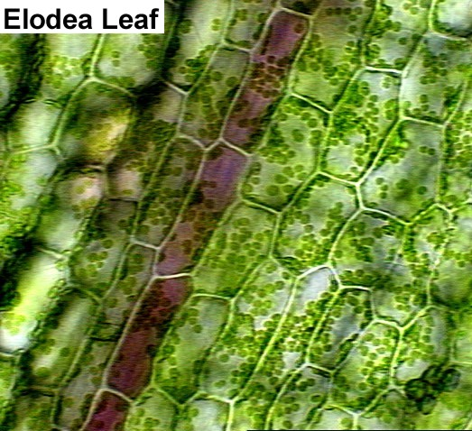
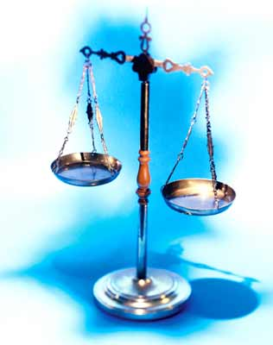
What is homeostasis?
The ability or tendency of an organism or cell to maintain internal equilibrium by adjusting its physiological processes.
Organism is in balance.

Slide 26
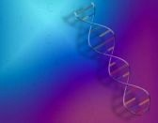
Body System | Function
 | Transports materials to and from the body cells
 | Exchanges oxygen and carbon dioxide gases
 | Breaks down food and absorbs digestive materials
 | Removes wastes from blood
 | Enables the body to move: keeps the heart beating
 | Sends messages through out the body
 | Controls many body process by means of chemicals
 | Produces offspring
 | Supports and protects the body: makes blood cells
 | Fights disease and infection in the body
 | Protects and covers internal structures from the outside environment
circulatory
Respiratory
Digestive
Excretory
Muscular
Nervous
Endocrine
Reproductive
Skeletal
Immune
Integrumentary

Slide 27
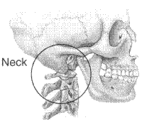
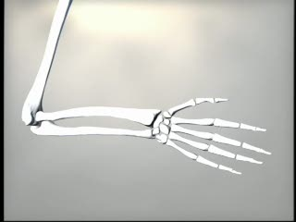
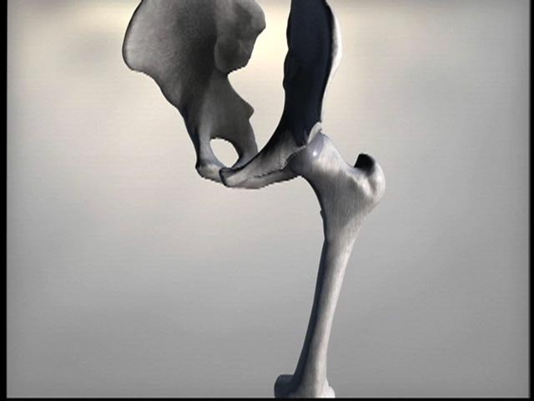
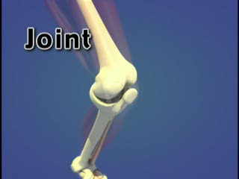
Label the type of joints seen in the pictures below.
Gliding Joint
Pivot Joint
Ball and Socket
Hindge Joint

Slide 28
Complete the statements below about the skeletal system
support
Gives Shape and _________ to your body.
Protects your ________ organs
_________ are attached to bones to help them move.
Blood cells are formed in the bone __________.
___________ and _________ are stored in the bones.
internal
muscles
marrow
calcium
Phosophorus

Slide 29
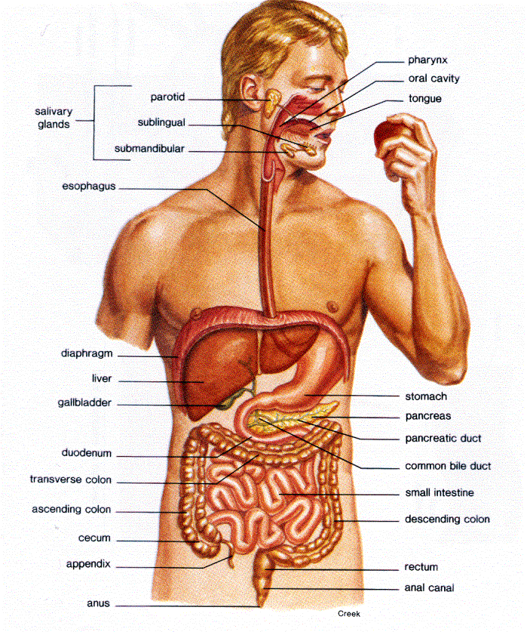
Name the organs through which a piece of food would pass if you ate it.
Mouth to esophagus to stomach to small intestine to large intestine to rectum to anus to toilet

Slide 30
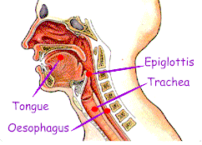
How is food prevented from going down the windpipe?
Epiglottis
the epiglottis folds down to a more horizontal position, with its superior side functioning as part of the pharynx. In this manner it prevents food from going into the trachea and instead directs it to the esophagus, which is posterior.

Slide 31
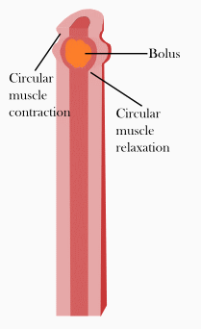
What causes food to move down the esophagus?
Peristalsis Muscles

Slide 32
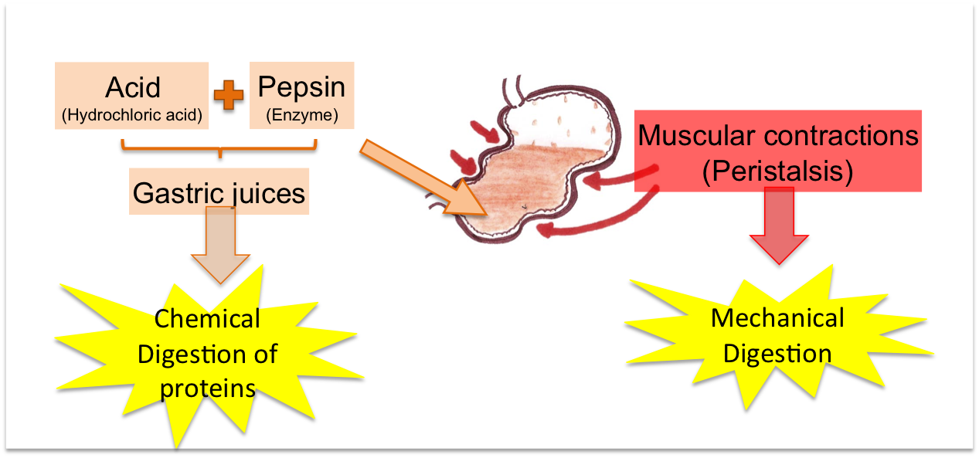
What are the two functions of the hydrochloric acid in your stomach?
Chemical Digestion: breaking down food and breaking down protein molecules
Kills harmful bacteria in the stomach

Slide 33
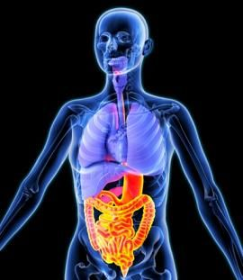
What are the two types of digestion? Describe the difference between the two.
Mechanical Digestion =physical change
Chemical Digestion =chemical change
Mechanical breaks the food into smaller pieces with changing it’s chemical make up.
Chemical breaks the food down into a new substance.

Slide 34
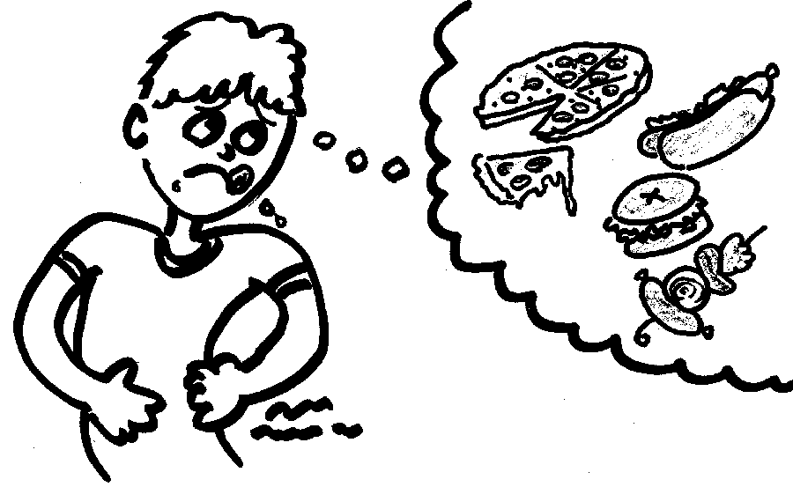
What are internal stimuli? Give an example.
An internal stimulus is something from within that gets you do 'do' something. An example of this would be "you feel a hunger pain, so you go get some food".

Slide 35
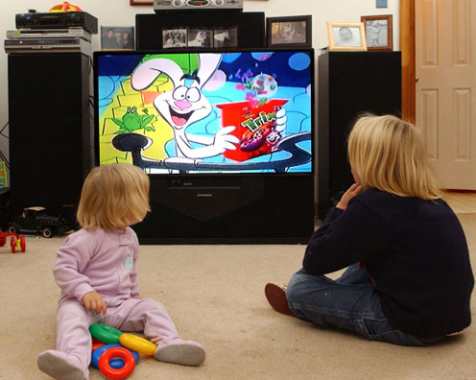
What are external stimuli? Give an example.
An external stimulus is something from outside (the environment) that gets you to 'do' something. And example of this would be "you see a commercial about food, so you go get some food".

Slide 36
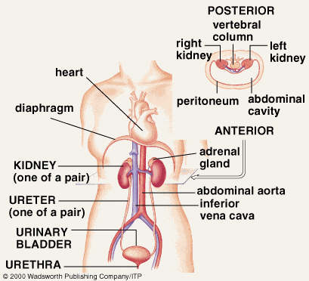
What organelle performs similar tasks to the excretory system?
Lysomes : they remove waste from the cell.
The Excretory System removes waste from the body.

Slide 37
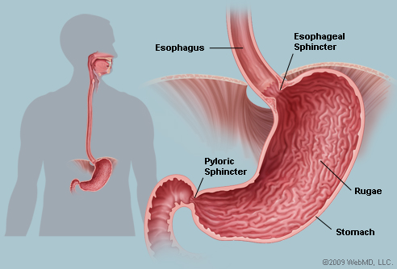
What occurs in the stomach?
Muscles in the stomach grind food into smaller pieces. Gastric Juice and hydrochloric acid made in the stomach breaks apart large protein molecules.

Slide 38
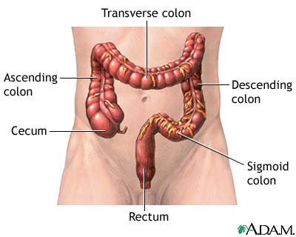
What occurs in the small and large intestines?
Materials that cannot be digested move into the large intestine. The large intestine absorbs much of the water still trapped in the food waste. The solid that remains is called feces.

Slide 39
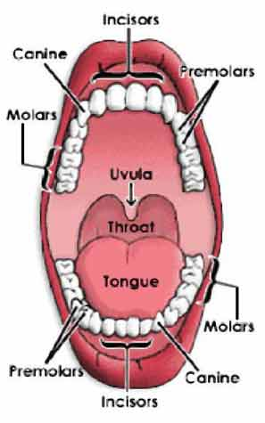
Breakdown of food in the mouth is an example of what type of change?
Mechanical: Teeth grind food into smaller pieces.
Chemical: Saliva begins to break down complex starches into smaller sugars.

Slide 40
Identify various physical and chemical changes that occur in digestion and label each.
Physical: Teeth break down food into smaller pieces / stomach muscles grind food into smaller pieces
Chemical: Saliva reacts with food to break it down / Bile reacts to break down fat molecules / Gastric Juice and hydrochloric acid react to break apart large protein molecules / Pancreas produces enzymes that react to break down carbohydrates

Slide 41
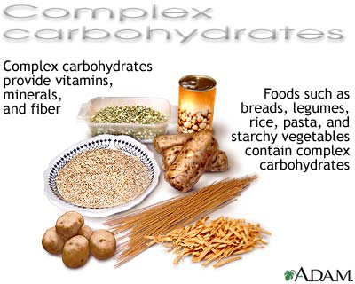
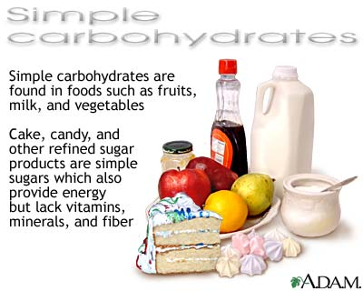
What foods contain carbohydrates?

Slide 42
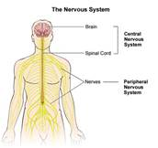
What system controls and coordinates all functions in the body?
Nervous System

Slide 43
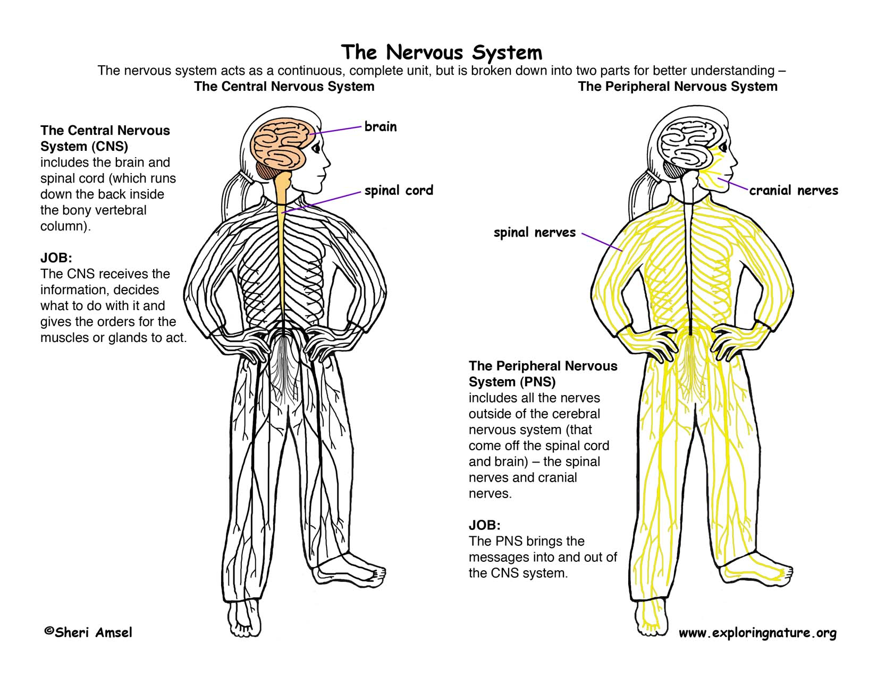
The brain and the spinal chord make up the _______________________.

Slide 44
The peripheral nervous system consists of ______________________.

Slide 45
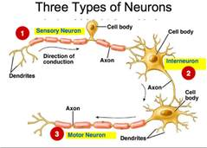
What are the three main types of neurons in the nervous system?
Sensory Neurons
Takes messages to/from the spinal chord
and brain
Motor Neurons
Takes messages to/from throughout the body
Interneurons
connects the message from/to the sensory and motor neurons

Slide 46
15. Why is the circulatory system important to the respiratory system?
The circulatory system transports the blood to all parts of the body picking up waste from the cells and delivering oxygen to the cells.
The respiratory system filters the waste out of the blood and refills it with oxygen as it flows through the lungs.

Slide 47
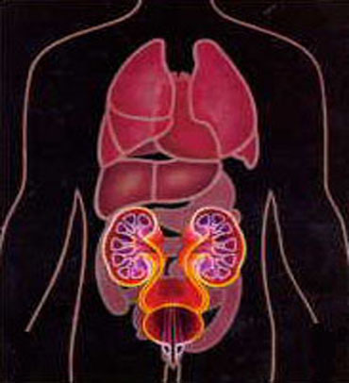
16. Why is the circulatory system important to the excretory system?
The circulatory system transports waste from the cells through out the body in blood to the excretory system.
The excretory system gets rid of the waster depending on what type it is.

Slide 48
19. What is the function of the excretory system?
To rid the body of waste

Slide 49
20. What is the function of the integrumentarty system?
To protect the body from outside forces

Slide 50
21. What is the function of the skin?
To protect body from negative things, germs and such, from entering the body

Slide 51
22. What is the function of the heart?
To pump blood through out the body

Slide 52
23. What is the function of the blood vessels?
To transport blood through out the body

Slide 53
24. What is the function of the blood?
To supply oxygen and nutrients to all the cells in the body.
To transports waste from the cells to the excretory system

Slide 54
25. What is the function of the lungs?
To exchange carbon dioxide and oxygen in the blood
To supply air for the individual to breath

Slide 55
26. What is the function of the alveolie?
Small air sacs that hold oxygen for the arteries to pick up
Small air sacs that hold carbon dioxide until body exhales it

Slide 56
27. What is the function of the kidney?
To filter waste out of the body

Slide 57
28. What is the function of the bladder?
To hold urine waste until body is able to relieve it self

Slide 58
Study these notes
Study Foldables in Journal
Study Graded Work
I know if you study, use your strategies correctly and believe in yourself you will pass this test.

