Slide 1
7th Grade 4th 6 Weeks District Test Review
Typed by: Katherine Pease
Test made by: Tracy Sandoval

Slide 2
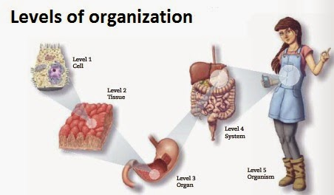
What is the correct order for the levels of organization in an organism when it goes from smallest to largest?
Cells make up
Tissues make up
Organs make up
Organ systems make up
organism

Slide 3
Match the correct level of organization with the correct picture below
# | Name | Letter
1 | Cell | A
2 | Tissue | E
3 | Organ | B
4 | Organ System | D
5 | Organism | C
A
B
C
E
D

Slide 4
State the three steps of the cell theory
Step 1 | All living things are made up of cells
Step 2 | Cells are the basic unit of structure and function in organisms
Step 3 | All cells arise from pre-existing cells

Slide 5
Who were the scientist famous for the cell theory? Explain each scientist’s contribution
Name of Scientist | How he helped the Cell Theory
Robert Hooke | First discovered, named the cell
Anton Van Leewenhook | First to see living organisms under microscope
Matthias Schleden | Determined all plants are composed of cells
Theodor Schwann | Determined all animals are composed of cells
Rudolph Virchow | Cells come from other cells

Slide 6
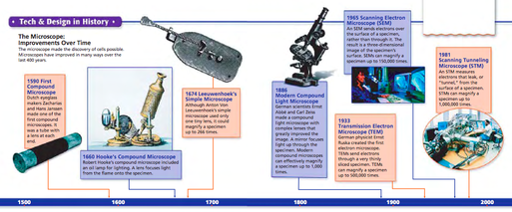
What instrument / tool had lead the science of micro-biology? Hint; led to the development of the cell theory
Microscope

Slide 7
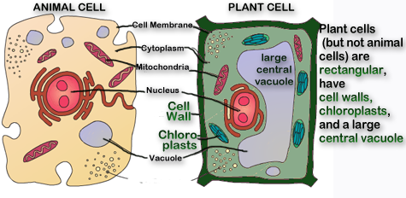
What does a plant cell have that an animal cell does? Explain the function of each
Cell Wall: Protects the cell, gives structure and support to the cell
Cholorlats: where photosynthesis takes place, responsible for a plants green color
Large Central Vacuole: Storage for Water, aids in a plants turgor pressure

Slide 8
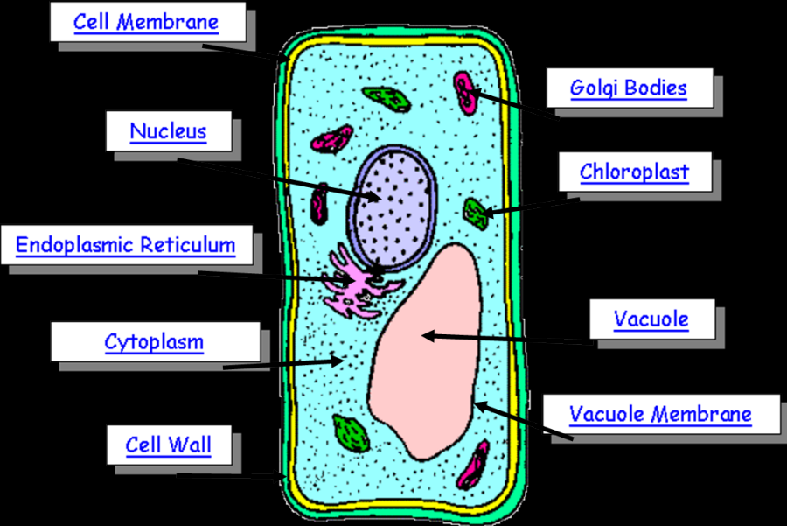
Label the parts of a plant cell below

Slide 9
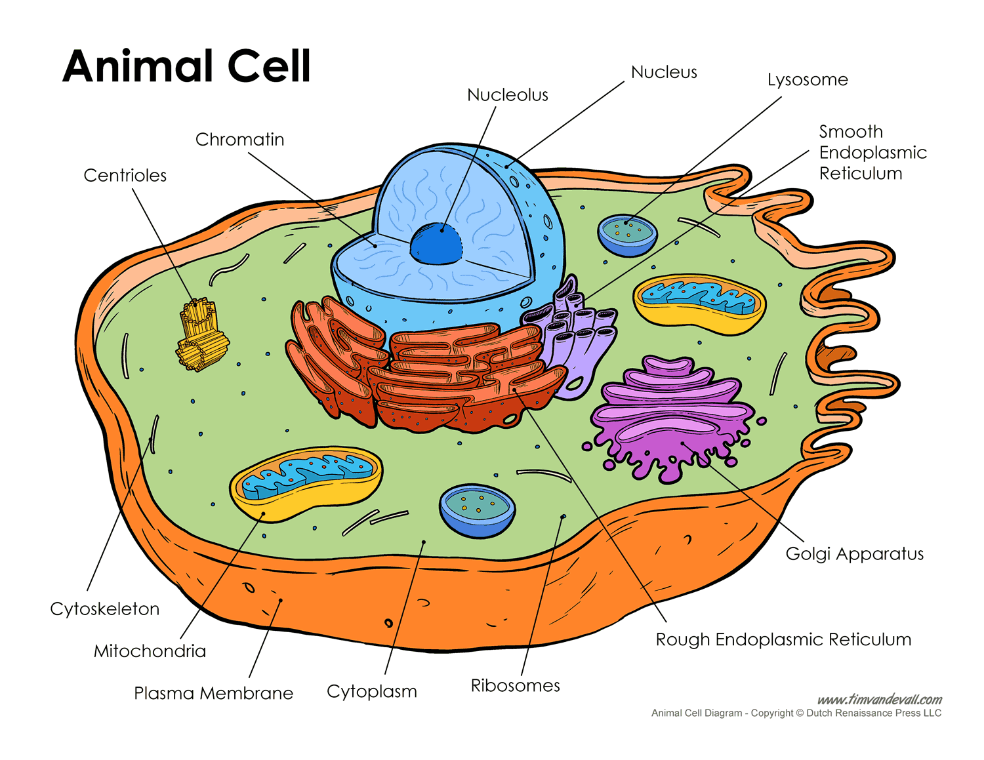
Label the parts of an Animal Cell Below

Slide 10
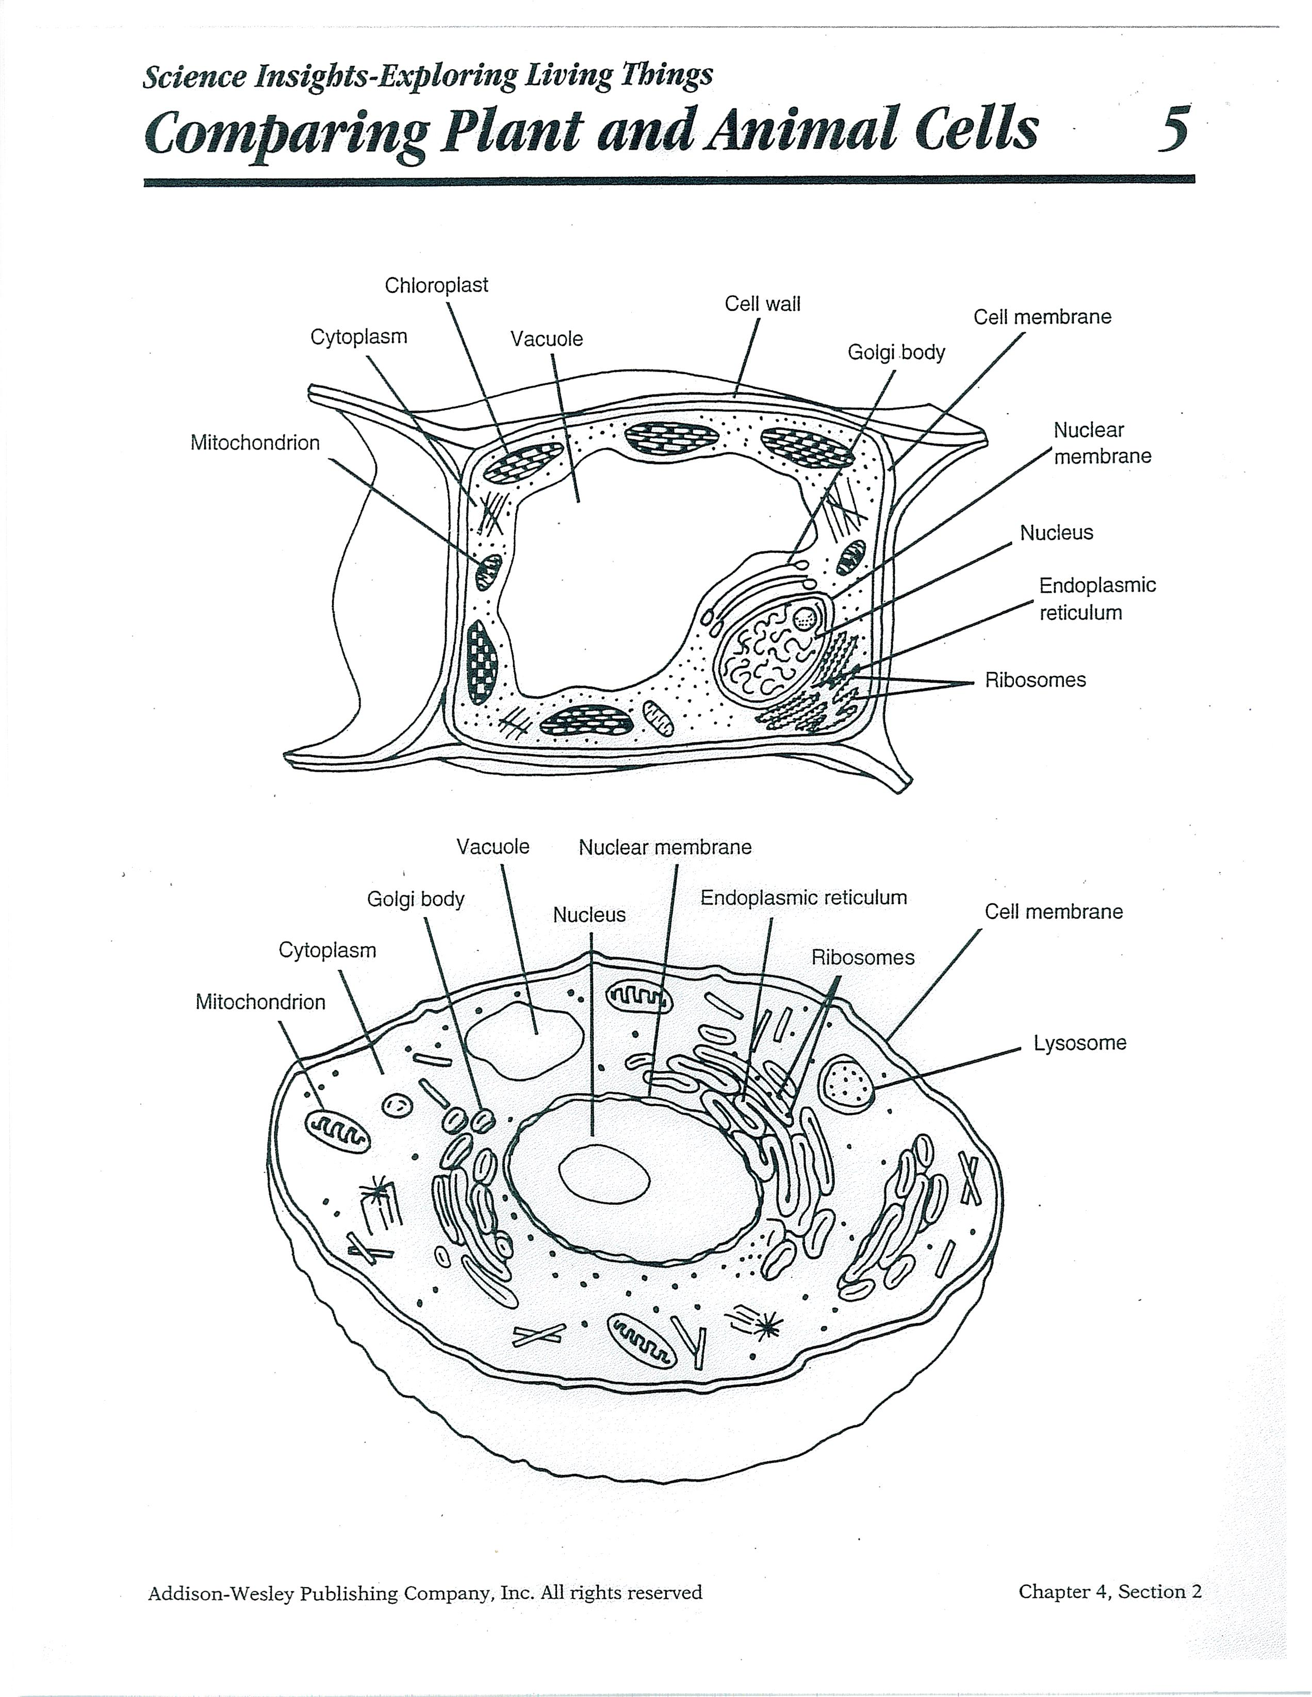
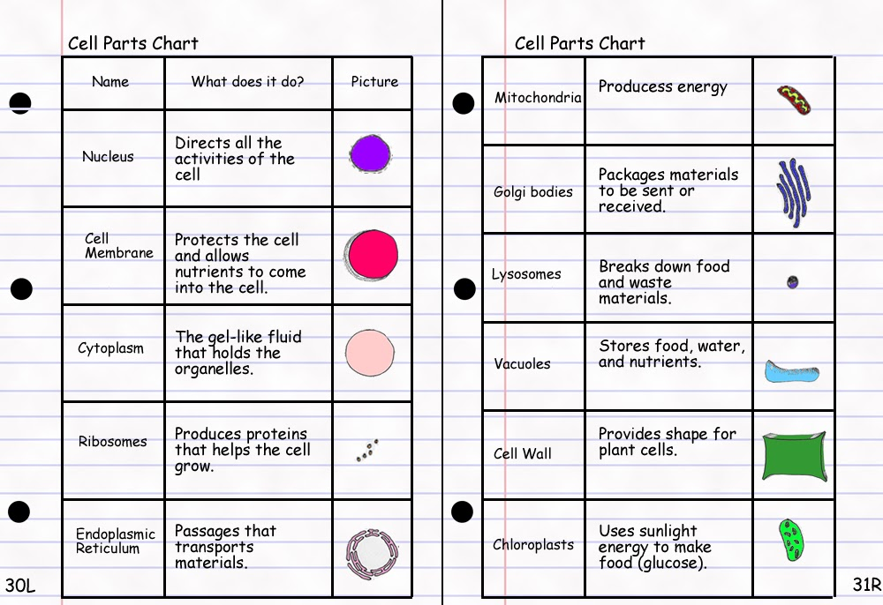
Explain the function of each Cell organelle listed below
11.
2.
3.
9.
10.
7.
6
6.
1.
1
5.
7
4.
2
8
9.
7.
5.
2.
3.
1.
3
4.
6.
9
8.
4
10
5
11

Slide 11
What must all cells have to be considered alive?
Take in Energy
Gets rids of wastes
Replicates to make new cells

Slide 12
Study Hard… YOU CAN do this! Coach Pease’s class with highest overall average will get popcorn party!
Options to help study….
1. this review
2. www.coachpease.com
3. Journals
4. PDN / Please Do nows (corrected and glued into journals)
5.DOL (corrected and glued into journals)
6. tutoring (Tues. / Weds. / Thurs. 8am to 8:30am / Coach Pease Students)

