Slide 1
4th 6 Weeks , Week 4-6 Review for District Test
By: Coach Pease 2015

Slide 2
Game Rules
Teacher will split class into teams
Each team will get 1 dry erase board, 1 dry erase marker, 1 paper towel, 1 review packet per student
Teacher will read question aloud, students will have 30 seconds to discuss as team the correct answer
Each group will write final answer on dry erase board, Each group will hold up board when teacher says “Times Up, Boards UP”
Teacher will take score of who got question correct, if correct teacher adds 1 point to groups score (note bad behavior can cause lost in points for group)
Teacher will show correct answer and allow discussion as to why, students record on review packet
Teacher will go to next question, students clear boards and go through the process again
Team with the most points at the end win.

Slide 3
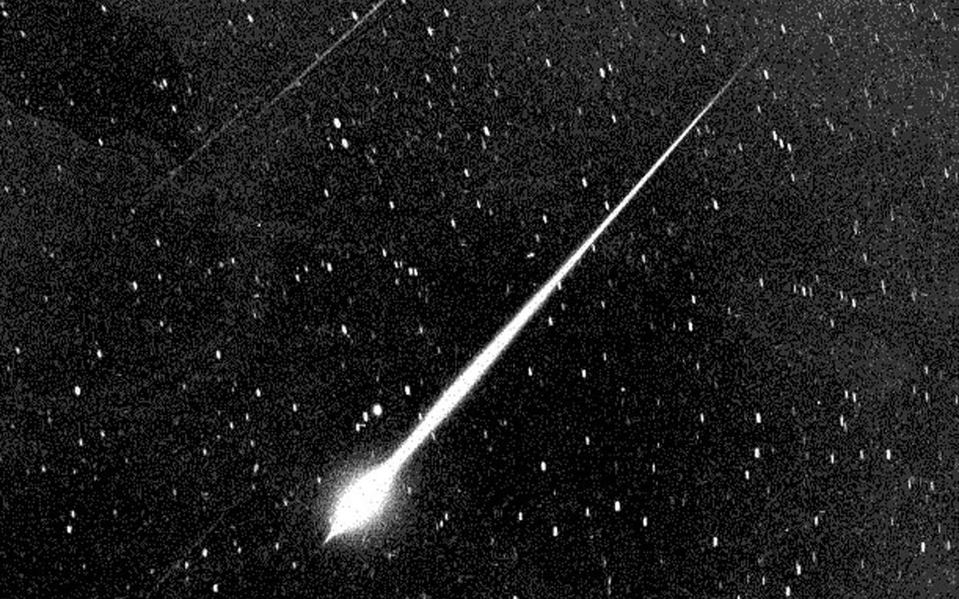
A visible streak of light which shows the path of rocky object which has entered Earth’s atmosphere is –
A a meteor.
B an asteroid.
C a Galilean moon.
D a comet.
Answer is: A a meteor
http://r.search.yahoo.com/_ylt=AwrB8pQuKupUbGEAfT2jzbkF;_ylu=X3oDMTBxNG1oMmE2BHNlYwNmcC1hdHRyaWIEc2xrA3J1cmwEaXQD/RV=2/RE=1424661166/RO=11/RU=http%3a%2f%2fparade.condenast.com%2f296999%2fmeteor-shower-ftr%2f/RK=0/RS=aMyhnF.rp_yuuqqthTDugFCWE.I-

Slide 4
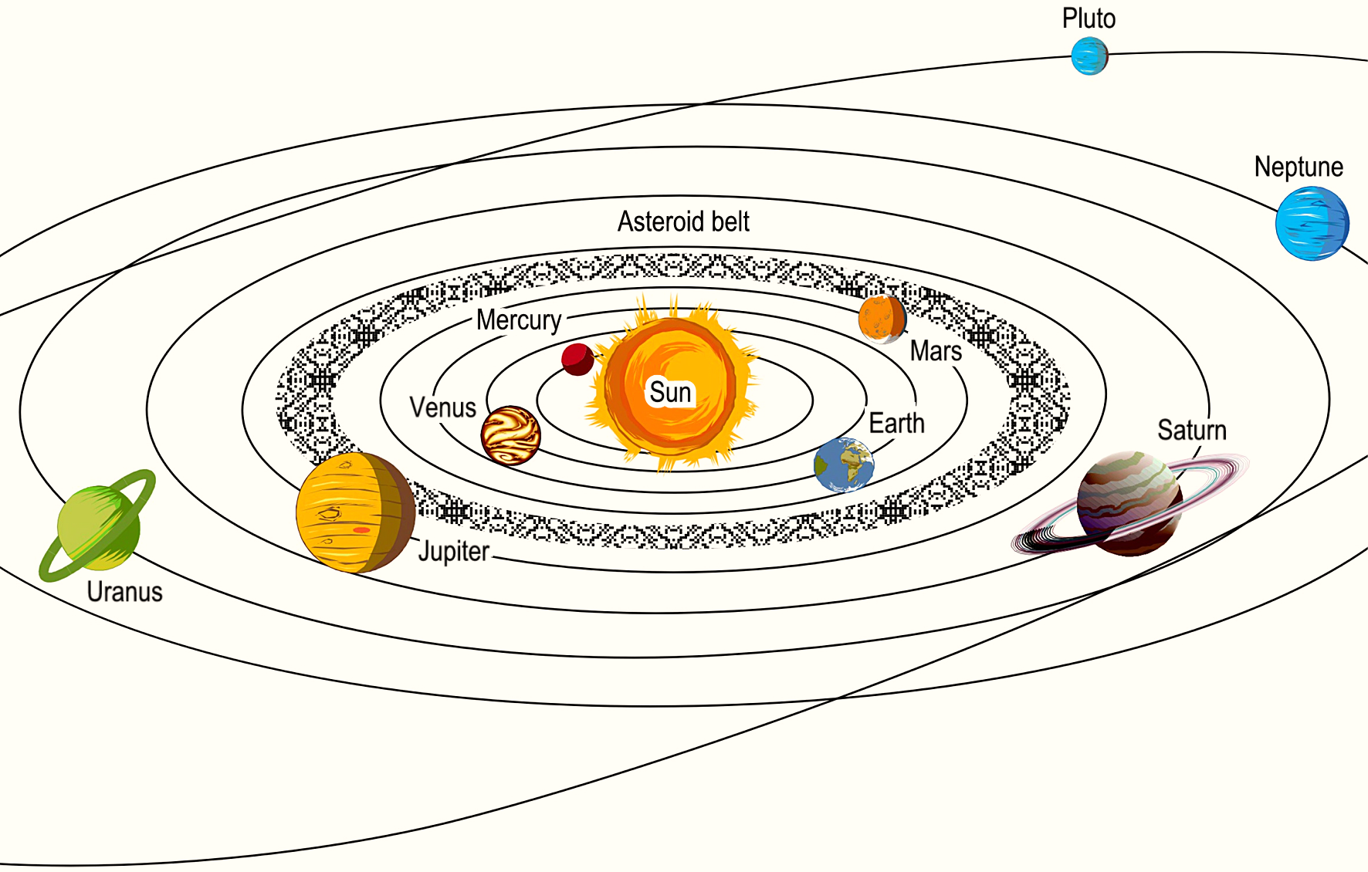
The orbital paths of objects in our solar system are the result of which of the following?
A The shape of the bodies and their chemical compositions
B The balance between the motion of the bodies and gravitational forces
C The relative age of the bodies and their chemical compositions
D The frictional forces acting on the bodies when they hit space debris
Correct answer: B

Slide 5
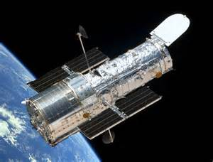
What science tool advanced space exploration by allowing humans to see better and farther into space?
A Microscope
B Telescope
C Camera
D Hand lens
Correct answer: B
http://r.search.yahoo.com/_ylt=AwrB8pXXLOpUnm4A_eyjzbkF;_ylu=X3oDMTBxNG1oMmE2BHNlYwNmcC1hdHRyaWIEc2xrA3J1cmwEaXQD/RV=2/RE=1424661848/RO=11/RU=http%3a%2f%2fdeskarati.com%2f2012%2f03%2f22%2fedwin-hubble%2f/RK=0/RS=LYqnmbU_bNh0adANbkwIRs_7yZQ-

Slide 6
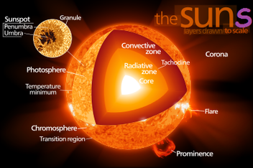
The composition of the Sun is best described as –
A liquid nitrogen and solid magnesium.
B molten rock, primarily iron.
C dense and composed of hot gases.
D lightweight particles of dust.
Correct Answer: C

Slide 7
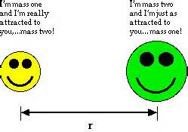
The gravitational attraction between two objects is reduced most when –
A the masses are increased, and the distance between them is increased.
B the masses are increased, and the distance between them is decreased.
C the masses are decreased, and the distance between them is decreased.
D the masses are decreased, and the distance between them is increased.
Correct Answer: D

Slide 8
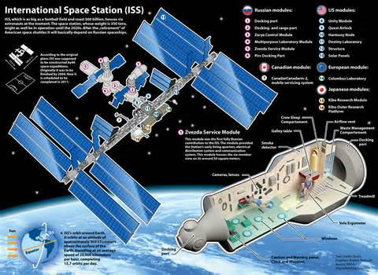
The International Space Station is a huge science laboratory that orbits Earth every 92 minutes. Experiments on board the International Space Station can help scientists learn —
A why Earth rotates on its axis every day.
B what substances are found in moon dust.
C when the first green plants appeared on Earth.
D how to solve problems of living in space.
Correct Answer: D

Slide 9
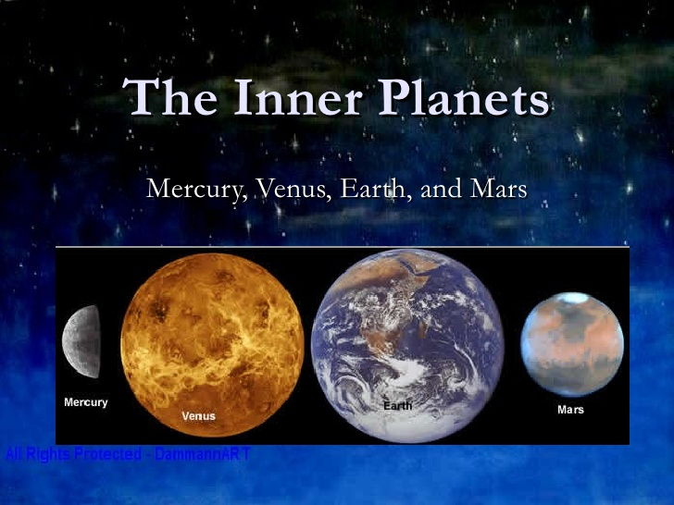
Which set of characteristics listed below are unique to the inner planets?
A Gaseous, small
B Cratered, liquid
C Cool, humid
D Terrestrial, rocky
Correct Answer: D

Slide 10
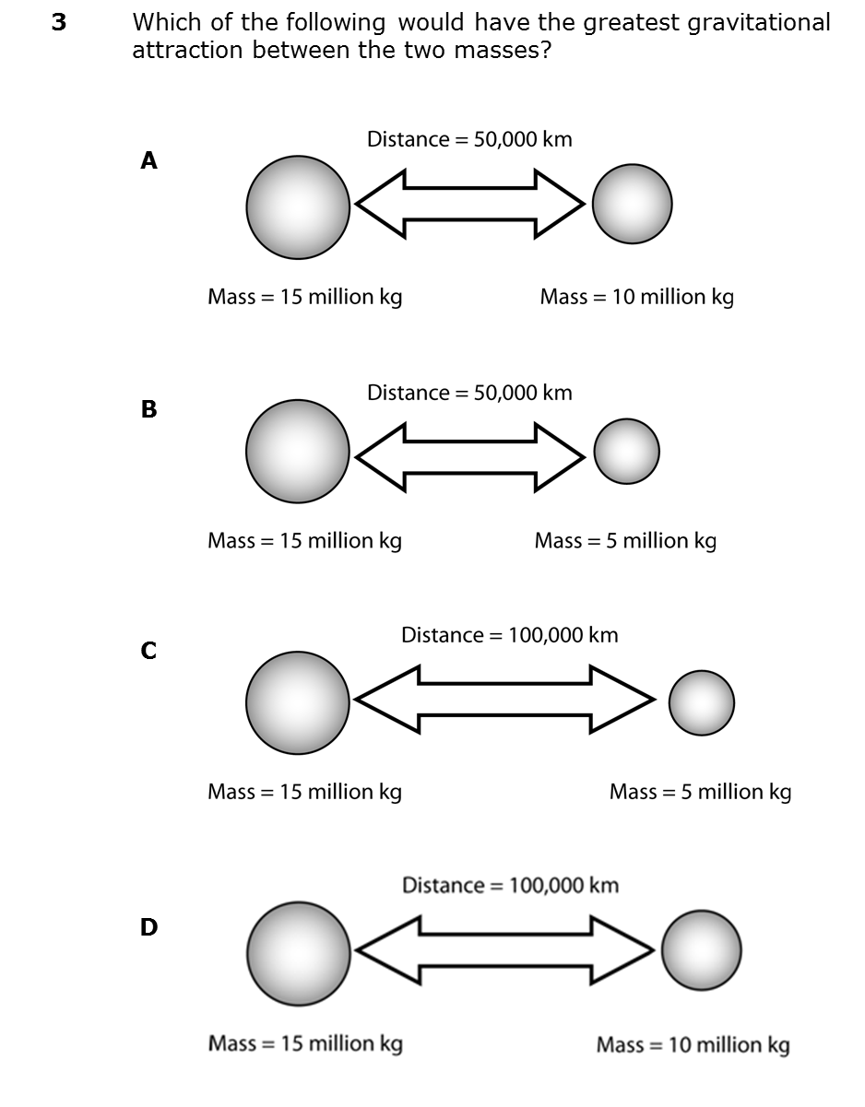
Which of the following would have the greatest gravitational attraction between the two masses?
A
B
C
D
Correct Answer: A

Slide 11
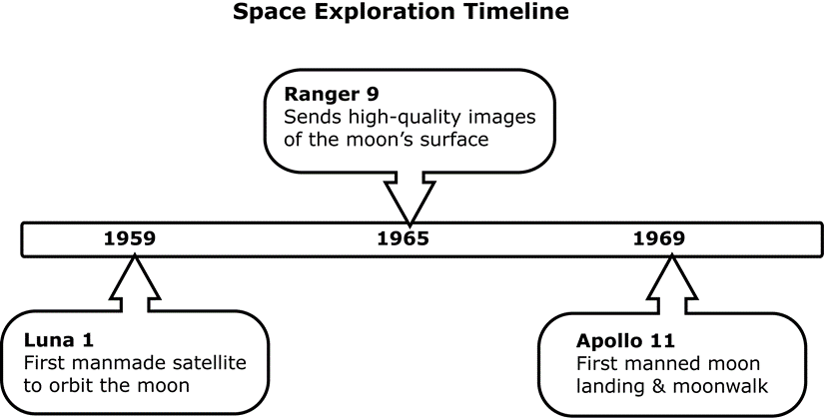
This diagram provides some important dates in the history of space exploration as it relates to the Moon. After scientists had a clear picture of the surface of the Moon, they landed an unmanned craft before risking human life. The Soviets landed the first unmanned craft on the Moon, named Luna 9. Which of the following is the most reasonable time period for this mission to have taken place? See Next Slide….
A | Sometime before 1959
B | Between 1959 and 1965
C | Between 1965 and 1969
D | Sometime after 1969

Slide 12
Which of the following is the most reasonable time period for this mission to have taken place?
A | Sometime before 1959
B | Between 1959 and 1965
C | Between 1965 and 1969
D | Sometime after 1969
Correct Answer: C

Slide 13
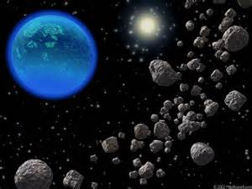
Most of the asteroids in our solar system are located between the orbits of what two objects?
A The Sun and Earth
B Venus and Earth
C Mars and Jupiter
D Uranus and Neptune
Correct Answer: C

Slide 14
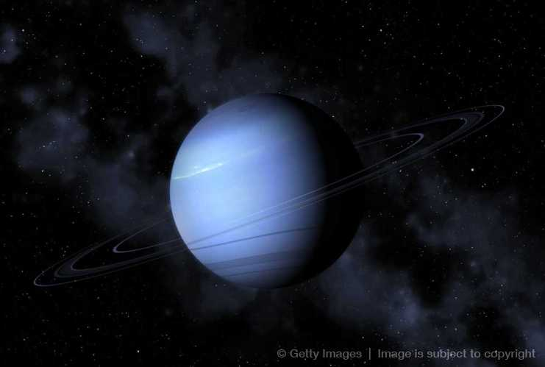
If Neptune’s mass was reduced, which of the following could be done to maintain the same force of gravitational attraction between Neptune and the Sun?
A Increase the distance between Neptune and the Sun
B Decrease the distance between Neptune and the Sun
C Increase the amount of energy the Sun puts out
D Decrease the speed of rotation of Neptune
Correct Answer: B

Slide 15
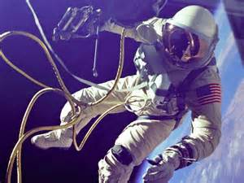
What is an important requirement for a manned spacecraft traveling through space?
A A supply of oxygen for the astronauts
B The ability to create its own gravity
C Bright lights to see where it’s going
D A device for growing food for humans
Correct Answer: A

Slide 16
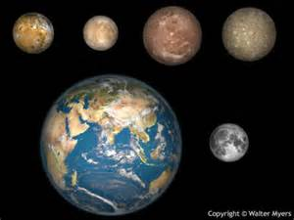
Europa, a Galilean moon, is quite different from Earth’s Moon. One characteristic it shares with Earth’s Moon is that Europa -
A is covered in ice.
B orbits a planet.
C has an oxygen atmosphere.
D contains water.
Correct Answer: B
tcaa.us

Slide 17
The path that planets take as they orbit the center of the solar system is a result of the interaction of what two things?
A The forward motion of the planet and gravitational pull of the Sun
B The mass of the planet and the composition of its atmosphere
C The magnetic field generated by the planet and friction with the air
D The age of the solar system and the radioactive decay of elements
Correct Answer: A

Slide 18
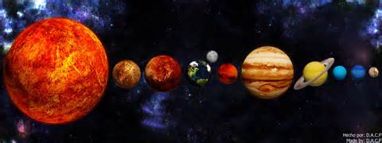
All of the planets in our solar system have more or less the same –
A diameter.
B composition.
C shape.
D mass.
Correct Answer: C

Slide 19
Example | Masses (kg) | Distance (km)
1 | M1 = 100 M2 = 200 | 20
2 | M1 = 100 M2 = 200 | 10
3 | M1 = 50 M2 = 100 | 20
4 | M1 = 50 M2 = 100 | 10
The table provides information on the masses and distances of pairs of objects. In which example is the gravitational force of attraction between the two objects the smallest?
A | Example 1
B | Example 2
C | Example 3
D | Example 4
See Next Slide…

Slide 20
In which example is the gravitational force of attraction between the two objects the smallest?
A | Example 1
B | Example 2
C | Example 3
D | Example 4
Correct Answer: C

Slide 21
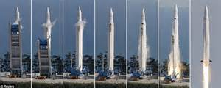
Which of the following is the first challenge that had to be overcome by rockets in order for humans to explore space?
First, rockets needed –
A a place in which the astronauts could sit.
B a way to return to Earth’s surface.
C enough thrust to overcome Earth’s gravity.
D landing gear that worked on another planet.
Correct Answer: C

Slide 22
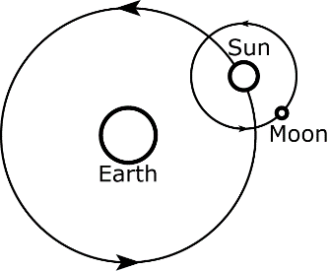
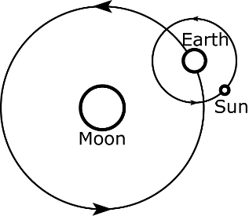
Which of the following diagrams is the most accurate representation of Earth’s relationship with the Sun and the Moon?
A
C
B
D
Correct Answer: D

Slide 23
With our current technology, travel to the closest star in another solar system is not possible for a human crew due to what limitation?
A Inability to store food and water for long periods of time
B Lack of data about the many objects found in space
C Absence of light and energy in the far reaches of space
D Relatively short human life spans and slow travel speeds
Correct Answer: D

Slide 24
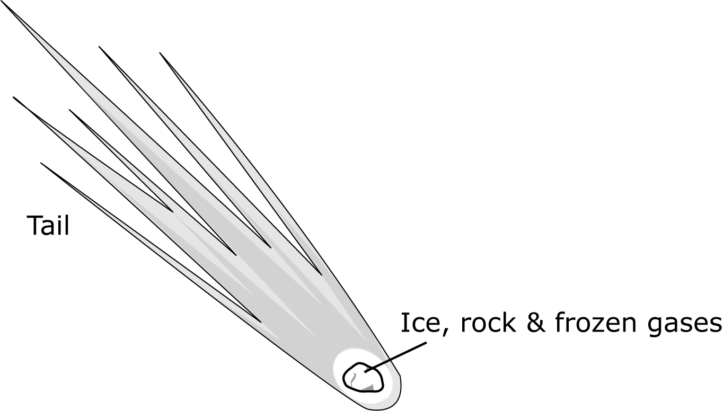
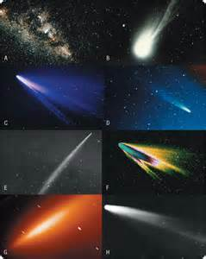
What celestial body does the picture represent?
A Comet
B Asteroid
C Moon
D Meteor
Correct Answer: A

Slide 25
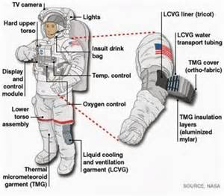
What is the most important function of a space suit like the ones astronauts wear when walking in space?
A To give the astronaut freedom of movement in space
B To provide oxygen and protection from radiation
C To make it easy to get in and out of the International Space Station
D To help the astronaut perform experiments in space
Correct Answer: B

Slide 26
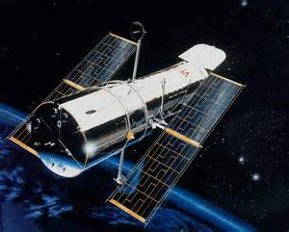
Many telescopes have been launched into orbit around Earth or sent out into deep space. What is an advantage of using these telescopes rather than an Earth-bound telescope to gather images?
A Telescopes launched into space are usually smaller than ones found on Earth
B The images are usually clearer because they do not have to look through our atmosphere
C It is easier for scientists to make adjustments to an orbiting telescope than a fixed telescope
D Orbiting telescopes usually last longer because it is cold in deep space
Correct Answer: B

Slide 27
Study Hard!!! Believe in yourself, cause I do ☺
Study these notes, notes in journal and vocabulary.
Info can be found on website www.coachpease.com
Remember the first class with the highest average overall passing that is over 50% passing will get Hot Chips!!!
This can be you but you have to study and use your stratagies correctly!!!!

Slide 28
