Slide 1
2nd 6 Week District Test Review 7th Grade Science
Typed By: K. Pease, 2016

Slide 2
An area of land that drains runoff into a particular stream, lake, ocean, or other body of water
1. What is a watershed?

Slide 3
2. What could the construction of a dam do to the watershed?

Slide 4
3. What is a hurricane?
An intense tropical storm with winds exceeding 119km/h

Slide 5
Gulf Coast and Marshes
4. Which type of ecoregion in Texas is most prone to hurricanes?

Slide 6
They migrate farther to find water the prey will die off due to lack or producers to feed on The predators will die off due to lack of prey
5. Explain how a drought could effect animals in an ecosystem?

Slide 7
Water is that found under the surface layer of the ground
6. What is ground water?

Slide 8
Not natural things added to the environment that cause harm
7. What is pollution?

Slide 9
8. What are 3 ways humans can protect our watersheds from pollution?

Slide 10
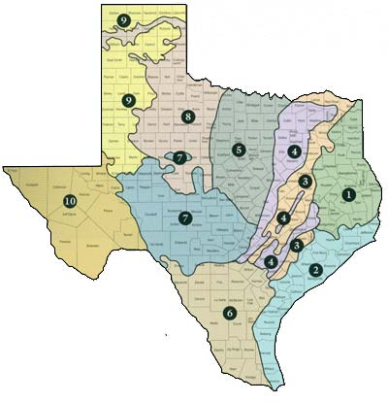
Ecoregions of Texas
9. What does this map show?

Slide 11
Tundra, taiga, marine
10. What type of ecosystems/biomes would you not find in Texas?

Slide 12
Climate, landscape
11. Ecoregions of Texas where distributed/located based on….

Slide 13
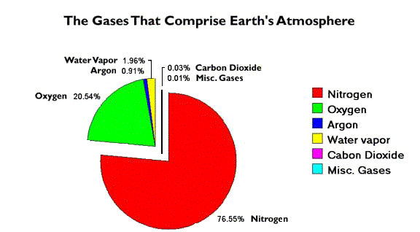
12. Explain what gasses the Earth’s atmosphere contains and how much of each one.

Slide 14
Area between Venus and Mars where conditions are perfect for life to exist
13. What is the Zone of Habitability in space?

Slide 15
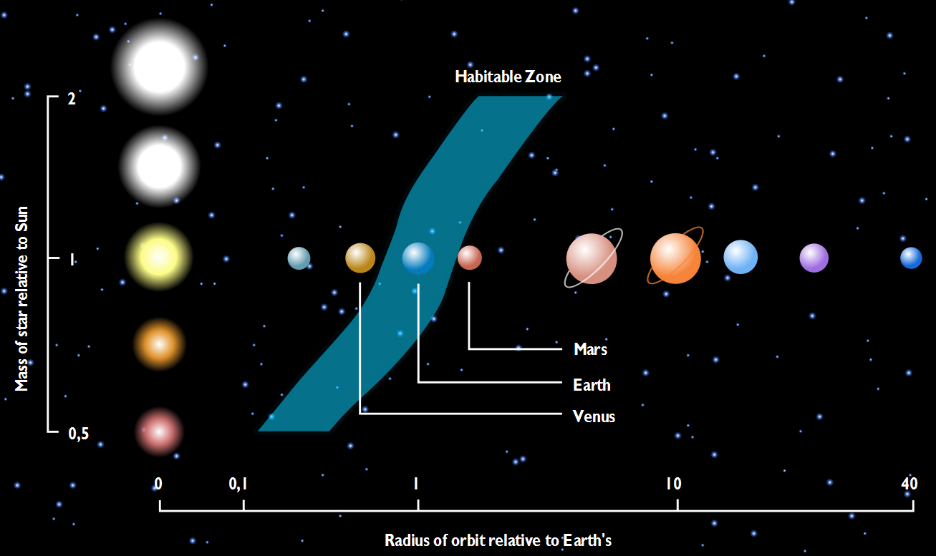
14. Draw a diagram to explain/show where the habitable zone for life is in outer space. Don’t forget your labels

Slide 16
A violent, whirling column of air in contact with the ground
15. Explain what a tornado is.

Slide 17
Ecological damage / damage done to nature
16. What type of damage is a tornado most likely to cause?

Slide 18
The breaking down and wearing away of rock
17. Explain what weathering is.

Slide 19
The carrying away from one spot to another by wind or water
18. Explain what erosion is.

Slide 20
The laying down or settling of eroded material
19. Explain what deposition is.

Slide 21
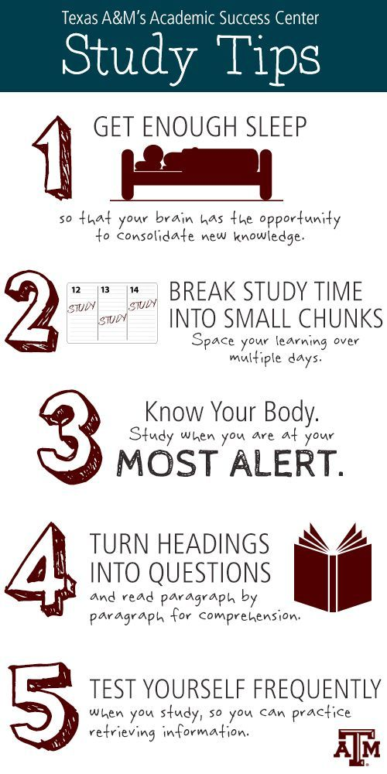
20. Explain 2 things you can do to prepare for this test. If you say study then explain how you will study.

