Slide 1
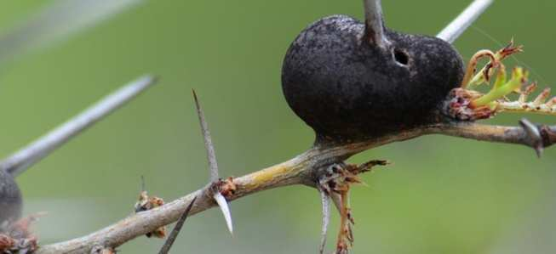
Ecology Interactions Unit
Part III, IV Review Game

Slide 2
Part III, IV Ecology Interactions
GET OFF ME | BY MY SIDE | STRANGE PETS | NOT FROM HERE | -Bonus- FOREIGN FILMS
1 | 6 | 11 | 16 | *21
2 | 7 | 12 | 17 | *22
3 | 8 | 13 | 18 | *23
4 | 9 | 14 | 19 | *24
5 | 10 | 15 | 20 | *25

Slide 3
How to play…
Don’t play like Jeo_ _ _ _ y.
Class should be divided into several small groups.
Groups should use science journal (red slide notes), homework, and other available materials to assist you.
Groups can communicate quietly with each other but no sharing answers between groups.
Practice quietly communicating right now?
Practice Communication Question:
Your group gets to order one pizza and you can have two toppings. What does your group want?

Slide 4
Questions 1-20 = 5pts Each
Final Category (Bonus) = 1pt Each
Final Questions = 5 pt wager
If you wager 5 on the last question and get it wrong you lose 5 pts. Wager 5 and get it right you get 5 pts.
Find the Owl =
Secretly write “Owl” in the correct box worth 1pt.
“I’ll be about this big.”

Slide 5
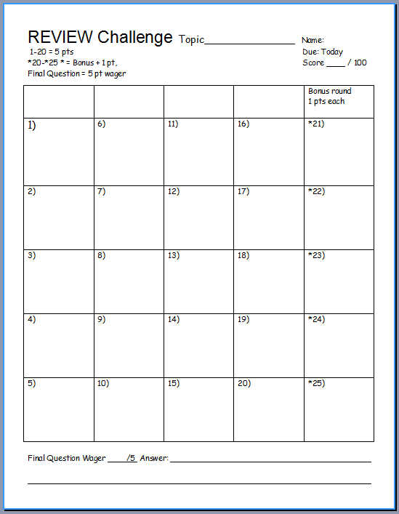
Is your name on the review sheet?
Name

Slide 6
Is your name on the review sheet?
Add the categories
along the top
on the next slide.

Slide 7
Ecology Interactions
GET AWAY | BY MY SIDE | STRANGE PETS | NOT FROM HERE | -Bonus- FOREIGN FILMS
1 | 6 | 11 | 16 | *21
2 | 7 | 12 | 17 | *22
3 | 8 | 13 | 18 | *23
4 | 9 | 14 | 19 | *24
5 | 10 | 15 | 20 | *25

Slide 8
Ecology Interactions
GET AWAY | BY MY SIDE | STRANGE PETS | NOT FROM HERE | -Bonus- FOREIGN FILMS
1 | 6 | 11 | 16 | *21
2 | 7 | 12 | 17 | *22
3 | 8 | 13 | 18 | *23
4 | 9 | 14 | 19 | *24
5 | 10 | 15 | 20 | *25

Slide 9
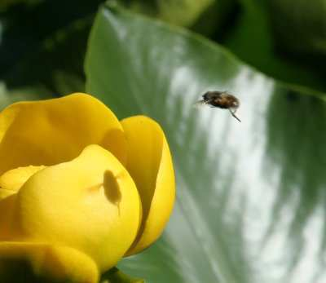
This is the name for a long term relationship between two or more different species.
1
Copyright © 2010 Ryan P. Murphy

Slide 10
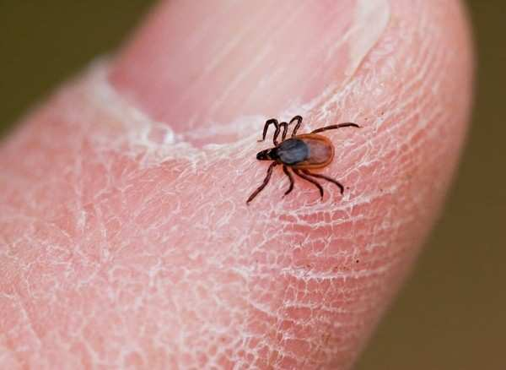
This is the type of symbiosis seen below?
2
Copyright © 2010 Ryan P. Murphy

Slide 11
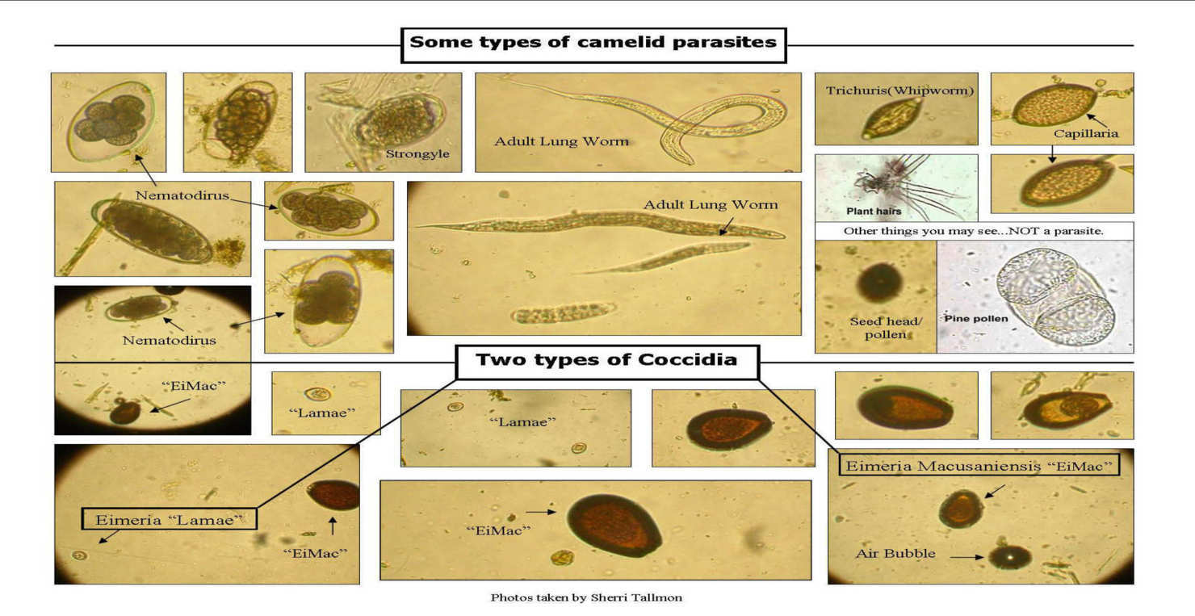
True or False.
Parasitism is one of the most successful modes of life displayed by any living organism?
For every species on earth, they may host a handful of unique parasites.
3
Copyright © 2010 Ryan P. Murphy

Slide 12
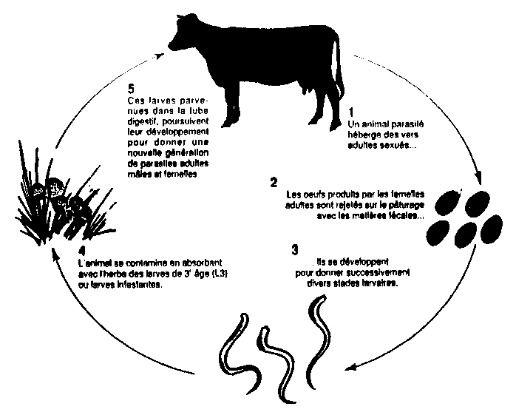
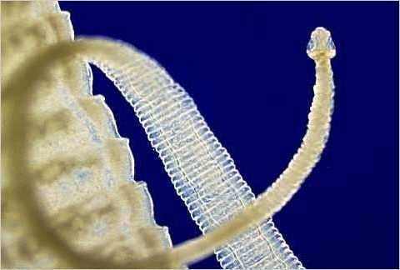
True or False. Parasite life cycles can often be complicated and go through a number and variety of organisms?
Most parasites have very complicated life cycles, often going through a number of different species before finding a host.
4
Host
Eggs
Rest
Larvae
Copyright © 2010 Ryan P. Murphy

Slide 13
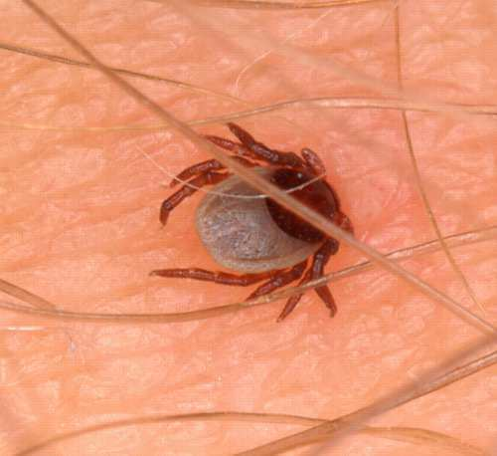
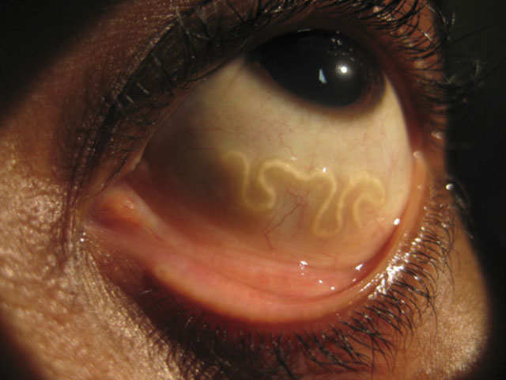
Which is an endoparasite, and which is an ectoparasite?
A
B
5
Copyright © 2010 Ryan P. Murphy

Slide 14
Ecology Interactions
GET AWAY | BY MY SIDE | STRANGE PETS | NOT FROM HERE | -Bonus- FOREIGN FILMS
1 | 6 | 11 | 16 | *21
2 | 7 | 12 | 17 | *22
3 | 8 | 13 | 18 | *23
4 | 9 | 14 | 19 | *24
5 | 10 | 15 | 20 | *25

Slide 15
Ecology Interactions
GET AWAY | BY MY SIDE | STRANGE PETS | NOT FROM HERE | -Bonus- FOREIGN FILMS
1 | 6 | 11 | 16 | *21
2 | 7 | 12 | 17 | *22
3 | 8 | 13 | 18 | *23
4 | 9 | 14 | 19 | *24
5 | 10 | 15 | 20 | *25

Slide 16
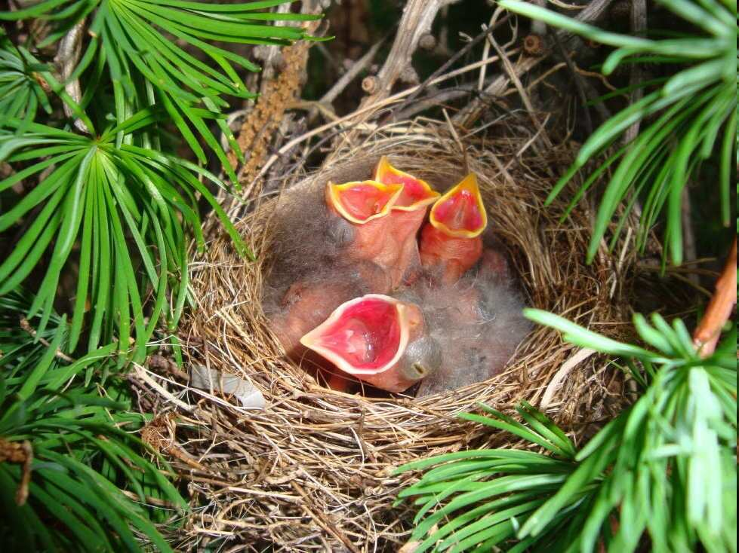
This is the name for a unique type of parasitism seen in birds that involves the laying of eggs in the nests of other birds.
The eggs are left under the parental care of the host parents.
6

Slide 17
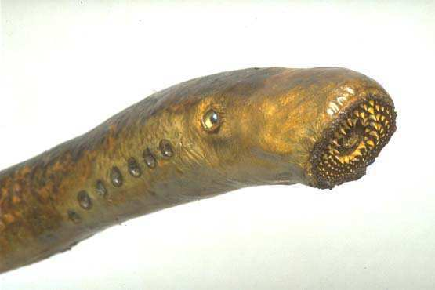
Name this jawless fish (Parasite)
They attach to fish with a sucker and bore a hole into flesh with their tongue.
7
Copyright © 2010 Ryan P. Murphy

Slide 18
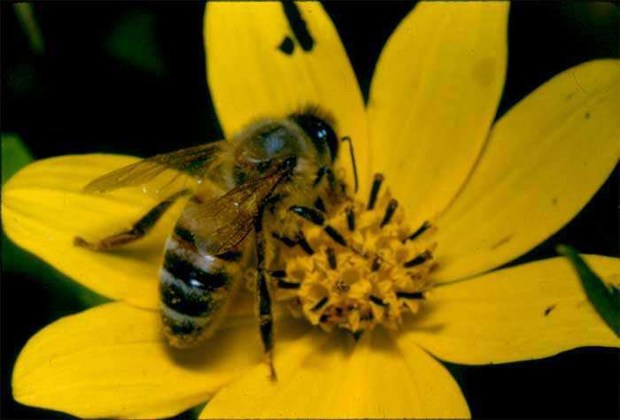
This is the type of evolution of two or more species, each adapting to changes in the other.
8

Slide 19
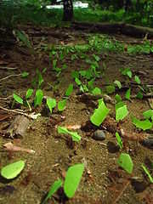
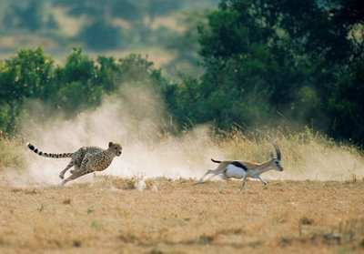
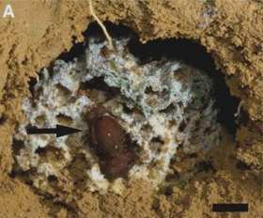
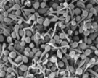
9
Which is which ecological relationship?
A.) Predator/prey and parasite/host
B.) Competitive species
C.) Mutualistic species
A
B
C

Slide 20
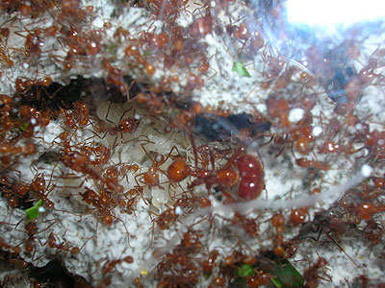
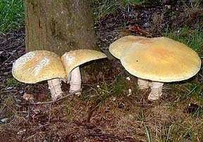
This is the type of mutualism where both species help feed each other.
Usually nutrient related.
10

Slide 21
Ecology Interactions
GET AWAY | BY MY SIDE | STRANGE PETS | NOT FROM HERE | -Bonus- FOREIGN FILMS
1 | 6 | 11 | 16 | *21
2 | 7 | 12 | 17 | *22
3 | 8 | 13 | 18 | *23
4 | 9 | 14 | 19 | *24
5 | 10 | 15 | 20 | *25

Slide 22
Ecology Interactions
GET AWAY | BY MY SIDE | STRANGE PETS | NOT FROM HERE | -Bonus- FOREIGN FILMS
1 | 6 | 11 | 16 | *21
2 | 7 | 12 | 17 | *22
3 | 8 | 13 | 18 | *23
4 | 9 | 14 | 19 | *24
5 | 10 | 15 | 20 | *25

Slide 23
This is the type of mutualism where one species protects the other and gets some benefits for its help.
11
Copyright © 2010 Ryan P. Murphy

Slide 24
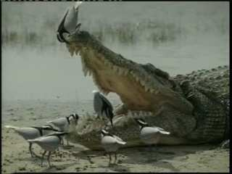
This is the type of mutualism where one species gets food and shelter, the other has parasites removed.
12
Copyright © 2010 Ryan P. Murphy

Slide 25
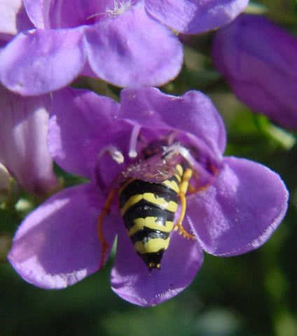
This is the type of mutualism where one species receives food in exchange for moving the pollen or seeds of its partner.
13
Copyright © 2010 Ryan P. Murphy

Slide 26
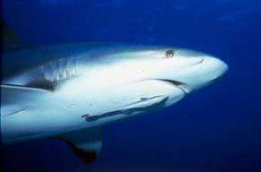
Name the type of Symbiosis?
+
Parasitism
Commensalism
Mutualism
Shark
Neutral
Neutral
Commensalism
-
Interspecific Competition?
Neutral
Parasitism
Remora
-
+

Slide 27
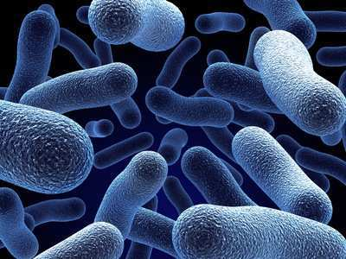
Bacteria live in our body. They are…
A.) Parasitic only
B.) Commensalisitic and Parasitic
C.) Mutualistic only
D.) Mutualistic, Commensalistic, and Parasitic
15

Slide 28
Bacteria live in our body. They are…
A.) Parasitic only
B.) Commensalisitic and Parasitic
C.) Mutualistic only
D.) Mutualistic, Commensalistic, and Parasitic
15

Slide 29
Bacteria live in our body. They are…
A.) Parasitic only
B.) Commensalisitic and Parasitic
C.) Mutualistic only
D.) Mutualistic, Commensalistic, and Parasitic
15

Slide 30
Bacteria live in our body. They are…
A.) Parasitic only
B.) Commensalisitic and Parasitic
C.) Mutualistic only
D.) Mutualistic, Commensalistic, and Parasitic
15

Slide 31
Bacteria live in our body. They are…
A.) Parasitic only
B.) Commensalisitic and Parasitic
C.) Mutualistic only
D.) Mutualistic, Commensalistic, and Parasitic
15

Slide 32
Ecology Interactions
GET AWAY | BY MY SIDE | STRANGE PETS | NOT FROM HERE | -Bonus- FOREIGN FILMS
1 | 6 | 11 | 16 | *21
2 | 7 | 12 | 17 | *22
3 | 8 | 13 | 18 | *23
4 | 9 | 14 | 19 | *24
5 | 10 | 15 | 20 | *25

Slide 33
Ecology Interactions
GET AWAY | BY MY SIDE | STRANGE PETS | NOT FROM HERE | -Bonus- FOREIGN FILMS
1 | 6 | 11 | 16 | *21
2 | 7 | 12 | 17 | *22
3 | 8 | 13 | 18 | *23
4 | 9 | 14 | 19 | *24
5 | 10 | 15 | 20 | *25

Slide 34
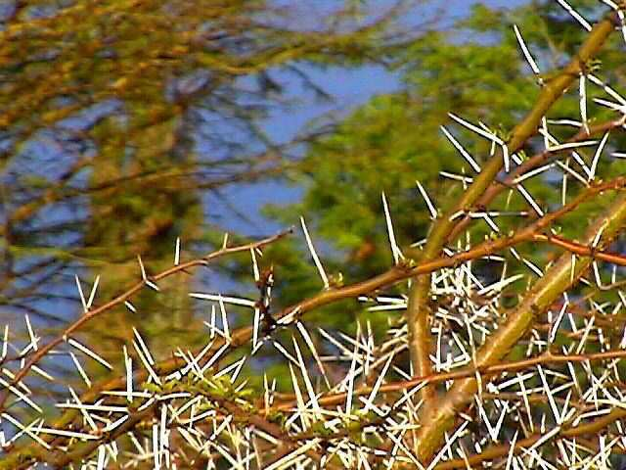
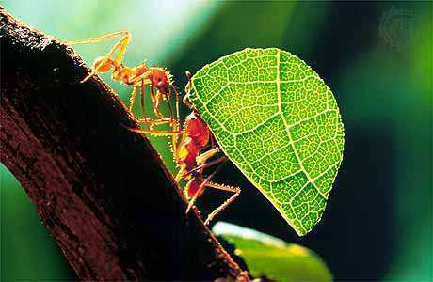
Which one uses microbe farms, and which one uses mechanical defenses?
A
B
Copyright © 2010 Ryan P. Murphy

Slide 35
17
Which one is poison ivy?
A
B
C
D

Slide 36
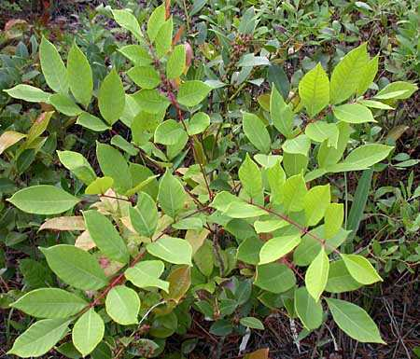
17
Which one is poison ivy?
A
B
C
D

Slide 37
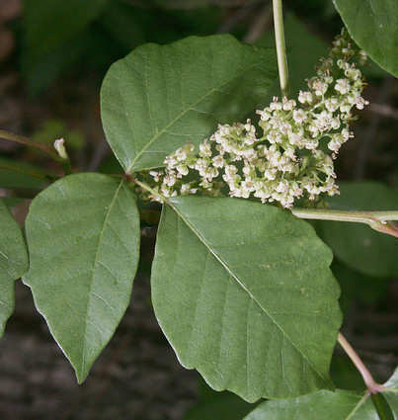
17
Which one is poison ivy?
A
B
C
D

Slide 38
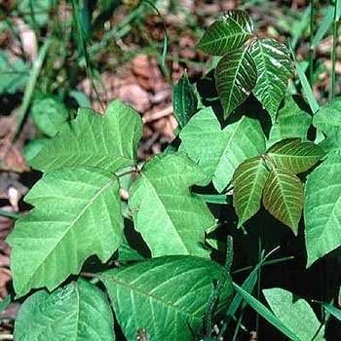
17
Which one is poison ivy?
A
B
C
D

Slide 39
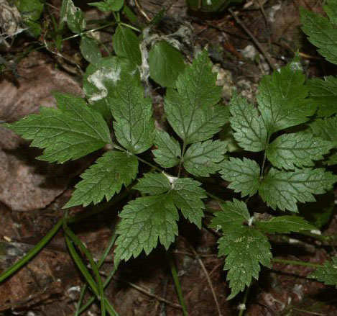
17
Which one is poison ivy?
A
B
C
D

Slide 40
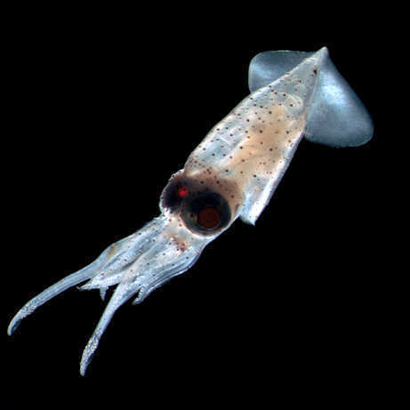
This is the term for an exotic species that causes harm to people, the environment, and native species.
18
Copyright © 2010 Ryan P. Murphy

Slide 41
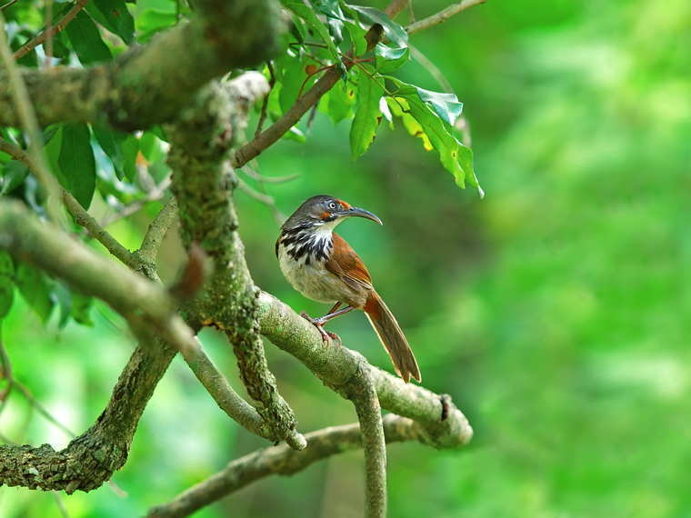
This is the name for an organism that has lived in the area for a considerable amount of time.
19
Copyright © 2010 Ryan P. Murphy

Slide 42
Name 5 invasive exotic species.
(1 point each)
20

Slide 43
End of Preview
Hundreds of more slides,
activities, video links,
homework package, lesson
notes, review games,
rubrics, and much more
on the full version of this unit
and larger curriculum.

Slide 44
This PowerPoint is one small part of my Ecology Interactions Unit that I offer on TpT. This unit includes…
4 Part 3,000+ Slide PowerPoint
14 page bundled homework packaged that chronologically follows PowerPoint, modified version, and answer keys.
7 pages of unit notes with visuals
3 PowerPoint review games (160+ slides each)
Rubrics, flash cards, board games, readings, video and academic links, and much more.
Ecology Interactions Unit on TpT

Slide 45
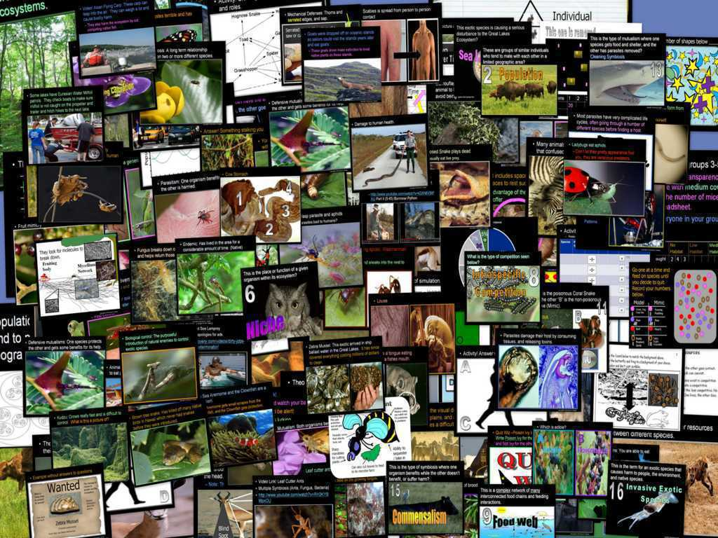
Ecology Interactions Unit

Slide 46
Ecology Interactions Unit
Areas of Focus within The Ecology Interactions Unit: Levels of Biological Organization (Ecology), Parts of the Biosphere, Habitat, Ecological Niche, Types of Competition, Competitive Exclusion Theory, Animal Interactions, Food Webs, Predator Prey Relationships, Camouflage, Population Sampling, Abundance, Relative Abundance, Diversity, Mimicry, Batesian Mimicry, Mullerian Mimicry, Symbiosis, Parasitism, Mutualism, Commensalism, Plant and Animal Interactions, Coevolution, Animal Strategies to Eat Plants, Plant Defense Mechanisms, Exotic Species, Impacts of Invasive Exotic Species. An entire mini unit of ecological succession is also included with homework, notes, field study project and PowerPoint review game.
Ecology Levels of Organization Lesson Bundle
Animal Habitats Lesson Bundle
Food Webs, Predator and Prey Cycles Lesson Bundle
Biodiversity and Population Sampling Lesson Bundle
Animal Competition Lesson Bundle
Animal Camouflage and Mimicry Lesson Bundle
Ecology, Camouflage, Mimicry, Population Sampling Review Game
Symbiosis Lesson Bundle
Invasive Exotic Species Lesson Bundle
Ecology Interactions Part III, IV Review Game, Symbiosis, Exotic Species
Ecology Interactions Unit Crossword Puzzle
Ecology Interactions Unit on TpT
Hundreds of PowerPoint samples, the bundled homework package, unit notes, and much more can be previewed at…
Ecology Interactions Unit Preview Link

Slide 48
NGSS Standards MS

Slide 49
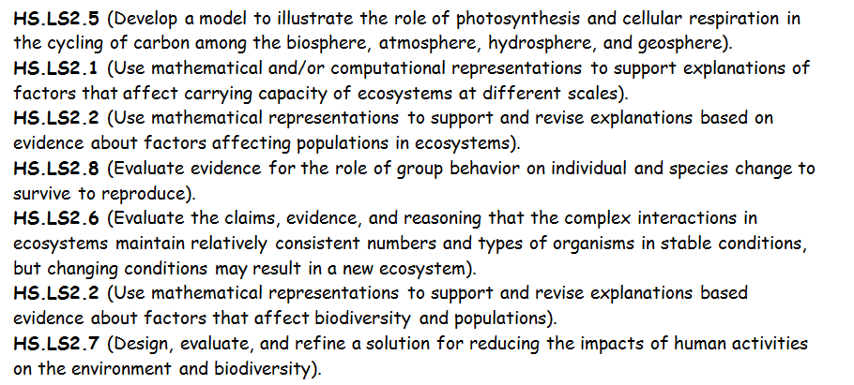

Slide 50
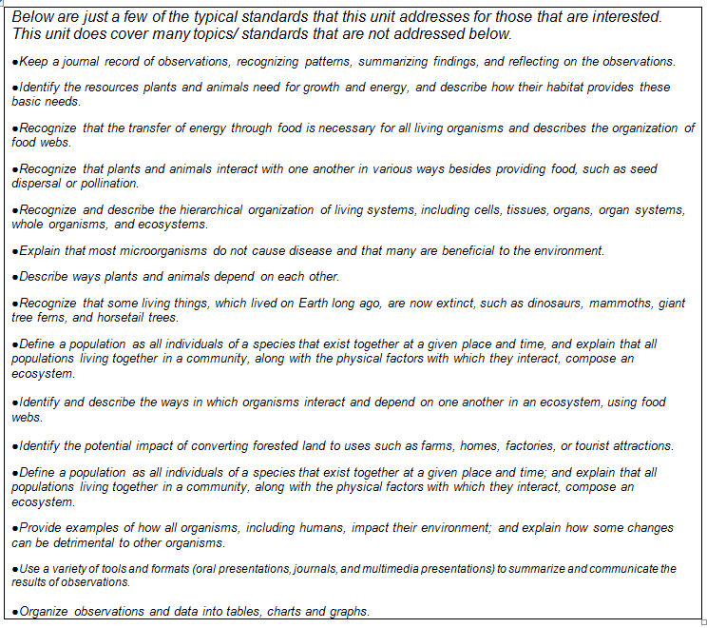
Additional Standards Addressed

Slide 51
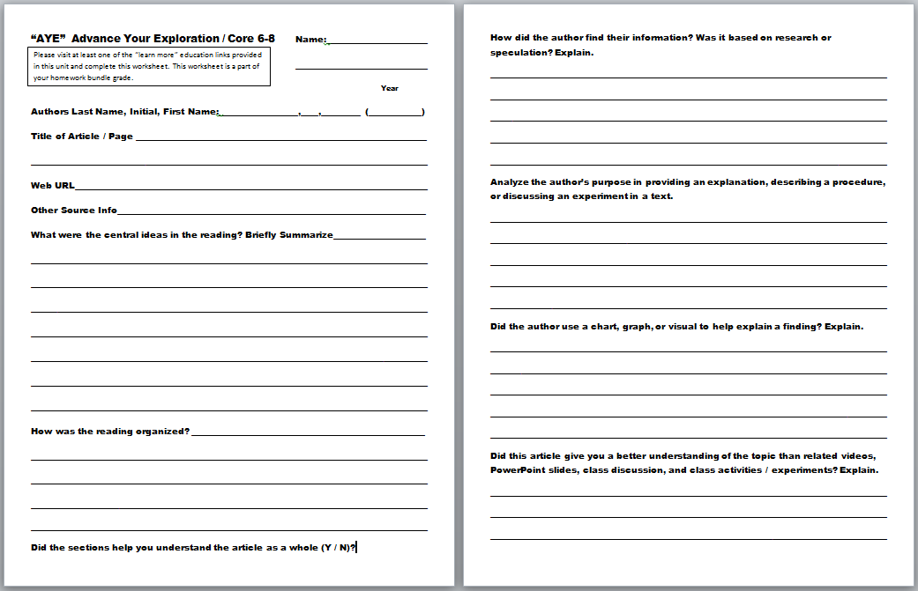
“AYE” Advance Your Exploration ELA and Literacy Opportunity Worksheet
Visit some of the many provided links or..
Articles can be found at (w/ membership to NABT and NSTA)
http://www.nabt.org/websites/institution/index.php?p=1
http://learningcenter.nsta.org/browse_journals.aspx?journal=tst
Please visit at least one of the “learn more” educational links provided in this unit and complete this worksheet

Slide 52
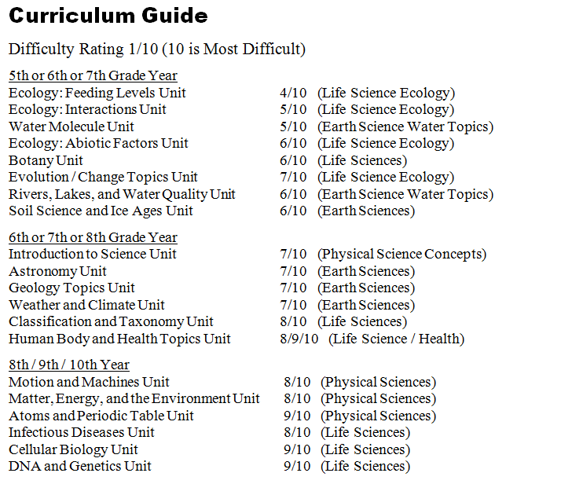

Slide 53
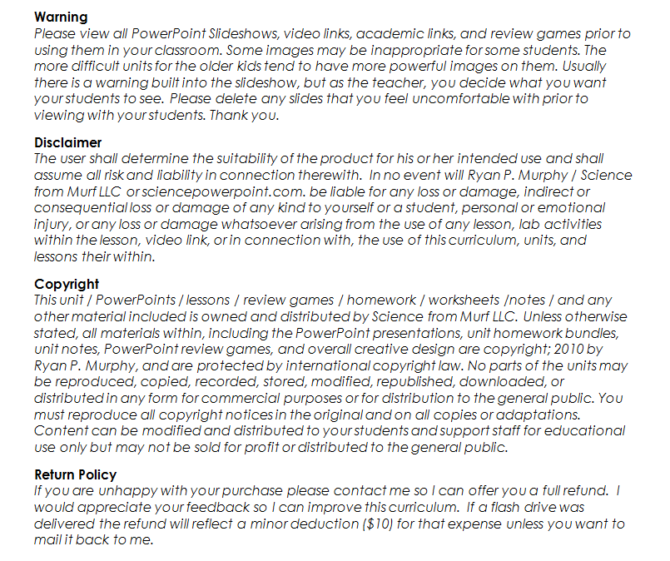

Slide 54
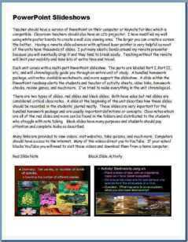
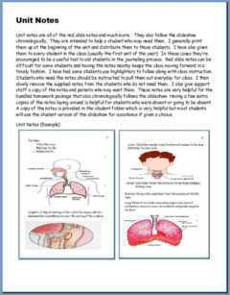
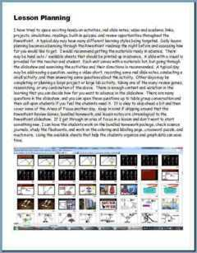
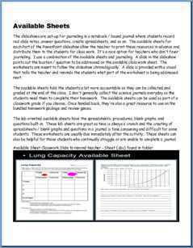
Please open the welcome / guide document on each unit preview.
This document will describe how to utilize these resources in your classroom and provide some curriculum possibilities.

Slide 55
This was a very brief tour. Please visit the links below to learn more and download detailed previews of the curriculum.
These units take me an extremely busy four years to complete with my middle level students.
Earth Science Unit Previews | Extended Tour Link and Curriculum Guide
Geology Topics Unit | Geology Topics Unit Preview Link
Astronomy Topics Unit | Astronomy Unit Preview Link
Weather and Climate Unit | Weather and Climate Unit Preview Link
Soil Science, Weathering, More | Weathering, Soil Science, Ice Ages, Glaciers Unit Preview Link
Water Unit | Water Unit Preview Link
Rivers Unit | Rivers, Lakes, and Water Quality Unit Preview Link
= Easier = More Difficult = Most Difficult
(5th – 7th grade) (6th – 8th grade) (8th – 10th grade)

Slide 56
Physical Science Unit Previews | Extended Tour Link and Curriculum Guide
Science Skills Unit | Science Skills Unit Preview Link
Motion and Machines Unit | Laws of Motion and Simple Machines Unit Preview Link
Matter, Energy, Envs. Unit | Matter, Energy, and the Environment Unit Preview
Atoms and Periodic Table Unit | Atoms and Periodic Table of the Elements Unit Preview Link
Life Science Unit Previews | Extended Tour Link and Curriculum Guide
Human Body / Health Topics | Human Body and Health Topics Unit Preview Link
DNA and Genetics Unit | DNA and Genetics Unit Preview Link
Cell Biology Unit | Cell Biology Unit Preview Link
Infectious Diseases Unit | Infectious Diseases Unit Preview Link
Taxonomy and Classification Unit | Taxonomy and Classification Unit Preview Link
Evolution / Natural Selection Unit | Evolution and Natural Selection Unit Preview Link
Botany Topics Unit | Botany Unit Preview Link
Ecology Feeding Levels Unit | Ecology Feeding Levels Unit Preview Link
Ecology Interactions Unit | Ecology Interactions Unit Preview Link
Ecology Abiotic Factors Unit | Ecology Abiotic Factors Unit Preview Link

Slide 57
Life Science Curriculum Link
Physical Science Curriculum Link
Earth Science Curriculum Link

Slide 58
Life Science Curriculum Link
Individual Lessons on TpT
Human Body Systems and Health Topics Unit
Anatomy Intro, Levels of Biological Organization Lesson Bundle
Skeletal System Lesson Bundle
Muscular System Lesson Bundle
Anatomy Intro, Skeletal, Muscular System Review Game
Healthy Eating, Molecules of Life Lesson Bundle
Obesity, Dangers of Fast Food, Eating Disorders
Healthy Eating and Living Review Game
Eating Disorders, Anabolic Steroids
Digestive System Lesson Bundle
Circulatory System and Respiratory System Lesson Bundle
Anti-Tobacco, Dangers of Smoking Lesson Bundle
Circulatory and Respiratory System Review Game
Excretory System Lesson Bundle
Nervous System Lesson Bundle
Nervous System Review Game
Endocrine System Lesson Bundle, Puberty, Hormones
Human Reproductive Lesson Bundle, Fertilization
Endocrine and Reproductive System Review Game
Immune System, HIV, AIDS, STD's Lesson Bundle
Immune System, HIV, AIDS, STD's Review Game
Anatomy Crossword Puzzle
DNA and Genetics Unit
DNA Lesson Bundle
DNA Lesson Review Game
DNA Crossword Puzzle
Cell Division, Mitosis and Meiosis Lesson Bundle
Cell Division Review Game
Mitosis and Meiosis Crossword Puzzle
Genetics Lesson Bundle
DNA and Genetics Crossword Puzzle
Genetics Review Game
Cellular Biology Unit
Introduction to Cells, Cell History, Cheek and Onion Cell Lab, Cell
Theory Lesson Bundle
Cell Review Game
Cell Transport Lesson Bundle, Osmosis, Diffusion, Active Transport
Cell Transport Review Game
Characteristics of Life Lesson
Cellular Organelles Lesson Bundle
Cellular Organelles Visual Quiz
Cellular Organelles Review Game
Cell Unit Crossword Puzzle
Cell Unit Flash Cards
Cellular Biology Unit Preview, Homework Bundle, Unit Notes, more

Slide 59
Life Science Curriculum Link
Individual Lessons on TpT
Infectious Diseases Unit
Infectious Diseases Unit Intro and Virus Lesson Bundle
Virus Lesson Review Game
Bacteria Lesson Bundle
Bacteria Review Game
Parasites Lesson Bundle
Immune System, HIV, AIDS, STD's Lesson Bundle
Infectious Diseases Unit Crossword Puzzle
Immune System, HIV, AIDS, STD's Review Game
Evolution and Natural Selection
Evolution and Natural Selection Lesson Bundle
Evolution and Natural Selection Review Game
Human Evolution Lesson Bundle
Life Origins and Human Evolution Quiz Game
Geologic Timescale, Earth System History Lesson Bundle
Earth Geologic History Quiz Game
Life Origins and Human Evolution Quiz Game Life Origins, Miller Urey Experiment Lesson Bundle
Ecological Succession Lesson Bundle
Ecological Succession Review Game
Botany Unit
Botany Unit Intro, Non-vascular Plants, Plate Evolution Lesson Bundle
Student Botany Projects, Grow Study Lesson Bundle
Botany Unit Review Game
Plants, Seeds, Seed Dispersal Lesson Bundle
Plants Review Game
Plants, Roots, Leaves, Lesson Bundle
Monocotyledons and Dicotyledons Lesson Bundle
Dendrochronology, Tree Ring Dating Lesson Bundle
Plant Hormones Lesson Bundle
Botany Unit Crossword Puzzle
Leaf Identification Lesson Bundle
Botany Unit Review Game
Plant Life Cycles, Flowers, Fruits Lesson Bundle
Plant Life Cycles, Flowers, Fruits Review Game
Taxonomy and Classification Unit
Taxonomy and Classification Lesson Bundle
Taxonomy and Classification Review Game
Bacteria Lesson Bundle
Bacteria Review Game
Kingdom Protista Lesson Bundle
Kingdom Animal Lesson Bundle
Animal Phylums Visual Quiz
Class Mammalia Lesson Bundle
Kingdom Animalia Review Game and Mammalia
Kingdom Fungi Lesson Bundle
Kingdom Fungi Review Game
Kingdom Plantae Lesson Bundle
Botany Unit Review Game
Name the Kingdom, Phylum, Class Visual Challenge
Taxonomy and Classification Crossword Puzzle

Slide 60
Life Science Curriculum Link
Individual Lessons on TpT
Ecology Feeding Levels Unit
Ecology Food Chain Lesson Bundle
Biomagnification, Bioaccumulation of Pollution, Food Chain Lesson Bundle
Ecology Feeding Levels, Pyramid of Biomass, Number Lesson Bundle
Animal Dentition Lesson Bundle
Ecology Feeding Levels Unit Review Game
Ecology Feeding Levels Unit Crossword
Food Chain Board Game
Ecology Abiotic Factors Unit
Ecology Non-living Factors, Light Lesson Bundle
Ecology, Non-living Factor Temperature Lesson Bundle
Photosynthesis and Respiration, Biogeochemical Cycles Lesson Bundle
Ecology Non-living Factors Quiz Game
Island Biogeography Lesson Bundle
Nitrogen Cycle Lesson Bundle
Phosphorus Cycle and Nutrient Pollution Lesson Bundle
Plant Succession, Fire Ecology, Lesson Bundle
Ecological Succession Quiz Game
Ecology Flash Cards
Ecology Interactions Unit
Ecology Levels of Organization Lesson Bundle
Animal Habitats Lesson Bundle
Food Webs, Predator and Prey Cycles Lesson Bundle
Biodiversity and Population Sampling Lesson Bundle
Animal Competition Lesson Bundle
Animal Camouflage and Mimicry Lesson Bundle
Ecology, Camouflage, Mimicry, Population Sampling Review Game
Symbiosis Lesson Bundle
Invasive Exotic Species Lesson Bundle
Ecology Interactions Part III, IV Review Game, Symbiosis, Exotic Species
Ecology Interactions Unit Crossword Puzzle

Slide 61
Physical Science Curriculum Link
Individual Lessons on TpT
Laws of Motion and Simple Machines Unit
Newton's Three Laws of Motion
Newton's Laws of Motion Review Game
Friction Lesson, Types of Friction
Kinetic and Potential Energy Lesson
Newton's Laws and Forces in Motion
Forces in Motion Review Game
Catapults and Trajectory Lesson
Simple Machines Lesson
Simple Machines Review Game
Laws of Motion and Simple Machines Unit Flashcards
Laws of Motion and Simple Machines Crossword Puzzle
Laws of Motion, Forces in Motion, Simple Machines Unit Preview, Homework, Notes
Science Skills Unit
Lab Safety Lesson Bundle
Microscopes and Magnification Lesson Bundle
Metric System / SI Lesson Bundle
Scientific Notation Lesson Bundle
Volume and Density Lesson Bundle
Scientific Method, Observation Skills Lesson Bundle
Science Skills Unit Flash Cards
Science Skills Unit Crossword Puzzle
Science Skills Unit Review Game
Science Skills Unit Preview, Homework Bundle, Notes
Matter, Energy, and the
Environment Unit
States of Matter, Physical Change, Chemical Change
States of Matter, Physical Change, Chemical Change Review Game
Gas Laws Introductory Lesson Bundle
Gas Laws Review Game
Viscosity Lesson Bundle
Forms of Energy Lesson Bundle
Heat Transfer, Convection, Conduction, Radiation Lesson Bundle
Electromagnetic Spectrum Lesson Bundle
Forms of Energy, Particles, Waves, EM Spectrum Review Game
Electromagnetic Spectrum Visual Quiz
Electricity and Magnetism Lesson Bundle
Electricity and Magnetism Review Game
Matter and Energy Crossword Puzzle and Solution
Matter, Energy, and the Environment Unit Preview, Homework Bundle, Notes
Environment Unit Bundle
Environment Unit Bundle Review Game
Atoms and the Periodic Table of the Elements Unit
Atoms, Atomic Number, Atomic Mass, Isotopes Lesson Bundle
Inside the Atom Lesson Bundle
Atoms Review Game
Atomic Theory, Electrons, Orbitals, Molecules Lesson Bundle
Atoms, Atomic Theory, Electrons, Orbitals, Molecules Review Game
Atomic Bonding, Balancing Chemical Equations, Reactions, Lesson Bundle
Atoms and the Periodic Table Crossword Puzzle and Solution
Atoms and Periodic Table Unit Preview, Homework Bundle, Unit Notes
Periodic Table of the Elements Unit Lesson Bundle
Periodic Table of the Elements Review Game

Slide 62
Earth Science Curriculum Link
Individual Lessons on TpT
Geology Topics Unit
Plate Tectonics, Continental Drift, Earth's Core,
Plate Boundaries Lesson Bundle
Dynamic Earth Review Game
Plate Boundaries Visual Quiz
Volcanoes Lesson Bundle
Types of Volcanoes
Volcanoes Review Game
Earthquakes Lesson Bundle
Earthquakes Review Game
Rock Deformation, Compression, Tension, Shearing
Minerals Lesson Bundle
Minerals Review Game
Rock or Mineral PowerPoint Quiz
Rocks and Minerals Lesson Bundle
Rocks and Minerals Flash Cards
Types of Rocks Visual Quiz
Rocks and the Rock Cycle Lesson Bundle
Rocks and Rock Cycle Review Game
Geologic Timescale, Earth System History Lesson Bundle
Earth Geologic History Quiz Game
Geology Unit Crossword Puzzle
Geology Unit Preview, Bundled Homework, Unit Notes
Astronomy Topics Unit
Solar System and Sun Lesson Bundle
Sun Lesson Bundle
Solar System and Sun Review Game
Solar and Lunar Eclipse Lesson Bundle
Inner Planets Lesson Bundle
Inner Planets Review Game
Moon, Phases of the Moon, Tides, Seasons, Lesson Bundle
Rocketry Lesson Bundle
Asteroid Belt, Meteors, Torino Scale Lesson Bundle
Asteroid Belt and Rocketry Review Game
Mission to the Moon, Apollo Lesson
Outer Planets Lesson Bundle
Outer Planets Review Game
Beyond the Solar System Lesson Bundle
Beyond the Solar System, Galaxies, Black Holes, Constellations Review Game
Galaxy Lesson, Hubble Exploration
Astronomy Unit Crossword Puzzle
Astronomy Unit in Spanish

Slide 63
Earth Science Curriculum Link
Individual Lessons on TpT
Weathering, Soil Science, Soil Conservation, Ice Ages, Glaciers Unit
Mechanical and Chemical Weathering Lesson Bundle
Mechanical and Chemical Weathering Review Game
Soil Science Lesson Bundle
Erosion, Soil Conservation Lesson Bundle
Soil Science, Erosion, Soil Conservation Review Game
Weathering, Soil Science Unit Flash Cards
Weathering and Soil Science Crossword Puzzle
Ice Ages and Glaciers Lesson Bundle
Ice Ages and Glaciers Review Game
Ice Ages and Glaciers Crossword Puzzle
Ice Ages, Glaciers Unit Flash Cards
Weathering, Soil Science, Soil Conservation, Ice Ages, Glaciers Unit Preview
Weather and Climate Unit
Atmosphere Lesson Bundle
Ozone Layer, Air Pollution, Skin Cancer
Atmosphere, Layers of the Atmosphere, Pollution Quiz Game
Air Pressure and Winds Lesson Bundle
Severe Weather Lesson Bundle, Hurricanes, Tornado, Blizzards
Seasons Lesson Bundle, Axial Tilt
Weather, Wind, Seasons, Quiz Game
Winds, Global Winds, Wind Chill Lesson Bundle
Oceans and Weather, Water Cycle, Clouds Lesson Bundle
Water Cycle and Clouds Lesson Bundle

Slide 64
Earth Science Curriculum Link
Individual Lessons on TpT
Rivers, Lakes, and
Water Quality Unit
Rivers and Watershed Lesson Bundle
Flooding Lesson Bundle
Benthic Macroinvertebrate Lesson Bundle
Lake Turnover Lesson Bundle
Salmon Lesson Bundle
Fish Lesson, Fashion a Fish, Lesson Bundle
Rivers, Lakes, and Water Quality Unit Review Game
Rivers, Lakes, and Water Quality Crossword Puzzle
Rivers, Lakes, and Water Quality Unit Preview, Homework Bundle, Unit Notes
Water Molecule Unit
Water Use, Water on Earth, Water Conservation Lesson Bundle
Groundwater, Groundwater Pollution Lesson Bundle
Properties of Water Lesson Bundle
Water Cycle Lesson Bundle
Water Unit Review Game
Water Unit Preview, Homework Package, Unit Notes, more

Slide 65
Individual units within the curriculum
Earth Science Units | Purchase Individual Unit Link on TpT
Geology Topics Unit | Geology Unit on TpT
Astronomy Topics Unit | Astronomy Unit on TpT
Weather and Climate Unit | Weather and Climate Unit on TpT
Soil Science, Weathering, More | Weathering, Soil Science, Ice-Ages, Glaciers Unit on TpT
Water Unit | Water Unit on TpT
Rivers Unit | Rivers, Lakes, and Water Quality Unit on TpT
= Easier = More Difficult = Most Difficult
(5th – 7th grade) (6th – 8th grade) (8th – 10th grade)

Slide 66
Physical Science Units | Purchase Individual Unit Link on TpT
Science Skills Unit | Science Skills Unit on TpT
Motion and Machines Unit | Newton's Laws of Motion, Forces in Motion and Simple Machines Unit
Matter, Energy, Envs. Unit | Matter, Energy, and the Environment Unit
Atoms and Periodic Table Unit | Atoms and Periodic Table of the Elements Unit on TpT
Life Science Units | Purchase Individual Unit Link on TpT
Human Body / Health Topics | Anatomy, Human Body and Health Unit on TpT
DNA and Genetics Unit | DNA and Genetics Unit on TpT
Cell Biology Unit | Cell Biology Unit on TpT
Infectious Diseases Unit | Virus, Bacteria, Parasites, Diseases Unit
Taxonomy and Classification Unit | Taxonomy and Classification Unit
Evolution / Natural Selection Unit | Evolution and Natural Selection Unit on TpT
Botany Topics Unit | Botany Unit
Ecology Feeding Levels Unit | Ecology Feeding Levels Unit on TpT
Ecology Interactions Unit | Ecology Interactions Unit on TpT
Ecology Abiotic Factors Unit | Ecology Abiotic Factors Unit on TpT

Slide 67
Curriculum Tour Link
Thank you for your time and interest. The curriculum link above will allow to see previews of the curriculum, bundled homework packages, review games, unit notes, the welcome guide, and much more. Thank you for your interest and feel free to contact me with any questions you may have. Best wishes.
Sincerely,
Ryan Murphy M.Ed
ryemurf@gmail.com

Slide 68
Entire Science Curriculum Link

