Slide 1
Origins of the Universe
By: K.Pease
8th grade 2013-14

Slide 2
The Universe
In astronomy , the sum total of all things which can be directly observed or whose physical effects on other things can be detected.
Major components:
Galaxies
Solar systems
planets
Can you think of something in the universe that cannot be seen, but its effects on other things can be detected?

Slide 3
Cosmology
The branch of astronomy that deals with the origin, large-scale properties, and the evolution of the observable universe

Slide 4
“Big Bang Theory”
The primeval explosion of space, time, matter and energy that most astronomers think gave rise to the universe as we see it today.
Occurred about 13.7 billion years ago
Thought to have expanded within a second from something the size of a spec of dust to the size of our solar system.
Misconception Alert: Describing this theory as the “Big Bang” is a misnomer because there really was not an explosion, just a release of energy

Slide 5
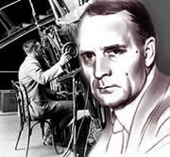
Edwin Hubble
Determined that other galaxies exist, besides the Milky Way
Observed that galaxies were moving away from each other
Hubble Law:
The farther away a galaxy is, the faster it is moving away from us; supports the Big Bang Theory

Slide 6
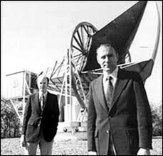
Arno Penzias & Robert Wilson
Accidentally detected faint radiation on a radio telescope in 1965
Determined that the radiation was leftover thermal energy from the “Big Bang”

Slide 7
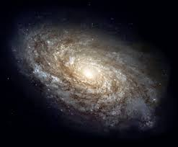
Galaxy
A large as semblance of stars (and other gas and dust) typically containing millions to hundreds of billions of member stars
A star is a large hot ball of gas which generates energy in its core by nuclear reactions
Around 100 billion in the universe
Held together by the gravitational attraction of all its member stars on one another
Formed around 200 million years after the Big Bang
Most large ones seem to have super-massive black holes at their centers
Sometimes contain very bright centers called quasars
3 major Types:
spiral
elliptical
irregular

Slide 8
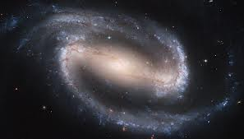
3 types of Galaxies
Spiral
have arms of stars, gas and dust that curve away from the center of the galaxy in a spiral pattern

Slide 9
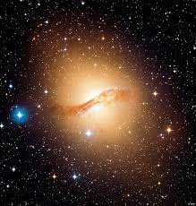
3 types of Galaxies
Elliptical
Shaped like spheres or eggs; have almost no dust or gas between stars; contain old stars

Slide 10
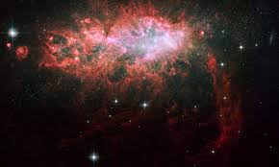
3 types of Galaxies
Irregular
Faint galaxies without a definite shape; smaller than the other types of galaxies; contain fewer stars

Slide 11
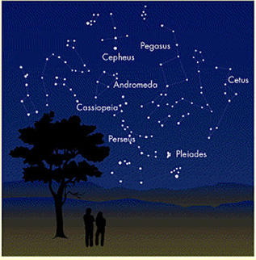
Constellation
A group of stars that form a pattern in the sky
Stars of a constellation are often far apart from each other, but they appear grouped together when viewed from Earth
One of the 88 sectors into which astronomers divide the sphere of the sky-named after a traditional constellation in that sector
Patterns of constellations are dynamic; therefore, the constellations of 100,000 years ago are quite different from today’s
A part of a constellation that forms its own pattern in the sky is know as a asterism (ex. The big dipper)

Slide 12
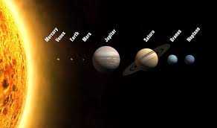
Solar System
The sun and all things orbiting around it, including the eight major planets, their satellites, and all the smaller pieces such as asteroids and comets
Formed around 4.6 billion years ago

Slide 13
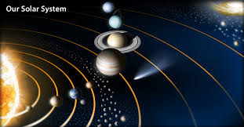
Planet
Derived from a Greek word that means “wanderer”
A major object which orbits around a star
In our solar system, there are eight such objects which are traditionally called “planets”

Slide 14
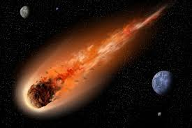
Asteroids
Small, solid, rocky bodies that orbit close to the sun
Most found between the orbits of Mars and Jupiter in the “Asteroid Belt”
Thought to be leftover material from the formation of the solar system
Range in size from 1000km or 621 miles (Ceres)

Slide 15
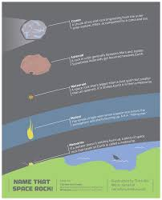
Meteoroid, Meteor, Meteorite
Meteoroid – solid debris from space (asteroids) that are moving towards Earth
Meteor- a brief streak of light produced by a small partial entering Earth’s atmosphere at high speed
Often referred to as a “shooting star”
Travels at speeds between 11-72 km per hour
Meteorite- a small object from outer space that passes through Earth’s atmosphere

Slide 16
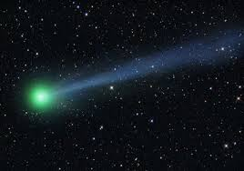
Comet
A small body of ice and dust (dirty snowball) that orbits the sun
Contain a head (coma) followed by a tail of gas and dust
The tail always points away from the sun and can be million of kilometers long

Slide 17
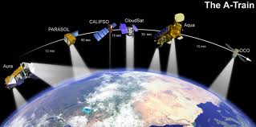
Satellite
An object that orbits a more massive object (ex. Moons)
Probes we launch into orbit around the Earth are called “Artificial Satellites”

Slide 18
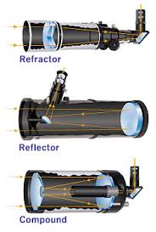
Telescope
A device that gathers electromagnetic radiation
Types:
Visible, Infrared, ultraviolet- pick up visible, infrared, and ultraviolet waves
Reflecting: use mirrors that reflect the image being viewed
Refracting: using lenses, gathers light and focuses it near the opposite end of the tube; works like a magnifying glass
Radio: pick up radio waves emitted from space

Slide 19
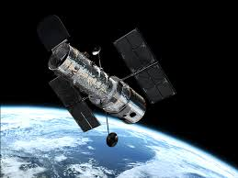
Hubble Space Telescope
A reflecting telescope that was placed into orbit in 1990
Sends images and measurements back to Earth electronically

Slide 20
Astronomical Unit (AU)
Unit of distance equal to the average spacing between the Earth and the Sun
Equal to about 150 million km (93 million miles)
Light takes about eight minutes to cover this distance

Slide 21
Parsec
Unit of distance equal to about 3.26 light years ( or 206,265 AU)

Slide 22
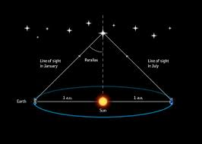
Parallax
The apparent shift in position of an object when viewed from different locations
Used by astronomers to measure distance

