Slide 1
Oct. 1, 2018
Collect card sort from red basket, 1 sort per table
Sharpen Pencil
Sit at table
Complete Card Sort

Slide 2
TEKS 6.5C
(C) identify the formation of a new substance by using the evidence of a possible chemical change such as production of a gas, change in temperature, production of a precipitate, or color change.

Slide 3
LO
Students will create an anchor chart to identify the 6 types of evidence that proves a chemical reaction has taken place.

Slide 4
DOL
Students will answer 5/5 questions over the 6 types of evidence of a chemical reaction with 80% accuracy or higher.

Slide 5
Review Types of Evidence of a Chemical Reaction

Slide 6
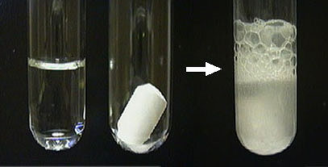
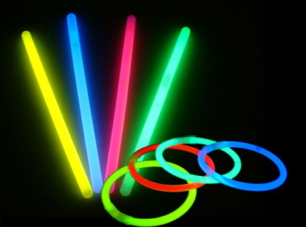
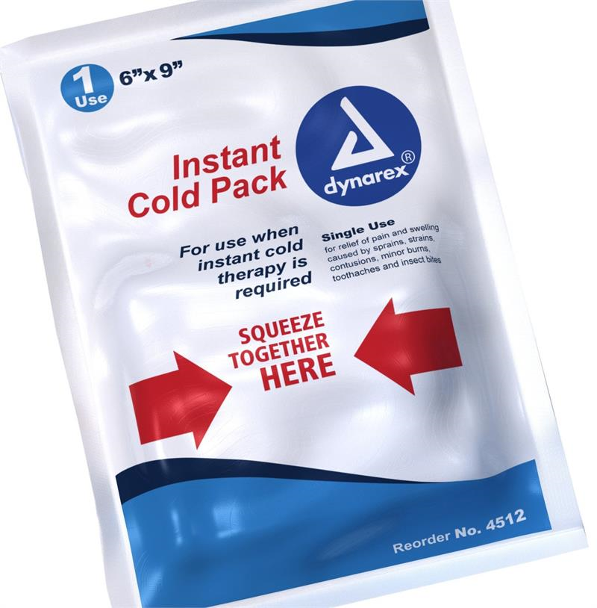
What can we use to help remember all 6 types of evidence when trying to decide if a chemical reaction has taken place?
City =Color Change
Girls = Gas Produced (bubbles)
Love = Light Produced
Their = Temperature Change
Phones = Precipitate forms
On = Odor Produced

Slide 7
Now it is your turn…. Make your own mnemonic device to help you remember the types of evidence of a chemical reaction
Honors
Create an anchor chart to illustrate a new mnemonic device for types of evidence
Must include all 6 types
Must include a picture for each
Must include color
Include analogy (Hot is to fire as cold is to Ice)
Must include Name/Period
Reg.
In groups of 2 people create an anchor chart to illustrate a new mnemonic device for types of evidence
Must include all 6 types
Must include a picture for each
Must include color
Must include Names/Period

Slide 8
DOL: Evidence of a Chemical Reaction
Name: ________________________________________ Teacher: _________ Per: __ Date: ___/__/____
Directions: Complete the table below based on information know about evidence of a chemical change.
# | Description | Physical / Chemical | Type of Evidence
1 | Chalk is added to vinegar, bubbles form
2 | Firecracker is let off, light forms
3 | 2 clear liquids are poured together, a yellow substance forms
4 | Paper is torn into 10 smaller pieces
5 | Tree trunk is chopped in half
6 | Ice pack is busted, it gets cold
7 | Rotten Egg is dropped, smell is let out
8 | Woman dies her hair, it turns purple
9 | Liquid water is frozen into ice
10 | Sugar is added to water for Kool-Aid

Slide 9
DOL: Evidence of a Chemical Reaction
Name: ________________________________________ Teacher: _________ Per: __ Date: ___/__/____
Directions: Complete the table below based on information know about evidence of a chemical change.
# | Description | Physical / Chemical | Type of Evidence
1 | Chalk is added to vinegar, bubbles form
2 | Firecracker is let off, light forms
3 | 2 clear liquids are poured together, a yellow substance forms
4 | Paper is torn into 10 smaller pieces
5 | Tree trunk is chopped in half
6 | Ice pack is busted, it gets cold
7 | Rotten Egg is dropped, smell is let out
8 | Woman dies her hair, it turns purple
9 | Liquid water is frozen into ice
10 | Sugar is added to water for Kool-Aid

