Slide 1
Muscular System Quiz

Slide 2
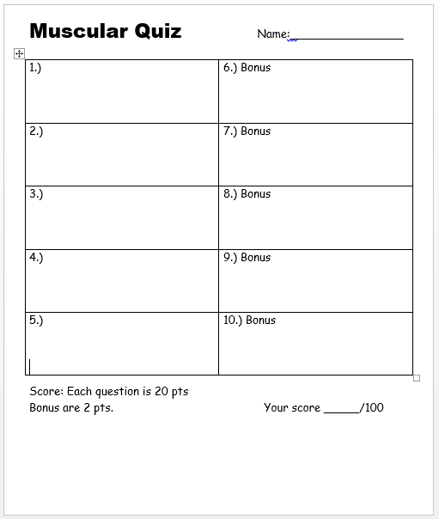

Slide 3
1-5 Quiz (20 points each)
With 5 bonus questions (2 points each)
Are you
weady?

Slide 4
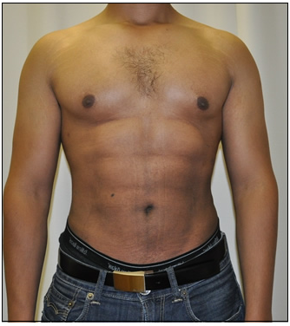
Please name these two muscles.
A
B

Slide 5
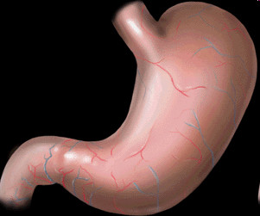
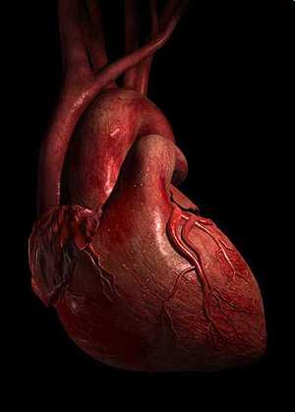
Name the 3 types of muscular tissue shown below?
A
C
B
A
B
C
Copyright © 2010 Ryan P. Murphy

Slide 6
Muscle fibers are long fibers that run parallel to each other and are held together by connective tissue. They contract and relax.
17
Copyright © 2010 Ryan P. Murphy

Slide 7
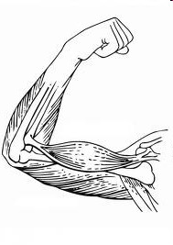
Please name the muscles described below?
18
A
B
Copyright © 2010 Ryan P. Murphy

Slide 8
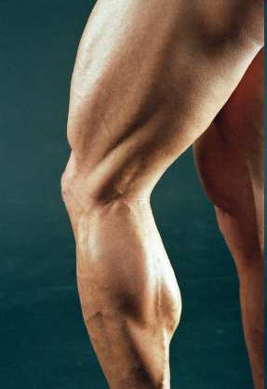
Please name the muscles labeled below?
A
A
B
C
B
C
Copyright © 2010 Ryan P. Murphy

Slide 9
The two muscles shown below are different because one is cardiac muscle, and one is skeletal muscle. How else are they different?
20
*6 (Bonus)
Copyright © 2010 Ryan P. Murphy

Slide 10
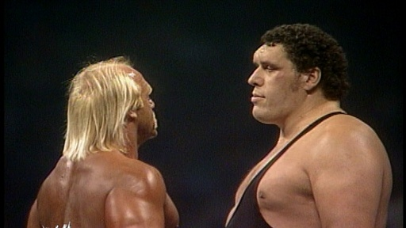
Name both of these professional wrestlers from the past?
*7
Copyright © 2010 Ryan P. Murphy

Slide 11
This is me before I became the governor.
You must spell my name correctly! Maybe…
*8
Copyright © 2010 Ryan P. Murphy

Slide 12
What are our last names?
*23
*9 (Bonus)
Copyright © 2010 Ryan P. Murphy

Slide 13
Who is this? What is he the master of?
*10

Slide 14
1-5 Quiz (20 points each)
With 5 bonus questions (2 points each)
Yo, here
ah the
answers?

Slide 15
Please name these two muscles.
A
B

Slide 16
Please name these two muscles.
Pectoralis
A
B

Slide 17
Please name these two muscles.
Pectoralis
A
B

Slide 18
Please name these two muscles.
Pectoralis
A
Abdominals
B

Slide 19
Name the 3 types of muscular tissue shown below?
A
C
C
B
Copyright © 2010 Ryan P. Murphy

Slide 20
Name the 3 types of muscular tissue shown below?
A Smooth
C
C
B
Copyright © 2010 Ryan P. Murphy

Slide 21
Name the 3 types of muscular tissue shown below?
A Smooth
C Skeletal
C
B
Copyright © 2010 Ryan P. Murphy

Slide 22
Name the 3 types of muscular tissue shown below?
A Smooth
C Skeletal
C
B Cardiac
Copyright © 2010 Ryan P. Murphy

Slide 23
Muscle fibers are long fibers that run parallel to each other and are held together by connective tissue. They contract and relax.
17
Copyright © 2010 Ryan P. Murphy

Slide 24
Muscle fibers are long fibers that run parallel to each other and are held together by connective tissue. They contract and relax.
17
Copyright © 2010 Ryan P. Murphy

Slide 25
Muscle fibers are long fibers that run parallel to each other and are held together by connective tissue. They contract and relax.
Contraction
17
Copyright © 2010 Ryan P. Murphy

Slide 26
Muscle fibers are long fibers that run parallel to each other and are held together by connective tissue. They contract and relax.
Contraction
17
Copyright © 2010 Ryan P. Murphy

Slide 27
Muscle fibers are long fibers that run parallel to each other and are held together by connective tissue. They contract and relax.
Relaxation
Contraction
17
Copyright © 2010 Ryan P. Murphy

Slide 28
Please name the muscles described below?
18
A
B
Copyright © 2010 Ryan P. Murphy

Slide 29
Please name the muscles described below?
18
A
B
Copyright © 2010 Ryan P. Murphy

Slide 30
Please name the muscles described below?
18
Biceps
A
B
Copyright © 2010 Ryan P. Murphy

Slide 31
Please name the muscles described below?
18
Biceps
A
B
Triceps
Copyright © 2010 Ryan P. Murphy

Slide 32
Please name the muscles labeled below?
A
A
B
C
B
C
Copyright © 2010 Ryan P. Murphy

Slide 33
Please name the muscles labeled below?
A
A
B
C
B
C
Copyright © 2010 Ryan P. Murphy

Slide 34
Please name the muscles labeled below?
A
A Quadriceps
B
C
B
C
Copyright © 2010 Ryan P. Murphy

Slide 35
Please name the muscles labeled below?
A
A Quadriceps
B
C
B
C
Copyright © 2010 Ryan P. Murphy

Slide 36
Please name the muscles labeled below?
A
A Quadriceps
B Hamstrings
C
B
C
Copyright © 2010 Ryan P. Murphy

Slide 37
Please name the muscles labeled below?
A
A Quadriceps
B Hamstrings
C
B
C
Copyright © 2010 Ryan P. Murphy

Slide 38
Please name the muscles labeled below?
A
A Quadriceps
B Hamstrings
C Calves
B
C
Copyright © 2010 Ryan P. Murphy

Slide 39
The two muscles shown below are different because one is cardiac muscle, and one is skeletal muscle. How else are they different?
20
*6 (Bonus)
Copyright © 2010 Ryan P. Murphy

Slide 40
The two muscles shown below are different because one is cardiac muscle, and one is skeletal muscle. How else are they different?
Voluntary Muscle
Involuntary Muscle
20
*6 (Bonus)
Copyright © 2010 Ryan P. Murphy

Slide 41
Name both of these professional wrestlers from the past?
*7
Copyright © 2010 Ryan P. Murphy

Slide 42
Name both of these professional wrestlers from the past?
*7
Copyright © 2010 Ryan P. Murphy

Slide 43
Name both of these professional wrestlers from the past?
Hulk Hogan
*7
Copyright © 2010 Ryan P. Murphy

Slide 44
Name both of these professional wrestlers from the past?
Hulk Hogan
*21
Copyright © 2010 Ryan P. Murphy

Slide 45
Name both of these professional wrestlers from the past?
Hulk Hogan
*7
Andre the Giant
Copyright © 2010 Ryan P. Murphy

Slide 46
This is me before I became the governor.
You must spell my name correctly! Maybe…
*8
Copyright © 2010 Ryan P. Murphy

Slide 47
This is me before I became the governor.
You must spell my name correctly! Maybe…
Arnold Schwarzenegger
*8
Copyright © 2010 Ryan P. Murphy

Slide 48
What are our last names?
*23
*9 (Bonus)
Copyright © 2010 Ryan P. Murphy

Slide 49
What are our last names? Ali
Laila Ali Muhammad Ali
*23
*9 (Bonus)
Copyright © 2010 Ryan P. Murphy

Slide 50
Who is this? What is he the master of?
*10

Slide 51
Who is this? What is he the master of?
*10

Slide 52
1-5 Quiz (20 points each)
With 5 bonus questions (2 points each)
Pass
em up?

Slide 53
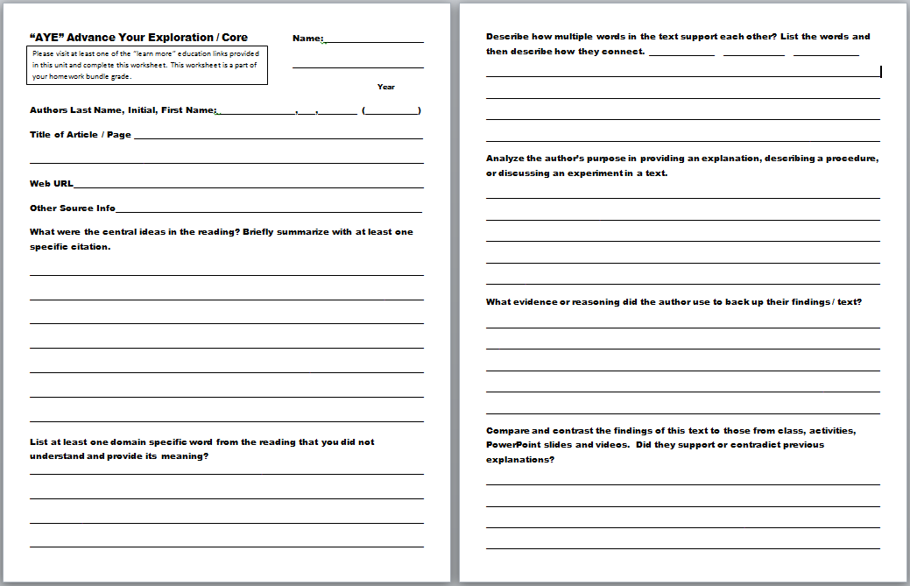
“AYE” Advance Your Exploration ELA and Literacy Opportunity Worksheet
Visit some of the many provided links or..
Articles can be found at (w/ membership to NABT and NSTA)
http://www.nabt.org/websites/institution/index.php?p=1
http://learningcenter.nsta.org/browse_journals.aspx?journal=tst
Please visit at least one of the “learn more” educational links provided in this unit and complete this worksheet.

Slide 54
“AYE” Advance Your Exploration ELA and Literacy Opportunity Worksheet
Visit some of the many provided links or..
Articles can be found at (w/ membership to NABT and NSTA)
http://www.nabt.org/websites/institution/index.php?p=1
http://learningcenter.nsta.org/browse_journals.aspx?journal=tst

Slide 55
In order of appearance. Note: In text citations not present in slideshow. Part I
Part I (Levels of Biological Organization)
. (n.d.). Nature.com. Retrieved July 3, 2014, from http://www.nature.com/scitable/topicpage/biological-complexity-and-integrative-levels-of-organization-468
. (n.d.). . Retrieved July 3, 2014, from https://bayo2pisay.files.wordpress.com/2012/06/handout-levels-of-biological-organization.pdf
. (n.d.). . Retrieved July 3, 2014, from https://www.google.com/search?q=form+follows+function&ie=utf-8&oe=utf-8&aq=t&rls=org.mozilla:en-US:official&client=firefox-a&channel=np&source=hp#channel=np&q=form+follows+function+biology&rls=org.mozilla:en-US:official
Organization of the Human Body. (n.d.). ( Read ). Retrieved July 3, 2014, from http://www.ck12.org/biology/Organization-of-the-Human-Body/lesson/user:bWpvbmVzMzk4QHRhbXBhYmF5LnJyLmNvbQ../Organization-of-the-Human-Body/
Plant Cell vs. Animal Cell. (n.d.). Plant Cell vs Animal Cell. Retrieved July 3, 2014, from http://www.diffen.com/difference/Animal_Cell_vs_Plant_Cell
Culture Collections. (n.d.). Culture Collections. Retrieved July 3, 2014, from http://www.phe-culturecollections.org.uk/products/celllines/primarycells/humanprimarycellsbycelltype.aspx
. (n.d.). . Retrieved July 3, 2014, from http://faculty.clintoncc.suny.edu/faculty/michael.gregory/files/bio%20102/bio%20102%20lectures/Animal%20cells%20and%20tissues/Animal%20Tissues.htm

Slide 56
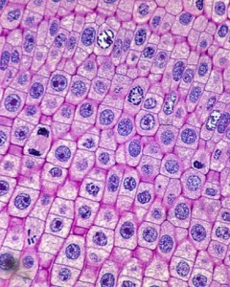
In order of appearance. Note: In text citations not present in slideshow. Part I
Part I (Levels of Biological Organization) Continued.
. (n.d.). . Retrieved July 3, 2014, from http://faculty.clintoncc.suny.edu/faculty/michael.gregory/files/bio%20102/bio%20102%20lectures/Animal%20cells%20and%20tissues/Animal%20Tissues.htm
Basic Tissue Types. (n.d.). SIU SOM Histology INTRO. Retrieved July 3, 2014, from http://www.siumed.edu/~dking2/intro/4basic.htm
Campbell, D., & Davison, N. (2012, May 28). Illegal kidney trade booms as new organ is 'sold every hour'. The Guardian. Retrieved July 3, 2014, from http://www.theguardian.com/world/2012/may/27/kidney-trade-illegal-operations-who
5 Common Examples of Homeostasis in the Human Body. (n.d.). Bright Hub. Retrieved July 3, 2014, from http://www.brighthub.com/science/medical/articles/112024.asp

Slide 57
Part II (Skeletal System)
Skeletal System. (n.d.). InnerBody. Retrieved July 3, 2014, from http://www.innerbody.com/image/skelfov.html
SKELETONS INSIDE AND OUT. (n.d.). Biology4Kids.com: Animal Systems: Skeletal System. Retrieved July 3, 2014, from http://www.biology4kids.com/files/systems_skeletal.html
Skeletal System: Anatomy and Physiology | Skeleton Anatomy | Quizzes. (n.d.). Skeletal System: Anatomy and Physiology | Skeleton Anatomy | Quizzes. Retrieved July 3, 2014, from http://www.getbodysmart.com/ap/skeletalsystem/skeleton/menu/menu.html
. (n.d.). . Retrieved July 3, 2014, from http://orthoinfo.aaos.org/topic.cfm?topic=a00425
Block, M. (n.d.). Sidelined By Brain Injury, Ex-NFL Player Copes With 'Desperation'. NPR. Retrieved July 3, 2014, from http://www.npr.org/2014/01/31/269422083/sidelined-by-brain-injury-ex-nfl-player-copes-with-desperation
. (n.d.). NPR. Retrieved July 3, 2014, from http://www.npr.org/player/v2/mediaPlayer.html?action=1&t=1&islist=false&id=269422083&m=269529730
. (n.d.). . Retrieved July 3, 2014, from http://www.nytimes.com/health/guides/disease/osteoporosis/
The Virtual Body. (n.d.). - MEDtropolis. Retrieved July 3, 2014, from http://medtropolis.com/virtual-body/
Skeleton Halloween Craft - Enchanted Learning Software. (n.d.). Skeleton Halloween Craft - Enchanted Learning Software. Retrieved July 3, 2014, from http://www.enchantedlearning.com/crafts/halloween/bones

Slide 58
Part II (Skeletal System) Continued
Skeletal System. (n.d.). InnerBody. Retrieved July 3, 2014, from Human Body Systems | Human Organ Systems. (n.d.). Human Body Systems | Human Organ Systems. Retrieved July 3, 2014, from http://www.getbodysmart.com/ap2/systems/tutorial.html
Rest, Ice, Compression, and Elevation (RICE)-Topic Overview. (n.d.). WebMD. Retrieved July 3, 2014, from http://www.webmd.com/first-aid/tc/rest-ice-compression-and-elevation-rice-topic-overview

Slide 59
Part III (Muscular System)
Muscular System. (n.d.). InnerBody. Retrieved July 4, 2014, from http://www.innerbody.com/image/musfov.html
Muscular. (n.d.). System Anatomy, Diagram & Function. Retrieved July 4, 2014, from http://www.healthline.com/human-body-maps/muscular-system
MUSCULAR SYSTEM - MEAT ON THE BONES. (n.d.). Biology4Kids.com: Animal Systems: Muscular System. Retrieved July 4, 2014, from http://www.biology4kids.com/files/systems_muscular.html
Muscular System. (n.d.). bozemanscience. Retrieved July 4, 2014, from http://www.bozemanscience.com/muscular-system/
Muscle tissues. (n.d.). Muscle tissue. Retrieved July 4, 2014, from http://www.botany.uwc.ac.za/sci_ed/grade10/mammal/muscle.htm
Skeletal Muscle Fibers | Muscle Fibers | Anatomy | Location. (n.d.). Skeletal Muscle Fibers | Muscle Fibers | Anatomy | Location. Retrieved July 4, 2014, from http://www.getbodysmart.com/ap/muscletissue/fibers/menu/menu.html
Anatomy Tutorial. (n.d.). Anatomy Tutorial. Retrieved July 4, 2014, from http://www.gwc.maricopa.edu/class/bio201/muscle/mustut.htm
Muscular System. (n.d.). InnerBody. Retrieved July 4, 2014, from http://www.innerbody.com/image/musfov.html
. (n.d.). BBC News. Retrieved July 4, 2014, from http://www.bbc.co.uk/science/humanbody/body/index_interactivebody.shtml

Slide 60
Part IV (Nutrients of Life)
. (n.d.). . Retrieved July 4, 2014, from http://www.mrgraba.net/uploads/8/2/6/3/8263952/bio3amoleculeslab.pdf
CHNOPS: Six Ingredients of Life | RCScience. (n.d.). CHNOPS: Six Ingredients of Life. Retrieved July 4, 2014, from http://www.realclearscience.com/2011/02/03/chnops_six_ingredients_of_life_239629.html
Types of Fats-Topic Overview. (0000, August 30). WebMD. Retrieved July 4, 2014, from http://www.webmd.com/food-recipes/tc/types-of-fats-topic-overview
Chemistry Tutorial. (n.d.). Chemistry Tutorial. Retrieved July 4, 2014, from http://www.biology.arizona.edu/biochemistry/tutorials/chemistry/page1.html
Carbohydrates. (2012, December 11). Centers for Disease Control and Prevention. Retrieved July 4, 2014, from http://www.cdc.gov/nutrition/everyone/basics/carbs.html
Role of proteins in the body. (n.d.). Science Learning Hub RSS. Retrieved July 4, 2014, from http://www.sciencelearn.org.nz/Contexts/Uniquely-Me/Science-Ideas-and-Concepts/Role-of-proteins-in-the-body
Fitness. (n.d.). Performance-enhancing drugs: Know the risks. Retrieved July 4, 2014, from http://www.mayoclinic.org/healthy-living/fitness/in-depth/performance-enhancing-drugs/art-20046134
U.S. Food and Drug Administration. (n.d.). How to Understand and Use the Nutrition Facts Label. Retrieved July 4, 2014, from http://www.fda.gov/food/ingredientspackaginglabeling/labelingnutrition/ucm274593.htm
Many Forms of Lipids. (n.d.). Chem4Kids.com: Biochemistry: Lipids. Retrieved July 4, 2014, from http://www.chem4kids.com/files/bio_lipids.html

Slide 61
Part IV (Nutrients of Life) Continued
Role of proteins in the body. (n.d.). Science Learning Hub RSS. Retrieved July 4, 2014, from http://www.sciencelearn.org.nz/Contexts/Uniquely-Me/Science-Ideas-and-Concepts/Role-of-proteins-in-the-body
DrugFacts: Anabolic Steroids. (n.d.). National Institute on Drug Abuse (NIDA). Retrieved July 4, 2014, from http://www.drugabuse.gov/publications/drugfacts/anabolic-steroids
Trans Fats. (n.d.). Trans Fats. Retrieved July 4, 2014, from http://www.heart.org/HEARTORG/GettingHealthy/FatsAndOils/Fats101/Trans-Fats_UCM_301120_Article.jsp
Green, J., & Shah, D. (2013, April 24). DNA: the 'smartest' molecule in existence?. BBC News. Retrieved July 4, 2014, from http://www.bbc.co.uk/science/0/22199991
Protein. (n.d.). Iowa State University Extension and Outreach. Retrieved July 4, 2014, from http://www.extension.iastate.edu/humansciences/protein

Slide 62
Part V (Healthy Living)
Choose a Food Group. (n.d.). Food Groups. Retrieved July 4, 2014, from http://www.choosemyplate.gov/food-groups/
Tips for Eating Healthy When Eating out. (n.d.). Tips for Eating Healthy when Eating out. Retrieved July 4, 2014, from http://www.choosemyplate.gov/healthy-eating-tips/tips-for-eating-out.html
. (2014, May 22). Centers for Disease Control and Prevention. Retrieved July 4, 2014, from http://www.cdc.gov/obesity/
. (n.d.). . Retrieved July 4, 2014, from http://www.stonybrook.edu/heartlinks/fastfooddangers.pdf
Statistics of Health Risks From Eating Fast Food | Healthy .... (n.d.). . Retrieved July 4, 2014, from http://healthyeating.sfgate.com/statistics-health-risks-eating-fast-food-3290.html
Parker, b. (2010, March 22). A sweet problem: Princeton researchers find that high-fructose corn syrup prompts considerably more weight gain. Princeton University. Retrieved July 4, 2014, from http://www.princeton.edu/main/news/archive/S26/91/22K07/
. (n.d.). . Retrieved July 4, 2014, from http://sweetsurprise.com/
The Importance of Calcium. (n.d.). Healthy Life Journal RSS. Retrieved July 4, 2014, from http://healthylifejournal.org/healthy-living/the-importance-of-calcium/
Why Hydrogenated Oils Should be Avoided at All Costs. (n.d.). NaturalNews. Retrieved July 4, 2014, from http://www.naturalnews.com/024694_oil_food_oils.html
Nutrition and healthy eating. (n.d.). Monosodium glutamate (MSG): Is it harmful?. Retrieved July 4, 2014, from http://www.mayoclinic.org/healthy-living/nutrition-and-healthy-eating/expert-answers/monosodium-glutamate/faq-20058196
#.UdxCJG3fMmY

Slide 63
Part V (Healthy Living) Continued
Phillips, B., & health, t. (n.d.). Top 9 Scary Food Additives. ABC News. Retrieved July 4, 2014, from http://abcnews.go.com/Health/top-11-scary-food-additives/story?id=18479268#.UdxCJG3fMmY
BMR Calorie Calculator. (n.d.). Calorie Calculator. Retrieved July 4, 2014, from http://www.my-calorie-counter.com/Calorie_Calculator.asp
Heart and Cardiovascular Diseases. (n.d.). WebMD. Retrieved July 4, 2014, from http://www.webmd.com/heart-disease/guide/diseases-cardiovascular
Preventing Obesity in Children, Causes of Child Obesity, and More. (n.d.). WebMD. Retrieved July 4, 2014, from http://www.webmd.com/children/guide/obesity-children
Dowshen, S. (2012, April 1). Type 2 Diabetes: What Is It?. KidsHealth - the Web's most visited site about children's health. Retrieved July 4, 2014, from http://kidshealth.org/parent/medical/endocrine/type2.html
Anorexia Nervosa. (n.d.). : Signs, Symptoms, Causes, And Treatment. Retrieved July 4, 2014, from http://www.helpguide.org/mental/anorexia_signs_symptoms_causes_treatment.htm
Anorexia nervosa. (n.d.). Definition. Retrieved July 4, 2014, from http://www.mayoclinic.org/diseases-conditions/anorexia/basics/definition/con-20033002

Slide 64
Part VI (Digestive System)
Digestive System. (n.d.). InnerBody. Retrieved July 4, 2014, from http://www.innerbody.com/image/digeov.html
National Digestive Diseases Information Clearinghouse (NDDIC). (n.d.). - National Digestive Diseases Information ClearinghouseYour Digestive System and How It Works. Retrieved July 4, 2014, from http://digestive.niddk.nih.gov/ddiseases/pubs/yrdd/
Digestive System. (n.d.). Digestive System. Retrieved July 4, 2014, from http://www.ama-assn.org/ama/pub/physician-resources/patient-education-materials/atlas-of-human-body/digestive-system.page?
. (n.d.). . Retrieved July 4, 2014, from http://www.biology4kids.com/files/systems_digestive.html
Saliva and Your Mouth: Function of Saliva in Oral Health. (n.d.). WebMD. Retrieved July 4, 2014, from http://www.webmd.com/oral-health/what-is-saliva
. (n.d.). . Retrieved July 4, 2014, from https://www.smartlivingnetwork.com/digestive/b/mechanical-and-chemical-digestion/
Understand These Three Important Phases of Swallowing. (n.d.). About.com Stroke. Retrieved July 4, 2014, from http://stroke.about.com/od/caregiverresources/qt/swallowphases.htm
The Virtual Body. (n.d.). - MEDtropolis. Retrieved July 4, 2014, from http://medtropolis.com/virtual-body/
Digestion and Human Nutrition. (n.d.). Digestion and Human Nutrition. Retrieved July 4, 2014, from http://www.guam.net/pub/sshs/depart/science/mancuso/apbiolecture/32_DigestionNut/DigestionNutrition.htm

Slide 65
Part VII (Circulatory and Lymphatic Systems)
Durani, Y. (2013, January 1). Heart and Circulatory System. KidsHealth - the Web's most visited site about children's health. Retrieved July 4, 2014, from http://kidshealth.org/parent/general/body_basics/heart.html
Cardiovascular System. (n.d.). InnerBody. Retrieved July 5, 2014, from http://www.innerbody.com/image/cardov.html
Heart. (n.d.). InnerBody. Retrieved July 5, 2014, from http://www.innerbody.com/image/card01.html
The Virtual Body. (n.d.). - MEDtropolis. Retrieved July 5, 2014, from http://medtropolis.com/virtual-body/
Label the heart. (n.d.). Science Learning Hub RSS. Retrieved July 5, 2014, from http://www.sciencelearn.org.nz/Contexts/See-through-Body/Sci-Media/Animation/Label-the-heart
Heart dissection. (n.d.). Heart dissection. Retrieved July 5, 2014, from http://www.biologyjunction.com/heart_dissection.htm
Dean, L. (0000, May 18). . Blood and the cells it contains. Retrieved July 5, 2014, from http://www.ncbi.nlm.nih.gov/books/NBK2263/
American Society of Hematology. (n.d.). Blood Basics. Retrieved July 5, 2014, from http://www.hematology.org/Patients/Basics/
Blood Types. (n.d.). American Red Cross. Retrieved July 5, 2014, from http://www.redcrossblood.org/learn-about-blood/blood-types
Edelson, M. (2014, June 1). Blood Types. KidsHealth - the Web's most visited site about children's health. Retrieved July 5, 2014, from http://kidshealth.org/teen/your_body/medical_care/blood_types.html
Immune and Lymphatic Systems. (n.d.). InnerBody. Retrieved July 5, 2014, from http://www.innerbody.com/image/lympov.html

Slide 66
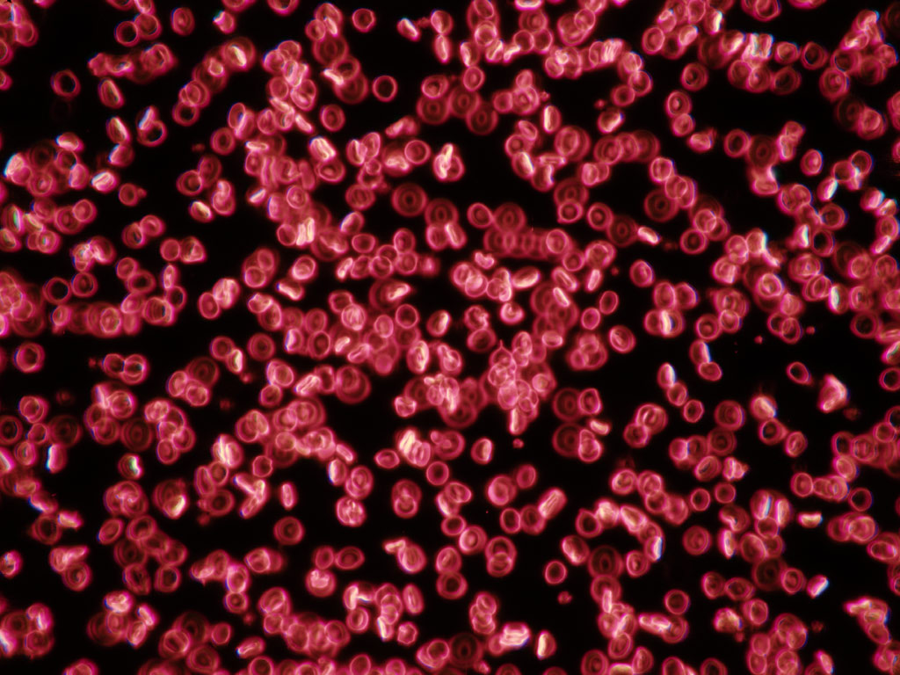
Part VII (Circulatory and Lymphatic Systems) Continued
Edelson, M. (2014, June 1). Blood Types. KidsHealth - the Web's most visited site about children's health. Retrieved July 5, 2014, from http://kidshealth.org/teen/your_body/medical_care/blood_types.html
Immune and Lymphatic Systems. (n.d.). InnerBody. Retrieved July 5, 2014, from http://www.innerbody.com/image/lympov.html
Lymph system: MedlinePlus Medical Encyclopedia. (n.d.). U.S National Library of Medicine. Retrieved July 5, 2014, from http://www.nlm.nih.gov/medlineplus/ency/article/002247.htm
Durani, Y. (2012, October 1). Spleen and Lymphatic System. KidsHealth - the Web's most visited site about children's health. Retrieved July 5, 2014, from http://kidshealth.org/teen/your_body/body_basics/spleen.html

Slide 67
Part VIII (Respiratory System, Anti-tobacco)
Respiratory System. (n.d.). InnerBody. Retrieved July 5, 2014, from http://www.innerbody.com/anatomy/respiratory
The Respiratory System. (n.d.). - NHLBI, NIH. Retrieved July 5, 2014, from http://www.nhlbi.nih.gov/health/health-topics/topics/hlw/system.html
Human Respiratory System and Lungs; How They Work. (n.d.). WebMD. Retrieved July 5, 2014, from http://www.webmd.com/lung/how-we-breathe
Durani, Y. (2012, October 1). Lungs and Respiratory System. KidsHealth - the Web's most visited site about children's health. Retrieved July 5, 2014, from http://kidshealth.org/parent/general/body_basics/lungs.html
Cell Respiration: Introduction. (n.d.). Cell Respiration: Introduction. Retrieved July 5, 2014, from http://www.phschool.com/science/biology_place/biocoach/cellresp/intro.html
Respiratory System - Anatomy & Physiology | Quizzes & Tutorials. (n.d.). Respiratory System - Anatomy & Physiology | Quizzes & Tutorials. Retrieved July 5, 2014, from http://www.getbodysmart.com/ap/respiratorysystem/menu/menu.html
. (n.d.). BBC News. Retrieved July 5, 2014, from http://www.bbc.co.uk/schools/gcsebitesize/science/add_ocr_gateway/living_growing/respirationact.shtml
Cellular Respiration. (n.d.). Cellular Respiration. Retrieved July 5, 2014, from http://users.rcn.com/jkimball.ma.ultranet/BiologyPages/C/CellularRespiration.html
pulmonary alveolus: alveoli and capillaries in the lungs. (n.d.). Encyclopedia Britannica Online. Retrieved July 5, 2014, from http://www.britannica.com/EBchecked/media/107200/The-alveoli-and-capillaries-in-the-lungs-exchange-oxygen-for

Slide 68
Part VIII (Respiratory System, Anti-tobacco) Continued
What Is Asthma?. (n.d.). - NHLBI, NIH. Retrieved July 5, 2014, from http://www.nhlbi.nih.gov/health/health-topics/topics/asthma/
http://www.medicalnewstoday.com/articles/181573.php
Respiratory System - myVMC. (n.d.). myVMC. Retrieved July 5, 2014, from http://www.myvmc.com/anatomy/respiratory-system/
Body Surface Area. (n.d.). Body Surface Area. Retrieved July 5, 2014, from http://www-users.med.cornell.edu/~spon/picu/calc/bsacalc.htm
. (n.d.). Medical News Today. Retrieved July 5, 2014, from http://www.medicalnewstoday.com/info/cancer-oncology/
Skin Cancer Foundation. (n.d.). The. Retrieved July 5, 2014, from http://www.skincancer.org
The Dangers of Teens and Tanning Beds. (n.d.). The Dangers of Teens and Tanning Beds. Retrieved July 5, 2014, from http://www.healthgrades.com/procedures/the-dangers-of-teens-and-tanning-beds
Skin Cancer / Melanoma Center: Signs, Treatments, Symptoms, Types, Causes, and Tests. (n.d.). WebMD. Retrieved July 5, 2014, from http://www.webmd.com/melanoma-skin-cancer/
ABCDE rule for skin cancer. (n.d.). ABCDE rule for skin cancer. Retrieved July 5, 2014, from http://www.sun-protection-and-products-guide.com/ABCDE-rule-for-skin-cancer.html
Screening Moles for Skin Cancer. (n.d.). WebMD. Retrieved July 5, 2014, from http://www.webmd.com/skin-problems-and-treatments/screening-moles-cancer

Slide 69
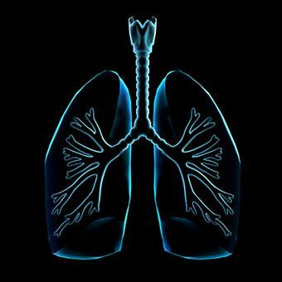
Part VIII (Respiratory System, Anti-tobacco) Continued 2
Smoking: Do you really know the risks?. (n.d.). Smoking: Do you really know the risks?. Retrieved July 5, 2014, from http://www.heart.org/HEARTORG/GettingHealthy/QuitSmoking/QuittingSmoking/Smoking-Do-you-really-know-the-risks_UCM_322718_Article.jsp
Health Effects of Cigarette Smoking. (2014, February 6). Centers for Disease Control and Prevention. Retrieved July 5, 2014, from http://www.cdc.gov/tobacco/data_statistics/fact_sheets/health_effects/effects_cig_smoking/
Top 10 Simple Lifestlye Changes to Help Prevent Cancer. (n.d.). About.com Cancer. Retrieved July 5, 2014, from http://cancer.about.com/od/causes/tp/topreventcancer.htm
Proctor, R. (2006, November 30). Puffing On Polonium. The New York Times. Retrieved July 5, 2014, from http://www.nytimes.com/2006/12/01/opinion/01proctor.html?_r=1&
Cigarette Ingredients - Chemicals in Cigarettes. (n.d.). Cigarette Ingredients - Chemicals in Cigarettes. Retrieved July 5, 2014, from http://www.tricountycessation.org/tobaccofacts/Cigarette-Ingredients.html
DrugFacts: Marijuana. (n.d.). National Institute on Drug Abuse (NIDA). Retrieved July 5, 2014, from http://www.drugabuse.gov/publications/drugfacts/marijuana
What Those Funny Old Smoking Ads Really Show. (n.d.). Smoking Ads. Retrieved July 5, 2014, from http://www.health.com/health/gallery/0,,20307049,00.html

Slide 70
Part IX Excretory System and Integumentary System
Excretory system. (n.d.). Princeton University. Retrieved July 5, 2014, from https://www.princeton.edu/~achaney/tmve/wiki100k/docs/Excretory_system.html
The Kidneys (Human Anatomy): Picture, Function, Definition, and Conditions. (n.d.). WebMD. Retrieved July 5, 2014, from http://www.webmd.com/urinary-incontinence-oab/picture-of-the-kidneys
New Health Guide. (n.d.). Excretory System Organs. Retrieved July 5, 2014, from http://www.newhealthguide.org/Excretory-System-Organs.html
Feature, S. (n.d.). Urine Color, Odor, and Your Health. WebMD. Retrieved July 5, 2014, from http://www.webmd.com/urinary-incontinence-oab/features/the-truth-about-urine
National Kidney and Urologic DiseasesInformation Clearinghouse (NKUDIC). (n.d.). The Urinary Tract and How It Works Page. Retrieved July 5, 2014, from http://kidney.niddk.nih.gov/kudiseases/pubs/yoururinary/
Cirrhosis of the Liver: Cirrhosis Signs and Stages. (n.d.). MedicineNet. Retrieved July 5, 2014, from http://www.medicinenet.com/cirrhosis/article.htm
Michel, J. (2011, March 1). Dandruff. KidsHealth - the Web's most visited site about children's health. Retrieved July 5, 2014, from http://kidshealth.org/teen/your_body/skin_stuff/dandruff.html
Integumentary System. (n.d.). InnerBody. Retrieved July 5, 2014, from http://www.innerbody.com/anatomy/integumentary
Skin (Integumentary) System Information. (n.d.). Skin (Integumentary) System Information. Retrieved July 5, 2014, from http://www.pennmedicine.org/health_info/body_guide/reftext/html/skin_sys_fin.html

Slide 71
Part X The Nervous System
Nervous System. (n.d.). InnerBody. Retrieved July 5, 2014, from http://www.innerbody.com/image/nervov.html
Durani, Y. (2012, October 1). Brain and Nervous System. KidsHealth - the Web's most visited site about children's health. Retrieved July 5, 2014, from http://kidshealth.org/parent/general/body_basics/brain_nervous_system.html
NERVOUS SYSTEM - I'M SENSING SOMETHING. (n.d.). Biology4Kids.com: Animal Systems: Nervous System. Retrieved July 5, 2014, from http://www.biology4kids.com/files/systems_nervous.html
Nervous System Information. (n.d.). Nervous System Information. Retrieved July 5, 2014, from http://www.pennmedicine.org/health_info/body_guide/reftext/html/nerv_sys_fin.htm
Neuroscience For Kids. (n.d.). - cells of the nervous system. Retrieved July 5, 2014, from https://faculty.washington.edu/chudler/cells.html
Neurobiology. (n.d.). Life Sciences Outreach at Harvard University: Animations. Retrieved July 5, 2014, from http://outreach.mcb.harvard.edu/animations_S05.htm
Neurons & Synapses - Memory & the Brain - The Human Memory. (n.d.). Neurons & Synapses - Memory & the Brain - The Human Memory. Retrieved July 5, 2014, from http://www.human-memory.net/brain_neurons.html
Hemispheric Dominance Inventory Test. (n.d.). Hemispheric Dominance Test determine if your left or right brain hemisphere is dominant. Retrieved July 5, 2014, from http://www.web-us.com/brain/braindominance.htm
Right Brain/ Left Brain Quiz. (n.d.). Right Brain/ Left Brain Quiz. Retrieved July 5, 2014, from http://www.intelliscript.net/test_area/questionnaire/questionnaire.cgi

Slide 72
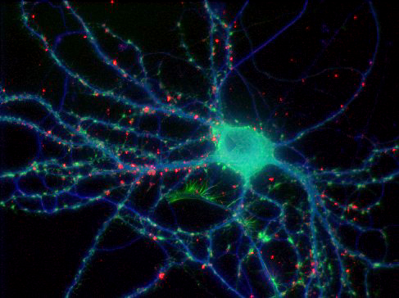
Part X The Nervous System Continued
What is a Spinal Cord Injury?. (n.d.). What is a Spinal Cord Injury. Retrieved July 5, 2014, from http://www.apparelyzed.com/spinal_cord_injury.html
Anatomy Of The Eye. (n.d.). Anatomy of the Eye. Learn about the different parts of the eye.. Retrieved July 5, 2014, from http://www.lensshopper.com/eye-anatomy.asp
Anatomy, Physiology & Pathology of the Human Eye. (n.d.). Anatomy, Physiology & Pathology of the Human Eye. Retrieved July 5, 2014, from http://www.tedmontgomery.com/the_eye/
Concentration Memory Game. (n.d.). Concentration Memory Game. Retrieved July 5, 2014, from http://www.mathsisfun.com/games/memory/index.html
The Sense of Smell. (n.d.). The Sense of Smell. Retrieved July 5, 2014, from http://www.wisc-online.com/Objects/ViewObject.aspx?ID=AP14004
Dangers & Effects - Inhalant Abuse Prevention. (n.d.). Inhalant Abuse Prevention. Retrieved July 5, 2014, from http://www.inhalant.org/parents/dangers-effects/
How the ear works. (n.d.). The Ear, The Human Ear, How Do We Hear, How Does The Ear Work, About Your Ear. Retrieved July 5, 2014, from http://www.hearinglink.org/howwehear
. (n.d.). NPR. Retrieved July 5, 2014, from http://www.npr.org/player/v2/mediaPlayer.html?action=1&t=1&islist=false&id=124119468&m=124188677

Slide 73
Part XI The Endocrine System
Endocrine System. (n.d.). InnerBody. Retrieved July 5, 2014, from http://www.innerbody.com/image/endoov.html
Dowshen, S. (2012, March 1). Endocrine System. KidsHealth - the Web's most visited site about children's health. Retrieved July 5, 2014, from http://kidshealth.org/teen/your_body/body_basics/endocrine.html
Endocrine System. (n.d.). Endocrine System. Retrieved July 5, 2014, from http://www.ama-assn.org/ama/pub/physician-resources/patient-education-materials/atlas-of-human-body/endocrine-system.page?
. (n.d.). Medical News Today. Retrieved July 5, 2014, from http://www.medicalnewstoday.com/info/addiction/
Vranken, M. (2011, January 1). Dealing With Addiction. KidsHealth - the Web's most visited site about children's health. Retrieved July 5, 2014, from http://kidshealth.org/teen/your_mind/problems/addictions.html
Dowshen, S. (2012, April 1). Type 1 Diabetes: What Is It?. KidsHealth - the Web's most visited site about children's health. Retrieved July 5, 2014, from http://kidshealth.org/kid/diabetes_basics/what/type1.html
. (n.d.). PBS. Retrieved July 5, 2014, from http://www.pbs.org/wgbh/pages/frontline/meth/body/
Using Meth: Health Risks. (n.d.). Using Meth: Health Risks. Retrieved July 5, 2014, from http://www.bouldercounty.org/family/addiction/pages/methuse.aspx
Dowshen, S. (2012, October 1). All About Puberty. KidsHealth - the Web's most visited site about children's health. Retrieved July 5, 2014, from http://kidshealth.org/kid/grow/body_stuff/puberty.html

Slide 74
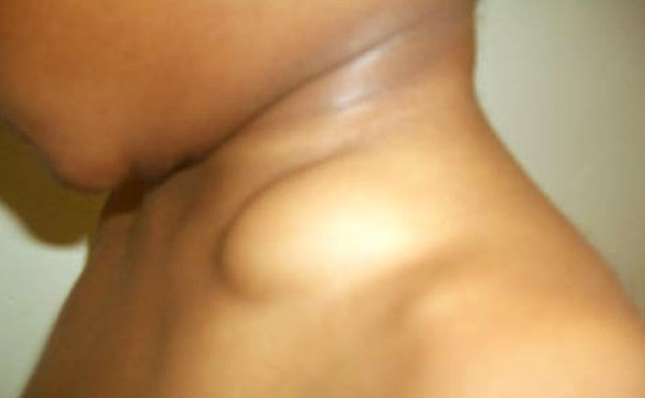
Part XI The Endocrine System (continued)
Dowshen, S. (2012, October 1). Everything You Wanted to Know About Puberty. KidsHealth - the Web's most visited site about children's health. Retrieved July 5, 2014, from http://kidshealth.org/teen/sexual_health/changing_body/puberty.html
Home | Puberty101.com – Boys Puberty, Girls Puberty, Teenage Development, Mental Health, STDs, Drug Abuse. (n.d.). Puberty 101 RSS. Retrieved July 5, 2014, from http://puberty101.com/
Hormones: MedlinePlus. (n.d.). U.S National Library of Medicine. Retrieved July 5, 2014, from http://www.nlm.nih.gov/medlineplus/hormones.htm
Endocrine Glands and Types of Hormones. (n.d.). Home. Retrieved July 5, 2014, from http://www.hormone.org/hormones-and-health/the-endocrine-system/endocrine-glands-and-types-of-hormones

Slide 75
Part XII The Reproductive System
Female Reproductive System. (n.d.). InnerBody. Retrieved July 5, 2014, from http://www.innerbody.com/image/repfov.html
Durani, Y. (2013, March 1). Female Reproductive System. KidsHealth - the Web's most visited site about children's health. Retrieved July 5, 2014, from http://kidshealth.org/parent/general/body_basics/female_reproductive_system.html
Female Reproductive System: Organs, Function, and More. (n.d.). WebMD. Retrieved July 5, 2014, from http://www.webmd.com/sex-relationships/guide/your-guide-female-reproductive-system
Reproductive Organs. (n.d.). Male Anatomy & Functions. Retrieved July 5, 2014, from http://www.healthline.com/human-body-maps/male-reproductive-organ
Female Reproductive System. (n.d.). Female Reproductive System. Retrieved July 5, 2014, from http://www.ama-assn.org/ama/pub/physician-resources/patient-education-materials/atlas-of-human-body/female-reproductive-system.page?
Animation: How Meiosis Works. (n.d.). Animation: How Meiosis Works. Retrieved July 5, 2014, from http://highered.mheducation.com/sites/0072495855/student_view0/chapter28/animation__how_meiosis_works.html
The Male Reproductive System: Organs, Function, and More. (n.d.). WebMD. Retrieved July 5, 2014, from http://www.webmd.com/sex-relationships/guide/male-reproductive-system
(n.d.). womenshealth.gov. Retrieved July 5, 2014, from http://womenshealth.gov/publications/our-publications/fact-sheet/menstruation.cf

Slide 76
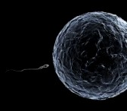
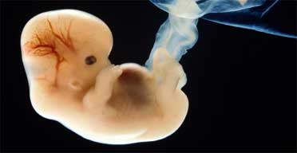
Part XII The Reproductive System (continued)
What your baby looks like this week. (n.d.). BabyCenter. Retrieved July 5, 2014, from http://www.babycenter.com/fetal-development-week-by-week
. (n.d.). Centers for Disease Control and Prevention. Retrieved July 5, 2014, from http://www.cdc.gov/reproductivehealth/TobaccoUsePregnancy/
Rochman, B., & Rochman, B. (n.d.). A New Study Details the Effects of Smoking in Pregnancy | TIME.com. Time. Retrieved July 5, 2014, from http://healthland.time.com/2011/07/12/why-its-bad-to-smoke-while-pregnant/
A Guide for First-Time Parents. (2014, January 1). KidsHealth - the Web's most visited site about children's health. Retrieved July 5, 2014, from http://kidshealth.org/parent/pregnancy_center/newborn_care/guide_parents.html
How To Take Care of a Newborn Baby. (n.d.). - BabyMed. Retrieved July 5, 2014, from http://www.babymed.com/how-to/how-to-take-care-of-a-baby-and-newborn
Feeding & Care Basics. (n.d.). BabyCenter. Retrieved July 5, 2014, from http://www.babycenter.com/newborn-baby-feeding-care-basics

Slide 77
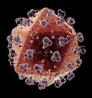
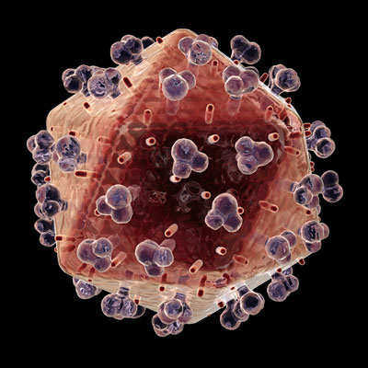
Part XIII The Immune System
Durani, Y. (2012, October 1). Immune System. KidsHealth - the Web's most visited site about children's health. Retrieved July 5, 2014, from http://kidshealth.org/parent/general/body_basics/immune.html
Immune System. (n.d.). Immune System. Retrieved July 5, 2014, from http://uhaweb.hartford.edu/bugl/immune.htm
The Immune System -- An Overview. (n.d.). TheBody.com. Retrieved July 5, 2014, from http://www.thebody.com/content/art1788.html
The Immune System. (n.d.). National Cancer Institute. Retrieved July 5, 2014, from http://www.cancer.gov/cancertopics/understandingcancer/immunesystem/AllPages
. (2014, June 25). Centers for Disease Control and Prevention. Retrieved July 5, 2014, from http://www.cdc.gov/parasites/
HIV/AIDS Basics. (n.d.). HIV/AIDS Basics. Retrieved July 5, 2014, from http://www.aids.gov/hiv-aids-basics/
AIDS and HIV Health Center - WebMD. (n.d.). WebMD. Retrieved July 5, 2014, from http://www.webmd.com/hiv-aids/
What are Vaccines?. (n.d.). News-Medical.net. Retrieved July 5, 2014, from http://www.news-medical.net/health/What-are-Vaccines.aspx
EPA. (n.d.). Mosquito Control. Retrieved July 5, 2014, from http://www2.epa.gov/mosquitocontrol
HIV and AIDS. (2012, February 1). KidsHealth - the Web's most visited site about children's health. Retrieved July 5, 2014, from http://kidshealth.org/teen/infections/stds/std_hiv.html
. (2014, July 2). Centers for Disease Control and Prevention. Retrieved July 5, 2014, from http://www.cdc.gov/std/

Slide 78
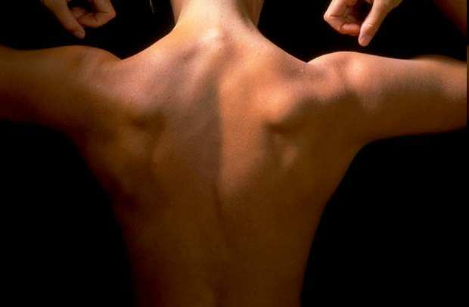
The Muscular System

Slide 80
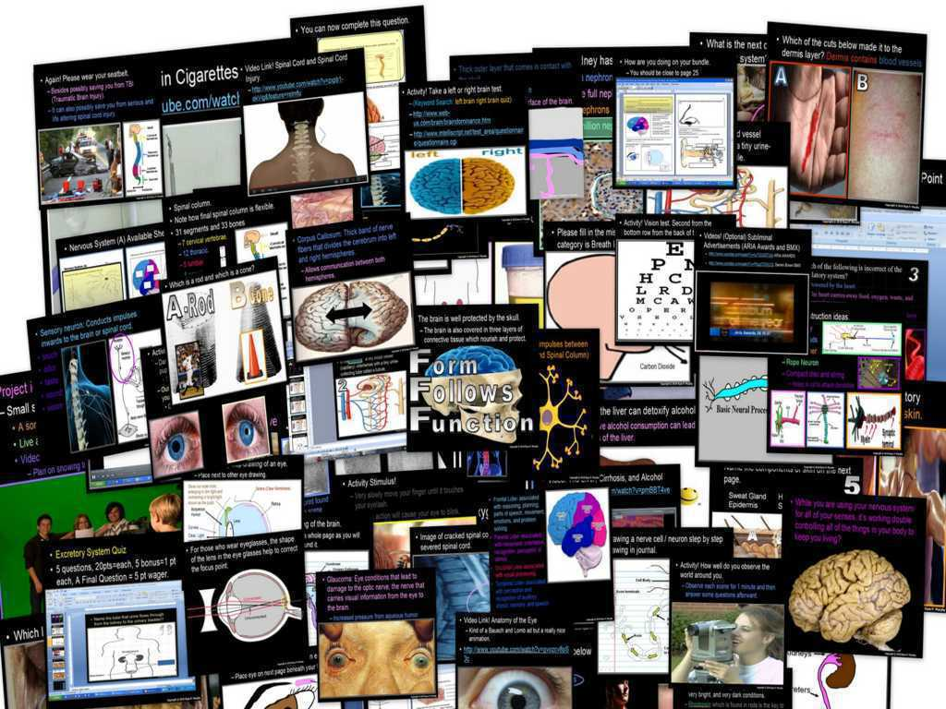
Human Body and
Health Topics Unit

Slide 81
Human Body and
Health Topics Unit
Areas of focus: Form Follows Function concept spread throughout. Levels of biological organization, cell basics, cells of the body, tissues, organs, organ systems, homeostasis, functions of the skeletal system, categories of bones, marrow, bones of the human body, bone disease, types of joints, muscular system, connective tissues, ligaments, tendons, muscles and energy use, types of muscle tissue, muscle fibers and movement, common muscles, biological molecules and important nutrients to the body (extensive), learning the contents of junk food, calories, obesity, fast food, eating disorders, anabolic steroids, digestive system, mechanical and chemical digestion, taste, enzymes, swallowing reflex, esophagus and peristalsis, organs of the GI Tract, focus on chemical digestion, duodenum, stomach, pancreas, liver, gall bladder, small intestine, villi and surface area, large intestine, appendix, rectum, cardiovascular system, cellular respiration, functions of the circulatory system, movement of blood, focus on the heart, blood vessels, cardiovascular disease, contents of blood, blood types, functions of the respiratory system, the nose, epiglottis, larynx and vocal cords, trachea, bronchus, lungs, alveoli, diaphragm, lung capacity, dangers of smoking, cancer, how to avoid cancer, skin cancer, what's inside a cigarette, smoking and advertising, excretory system, kidneys, urine, inside the nephron, ureters, bladder, urethra, kidney's role in detoxifying, cirrhosis of the liver, integumentary system (skin), functions of the skin, anatomy of skin, fingerprints, nervous system, stimulus, anatomy of a neuron, types of neurons, voluntary and involuntary functions, central and peripheral nervous systems, regions of the brain and roles, right brain vs. left brain, spinal cord injuries, anatomy of the eye and sight, lenses, rods and cones, night vision, anatomy of the nose and smell, dangers of inhalants, anatomy of the ear and hearing, noise induced hearing loss, sense of touch, the adolescent brain -whoa!, lobes of the brain, endocrine system, glands, hormones, activities in your body, endocrine system vs. nervous system, exocrine glands, puberty, body stability, parenting, male and female reproductive systems, sex cells, chromosomes, fertilization, menstrual cycle, placenta, embryo development, dangers of smoking and drinking while pregnant, immune system, diseases, how diseases are spread, the immune response, parasites, vaccines, virus prevention, HIV, HIV transmission, abstinence vs. prevention, AIDS, STD's, and much more. (8,500 Slides)

Slide 82
Human Body and
Health Topics Unit
Human Body Systems and Health Topics Unit on TpT (10,000 Slides, 40 page homework bundle, 54 pages of lesson notes, hundreds of worksheets, much more)
Hundreds of PowerPoint samples, the bundled homework package, unit notes, and much more can be previewed at…
Human Body and Health Topics Unit Preview Link
Anatomy Intro, Levels of Biological Organization Lesson Bundle
Skeletal System Lesson Bundle
Muscular System Lesson Bundle
Anatomy Intro, Skeletal, Muscular System Review Game
Healthy Eating, Molecules of Life Lesson Bundle
Obesity, Dangers of Fast Food, Eating Disorders
Healthy Eating and Living Review Game
Eating Disorders, Anabolic Steroids
Digestive System Lesson Bundle
Circulatory System and Respiratory System Lesson Bundle
Anti-Tobacco, Dangers of Smoking Lesson Bundle
Circulatory and Respiratory System Review Game
Excretory System Lesson Bundle
Nervous System Lesson Bundle
Nervous System Review Game
Endocrine System Lesson Bundle, Puberty, Hormones
Human Reproductive Lesson Bundle, Fertilization
Endocrine and Reproductive System Review Game
Immune System, HIV, AIDS, STD's Lesson Bundle
Immune System, HIV, AIDS, STD's Review Game
Anatomy Crossword Puzzle

Slide 83
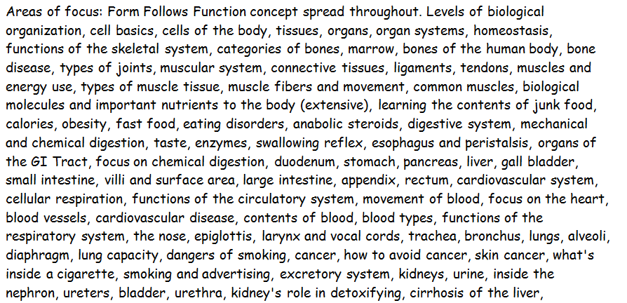

Slide 84
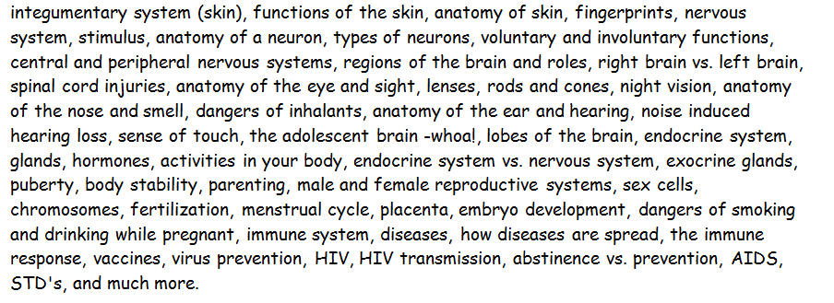

Slide 85
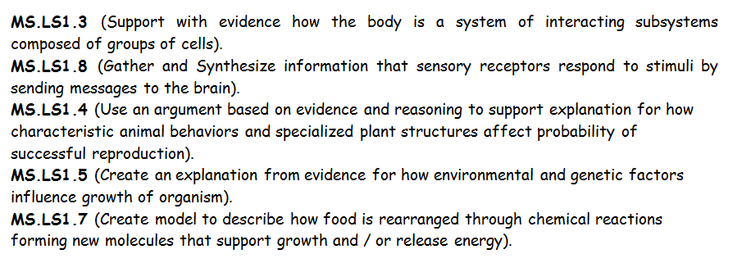

Slide 87
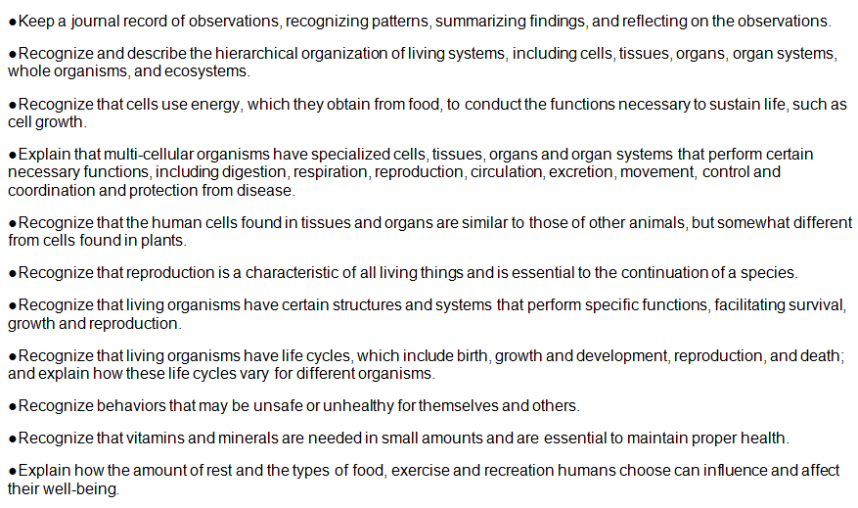
Additional Standards Addressed

Slide 88
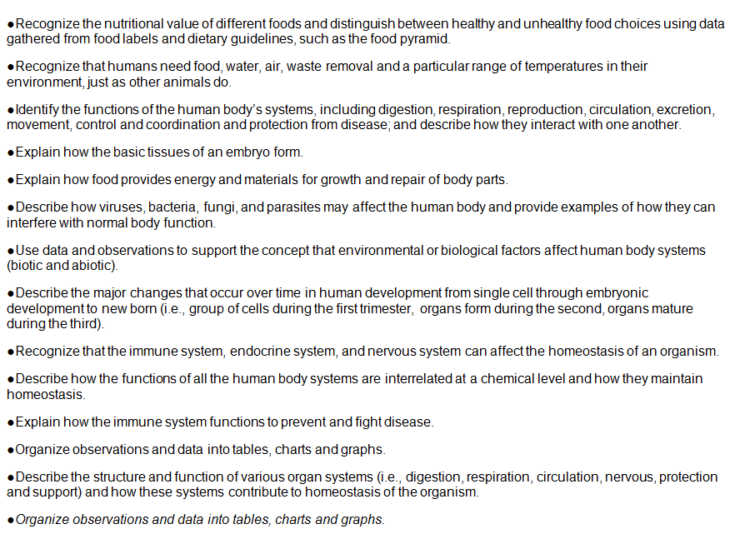
Additional Standards Addressed

Slide 89
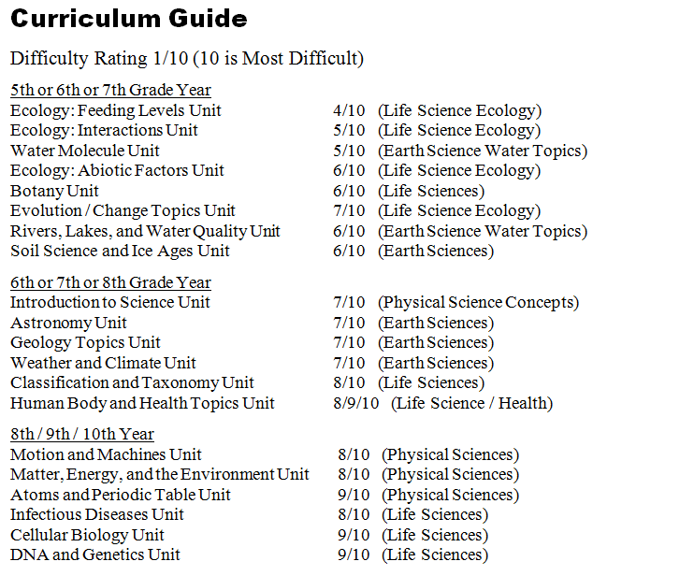

Slide 90
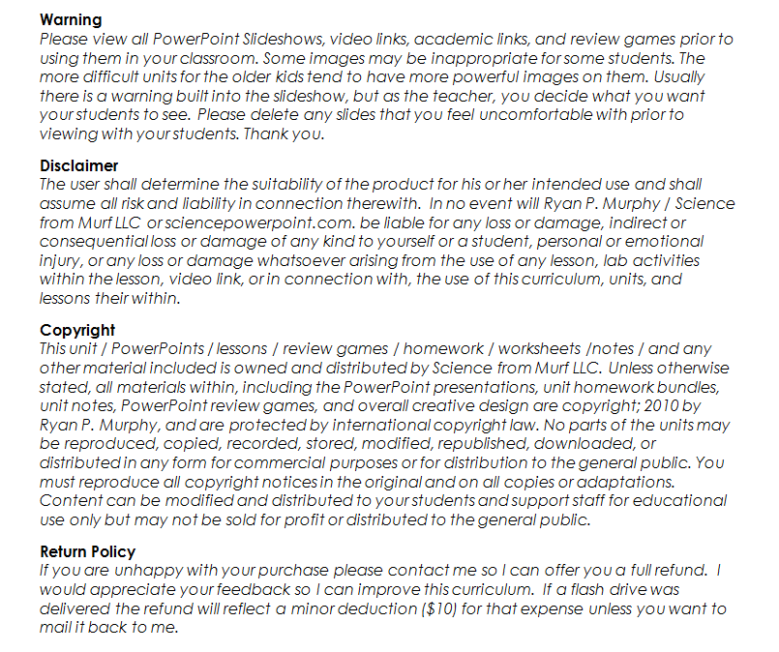

Slide 91
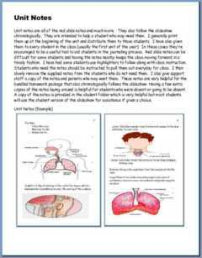
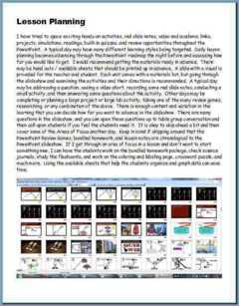
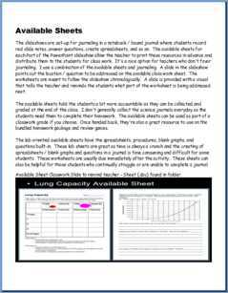
Please open the welcome / guide document on each unit preview.
This document will describe how to utilize these resources in your classroom and provide some curriculum possibilities.

Slide 92
This was a very brief tour. Please visit the links below to learn more and download detailed previews of the curriculum.
These units take me an extremely busy four years to complete with my middle level students.
Earth Science Unit Previews | Extended Tour Link and Curriculum Guide
Geology Topics Unit | Geology Topics Unit Preview Link
Astronomy Topics Unit | Astronomy Unit Preview Link
Weather and Climate Unit | Weather and Climate Unit Preview Link
Soil Science, Weathering, More | Weathering, Soil Science, Ice Ages, Glaciers Unit Preview Link
Water Unit | Water Unit Preview Link
Rivers Unit | Rivers, Lakes, and Water Quality Unit Preview Link
= Easier = More Difficult = Most Difficult
(5th – 7th grade) (6th – 8th grade) (8th – 10th grade)

Slide 93
Physical Science Unit Previews | Extended Tour Link and Curriculum Guide
Science Skills Unit | Science Skills Unit Preview Link
Motion and Machines Unit | Laws of Motion and Simple Machines Unit Preview Link
Matter, Energy, Envs. Unit | Matter, Energy, and the Environment Unit Preview
Atoms and Periodic Table Unit | Atoms and Periodic Table of the Elements Unit Preview Link
Life Science Unit Previews | Extended Tour Link and Curriculum Guide
Human Body / Health Topics | Human Body and Health Topics Unit Preview Link
DNA and Genetics Unit | DNA and Genetics Unit Preview Link
Cell Biology Unit | Cell Biology Unit Preview Link
Infectious Diseases Unit | Infectious Diseases Unit Preview Link
Taxonomy and Classification Unit | Taxonomy and Classification Unit Preview Link
Evolution / Natural Selection Unit | Evolution and Natural Selection Unit Preview Link
Botany Topics Unit | Botany Unit Preview Link
Ecology Feeding Levels Unit | Ecology Feeding Levels Unit Preview Link
Ecology Interactions Unit | Ecology Interactions Unit Preview Link
Ecology Abiotic Factors Unit | Ecology Abiotic Factors Unit Preview Link

Slide 94
Life Science Curriculum Link
Physical Science Curriculum Link
Earth Science Curriculum Link

Slide 95
Life Science Curriculum Link
Individual Lessons on TpT
Human Body Systems and Health Topics Unit
Anatomy Intro, Levels of Biological Organization Lesson Bundle
Skeletal System Lesson Bundle
Muscular System Lesson Bundle
Anatomy Intro, Skeletal, Muscular System Review Game
Healthy Eating, Molecules of Life Lesson Bundle
Obesity, Dangers of Fast Food, Eating Disorders
Healthy Eating and Living Review Game
Eating Disorders, Anabolic Steroids
Digestive System Lesson Bundle
Circulatory System and Respiratory System Lesson Bundle
Anti-Tobacco, Dangers of Smoking Lesson Bundle
Circulatory and Respiratory System Review Game
Excretory System Lesson Bundle
Nervous System Lesson Bundle
Nervous System Review Game
Endocrine System Lesson Bundle, Puberty, Hormones
Human Reproductive Lesson Bundle, Fertilization
Endocrine and Reproductive System Review Game
Immune System, HIV, AIDS, STD's Lesson Bundle
Immune System, HIV, AIDS, STD's Review Game
Anatomy Crossword Puzzle
DNA and Genetics Unit
DNA Lesson Bundle
DNA Lesson Review Game
DNA Crossword Puzzle
Cell Division, Mitosis and Meiosis Lesson Bundle
Cell Division Review Game
Mitosis and Meiosis Crossword Puzzle
Genetics Lesson Bundle
DNA and Genetics Crossword Puzzle
Genetics Review Game
Cellular Biology Unit
Introduction to Cells, Cell History, Cheek and Onion Cell Lab, Cell
Theory Lesson Bundle
Cell Review Game
Cell Transport Lesson Bundle, Osmosis, Diffusion, Active Transport
Cell Transport Review Game
Characteristics of Life Lesson
Cellular Organelles Lesson Bundle
Cellular Organelles Visual Quiz
Cellular Organelles Review Game
Cell Unit Crossword Puzzle
Cell Unit Flash Cards
Cellular Biology Unit Preview, Homework Bundle, Unit Notes, more
Life Science

Slide 96
Life Science Curriculum Link
Individual Lessons on TpT
Infectious Diseases Unit
Infectious Diseases Unit Intro and Virus Lesson Bundle
Virus Lesson Review Game
Bacteria Lesson Bundle
Bacteria Review Game
Parasites Lesson Bundle
Immune System, HIV, AIDS, STD's Lesson Bundle
Infectious Diseases Unit Crossword Puzzle
Immune System, HIV, AIDS, STD's Review Game
Evolution and Natural Selection
Evolution and Natural Selection Lesson Bundle
Evolution and Natural Selection Review Game
Human Evolution Lesson Bundle
Life Origins and Human Evolution Quiz Game
Geologic Timescale, Earth System History Lesson Bundle
Earth Geologic History Quiz Game
Life Origins and Human Evolution Quiz Game Life Origins, Miller Urey Experiment Lesson Bundle
Ecological Succession Lesson Bundle
Ecological Succession Review Game
Taxonomy and Classification Unit
Taxonomy and Classification Lesson Bundle
Taxonomy and Classification Review Game
Bacteria Lesson Bundle
Bacteria Review Game
Kingdom Protista Lesson Bundle
Kingdom Animal Lesson Bundle
Animal Phylums Visual Quiz
Class Mammalia Lesson Bundle
Kingdom Animalia Review Game and Mammalia
Kingdom Fungi Lesson Bundle
Kingdom Fungi Review Game
Kingdom Plantae Lesson Bundle
Botany Unit Review Game
Name the Kingdom, Phylum, Class Visual Challenge
Taxonomy and Classification Crossword Puzzle
Botany Unit
Botany Unit Intro, Non-vascular Plants, Plate Evolution Lesson Bundle
Student Botany Projects, Grow Study Lesson Bundle
Botany Unit Review Game
Plants, Seeds, Seed Dispersal Lesson Bundle
Plants Review Game
Plants, Roots, Leaves, Lesson Bundle
Monocotyledons and Dicotyledons Lesson Bundle
Dendrochronology, Tree Ring Dating Lesson Bundle
Plant Hormones Lesson Bundle
Botany Unit Crossword Puzzle
Leaf Identification Lesson Bundle
Botany Unit Review Game
Plant Life Cycles, Flowers, Fruits Lesson Bundle
Plant Life Cycles, Flowers, Fruits Review Game

Slide 97
Life Science Curriculum Link
Individual Lessons on TpT
Ecology Feeding Levels Unit
Ecology Food Chain Lesson Bundle
Biomagnification, Bioaccumulation of Pollution, Food Chain Lesson Bundle
Ecology Feeding Levels, Pyramid of Biomass, Number Lesson Bundle
Animal Dentition Lesson Bundle
Ecology Feeding Levels Unit Review Game
Ecology Feeding Levels Unit Crossword
Food Chain Board Game
Ecology Abiotic Factors Unit
Ecology Non-living Factors, Light Lesson Bundle
Ecology, Non-living Factor Temperature Lesson Bundle
Photosynthesis and Respiration, Biogeochemical Cycles Lesson Bundle
Ecology Non-living Factors Quiz Game
Island Biogeography Lesson Bundle
Nitrogen Cycle Lesson Bundle
Phosphorus Cycle and Nutrient Pollution Lesson Bundle
Plant Succession, Fire Ecology, Lesson Bundle
Ecological Succession Quiz Game
Ecology Flash Cards
Ecology Interactions Unit
Ecology Levels of Organization Lesson Bundle
Animal Habitats Lesson Bundle
Food Webs, Predator and Prey Cycles Lesson Bundle
Biodiversity and Population Sampling Lesson Bundle
Animal Competition Lesson Bundle
Animal Camouflage and Mimicry Lesson Bundle
Ecology, Camouflage, Mimicry, Population Sampling Review Game
Symbiosis Lesson Bundle
Invasive Exotic Species Lesson Bundle
Ecology Interactions Part III, IV Review Game, Symbiosis, Exotic Species
Ecology Interactions Unit Crossword Puzzle

Slide 98
Physical Science Curriculum Link
Individual Lessons on TpT
Laws of Motion and Simple
Machines Unit
Newton's Three Laws of Motion
Newton's Laws of Motion Review Game
Friction Lesson, Types of Friction
Kinetic and Potential Energy Lesson
Newton's Laws and Forces in Motion
Forces in Motion Review Game
Catapults and Trajectory Lesson
Simple Machines Lesson
Simple Machines Review Game
Laws of Motion and Simple Machines Unit Flashcards
Laws of Motion and Simple Machines Crossword Puzzle
Laws of Motion, Forces in Motion, Simple Machines Unit Preview, Homework, Notes
Science Skills Unit
Lab Safety Lesson Bundle
Microscopes and Magnification Lesson Bundle
Metric System / SI Lesson Bundle
Scientific Notation Lesson Bundle
Volume and Density Lesson Bundle
Scientific Method, Observation Skills Lesson Bundle
Science Skills Unit Flash Cards
Science Skills Unit Crossword Puzzle
Science Skills Unit Review Game
Science Skills Unit Preview, Homework Bundle, Notes
Matter, Energy, and the
Environment Unit
States of Matter, Physical Change, Chemical Change
States of Matter, Physical Change, Chemical Change Review Game
Gas Laws Introductory Lesson Bundle
Gas Laws Review Game
Viscosity Lesson Bundle
Forms of Energy Lesson Bundle
Heat Transfer, Convection, Conduction, Radiation Lesson Bundle
Electromagnetic Spectrum Lesson Bundle
Forms of Energy, Particles, Waves, EM Spectrum Review Game
Electromagnetic Spectrum Visual Quiz
Electricity and Magnetism Lesson Bundle
Electricity and Magnetism Review Game
Matter and Energy Crossword Puzzle and Solution
Matter, Energy, and the Environment Unit Preview, Homework Bundle, Notes
Environment Unit Bundle
Environment Unit Bundle Review Game
Atoms and the Periodic Table of the Elements Unit
Atoms, Atomic Number, Atomic Mass, Isotopes Lesson Bundle
Inside the Atom Lesson Bundle
Atoms Review Game
Atomic Theory, Electrons, Orbitals, Molecules Lesson Bundle
Atoms, Atomic Theory, Electrons, Orbitals, Molecules Review Game
Atomic Bonding, Balancing Chemical Equations, Reactions, Lesson Bundle
Atoms and the Periodic Table Crossword Puzzle and Solution
Atoms and Periodic Table Unit Preview, Homework Bundle, Unit Notes
Periodic Table of the Elements Unit Lesson Bundle
Periodic Table of the Elements Review Game
Physical Science

Slide 99
Earth Science Curriculum Link
Individual Lessons on TpT
Geology Topics Unit
Plate Tectonics, Continental Drift, Earth's Core,
Plate Boundaries Lesson Bundle
Dynamic Earth Review Game
Plate Boundaries Visual Quiz
Volcanoes Lesson Bundle
Types of Volcanoes
Volcanoes Review Game
Earthquakes Lesson Bundle
Earthquakes Review Game
Rock Deformation, Compression, Tension, Shearing
Minerals Lesson Bundle
Minerals Review Game
Rock or Mineral PowerPoint Quiz
Rocks and Minerals Lesson Bundle
Rocks and Minerals Flash Cards
Types of Rocks Visual Quiz
Rocks and the Rock Cycle Lesson Bundle
Rocks and Rock Cycle Review Game
Geologic Timescale, Earth System History Lesson Bundle
Earth Geologic History Quiz Game
Geology Unit Crossword Puzzle
Geology Unit Preview, Bundled Homework, Unit Notes
Astronomy Topics Unit
Solar System and Sun Lesson Bundle
Sun Lesson Bundle
Solar System and Sun Review Game
Solar and Lunar Eclipse Lesson Bundle
Inner Planets Lesson Bundle
Inner Planets Review Game
Moon, Phases of the Moon, Tides, Seasons, Lesson Bundle
Rocketry Lesson Bundle
Asteroid Belt, Meteors, Torino Scale Lesson Bundle
Asteroid Belt and Rocketry Review Game
Mission to the Moon, Apollo Lesson
Outer Planets Lesson Bundle
Outer Planets Review Game
Beyond the Solar System Lesson Bundle
Beyond the Solar System, Galaxies, Black Holes, Constellations Review Game
Galaxy Lesson, Hubble Exploration
Astronomy Unit Crossword Puzzle
Astronomy Unit in Spanish

Slide 100
Earth Science Curriculum Link
Individual Lessons on TpT
Weathering, Soil Science, Soil Conservation, Ice Ages, Glaciers Unit
Mechanical and Chemical Weathering Lesson Bundle
Mechanical and Chemical Weathering Review Game
Soil Science Lesson Bundle
Erosion, Soil Conservation Lesson Bundle
Soil Science, Erosion, Soil Conservation Review Game
Weathering, Soil Science Unit Flash Cards
Weathering and Soil Science Crossword Puzzle
Ice Ages and Glaciers Lesson Bundle
Ice Ages and Glaciers Review Game
Ice Ages and Glaciers Crossword Puzzle
Ice Ages, Glaciers Unit Flash Cards
Weathering, Soil Science, Soil Conservation, Ice Ages, Glaciers Unit Preview
Weather and Climate Unit
Atmosphere Lesson Bundle
Ozone Layer, Air Pollution, Skin Cancer
Atmosphere, Layers of the Atmosphere, Pollution Quiz Game
Air Pressure and Winds Lesson Bundle
Severe Weather Lesson Bundle, Hurricanes, Tornado, Blizzards
Seasons Lesson Bundle, Axial Tilt
Weather, Wind, Seasons, Quiz Game
Winds, Global Winds, Wind Chill Lesson Bundle
Oceans and Weather, Water Cycle, Clouds Lesson Bundle
Water Cycle and Clouds Lesson Bundle

Slide 101
Earth Science Curriculum Link
Individual Lessons on TpT
Rivers, Lakes, and
Water Quality Unit
Rivers and Watershed Lesson Bundle
Flooding Lesson Bundle
Benthic Macroinvertebrate Lesson Bundle
Lake Turnover Lesson Bundle
Salmon Lesson Bundle
Fish Lesson, Fashion a Fish, Lesson Bundle
Rivers, Lakes, and Water Quality Unit Review Game
Rivers, Lakes, and Water Quality Crossword Puzzle
Rivers, Lakes, and Water Quality Unit Preview, Homework Bundle, Unit Notes
Water Molecule Unit
Water Use, Water on Earth, Water Conservation Lesson Bundle
Groundwater, Groundwater Pollution Lesson Bundle
Properties of Water Lesson Bundle
Water Cycle Lesson Bundle
Water Unit Review Game
Water Unit Preview, Homework Package, Unit Notes, more

Slide 102
Individual units within the curriculum
Earth Science Units | Purchase Individual Unit Link on TpT
Geology Topics Unit | Geology Unit on TpT
Astronomy Topics Unit | Astronomy Unit on TpT
Weather and Climate Unit | Weather and Climate Unit on TpT
Soil Science, Weathering, More | Weathering, Soil Science, Ice-Ages, Glaciers Unit on TpT
Water Unit | Water Unit on TpT
Rivers Unit | Rivers, Lakes, and Water Quality Unit on TpT
= Easier = More Difficult = Most Difficult
(5th – 7th grade) (6th – 8th grade) (8th – 10th grade)

Slide 103
Physical Science Units | Purchase Individual Unit Link on TpT
Science Skills Unit | Science Skills Unit on TpT
Motion and Machines Unit | Newton's Laws of Motion, Forces in Motion and Simple Machines Unit
Matter, Energy, Envs. Unit | Matter, Energy, and the Environment Unit
Atoms and Periodic Table Unit | Atoms and Periodic Table of the Elements Unit on TpT
Life Science Units | Purchase Individual Unit Link on TpT
Human Body / Health Topics | Human Body Systems and Health Topics Unit on TpT
DNA and Genetics Unit | DNA and Genetics Unit on TpT
Cell Biology Unit | Cell Biology Unit on TpT
Infectious Diseases Unit | Virus, Bacteria, Parasites, Diseases Unit
Taxonomy and Classification Unit | Taxonomy and Classification Unit
Evolution / Natural Selection Unit | Evolution and Natural Selection Unit on TpT
Botany Topics Unit | Botany Unit
Ecology Feeding Levels Unit | Ecology Feeding Levels Unit on TpT
Ecology Interactions Unit | Ecology Interactions Unit on TpT
Ecology Abiotic Factors Unit | Ecology Abiotic Factors Unit on TpT

Slide 104
Curriculum Tour Link
Thank you for your time and interest. The curriculum link above will allow to see previews of the curriculum, bundled homework packages, review games, unit notes, the welcome guide, and much more. Thank you for your interest and feel free to contact me with any questions you may have. Best wishes.
Sincerely,
Ryan Murphy M.Ed
ryemurf@gmail.com

Slide 105
Entire Science Curriculum Link

