Slide 1
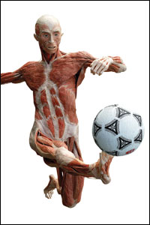
March 3, 2016, Please Do Now
Sharpen Pencil
Collect Please Do Now, chrome book, pen/pencil that works
Take out Planner, write in homework ( STUDY/FINISH muscular system foldable)
Complete Wed. & Thurs. Please Do Now (complete sentences)

Slide 2
Essential Question
We know that our skeletal system cannot move without our muscles, but are the muscles that move our arms and legs one that are voluntary or involuntary? Explain.

Slide 3
Video Clip to assist with answering the essential question.
https://youtu.be/f_F5UwtdPOc

Slide 4
Muscular System Foldable
Teacher will pass out and explain how to fold
Students will use web links below and on the back of the foldable to complete.
http://www.scholastic.com/teachers/activity/human-body-14-studyjams-interactive-science-activities
http://www.childrensuniversity.manchester.ac.uk/media/services/thechildrensuniversityofmanchester/flash/exercise_3_muscles.swf
http://kidshealth.org/en/kids/muscles.html

Slide 5
Exit Slip
We know that our skeletal system cannot move without our muscles, but are the muscles that move our arms and legs one that are voluntary or involuntary? Explain.

