Slide 1
April 3, 2017
Sharpen Pencil
Collect PDN / DOL , 7th grade textbook
Sit in assigned seat
Complete PDN / DOL

Slide 2
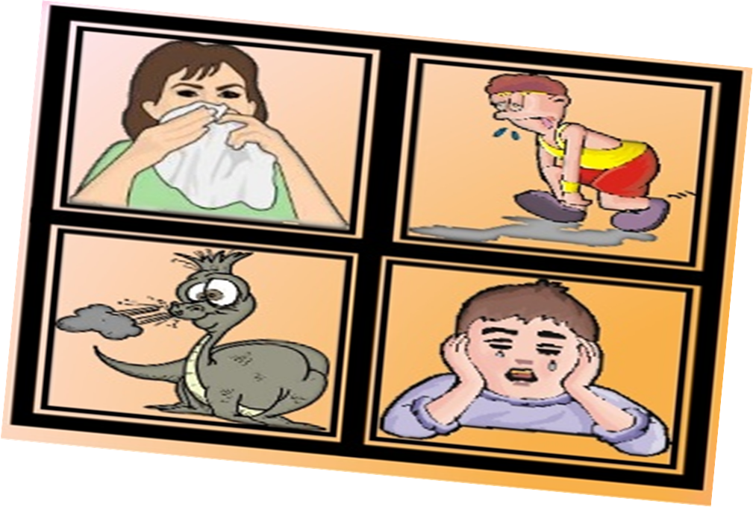
7th Grade Agenda
1. PDN
2. Explain Excretory System Foldable
3. Excretory System Video Clip
4. Complete Excretory System Foldable
5. DOL Quiz

Slide 3
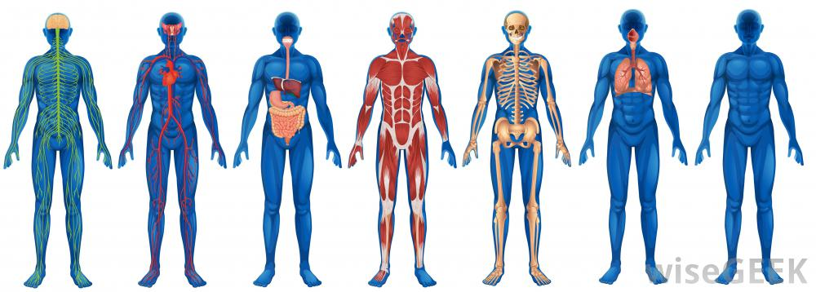
7th Grade TEK
7.12(B) identify the main functions of the systems of the human organism, including the circulatory, respiratory, skeletal, muscular, digestive, excretory, reproductive, integumentary, nervous, and endocrine systems

Slide 4
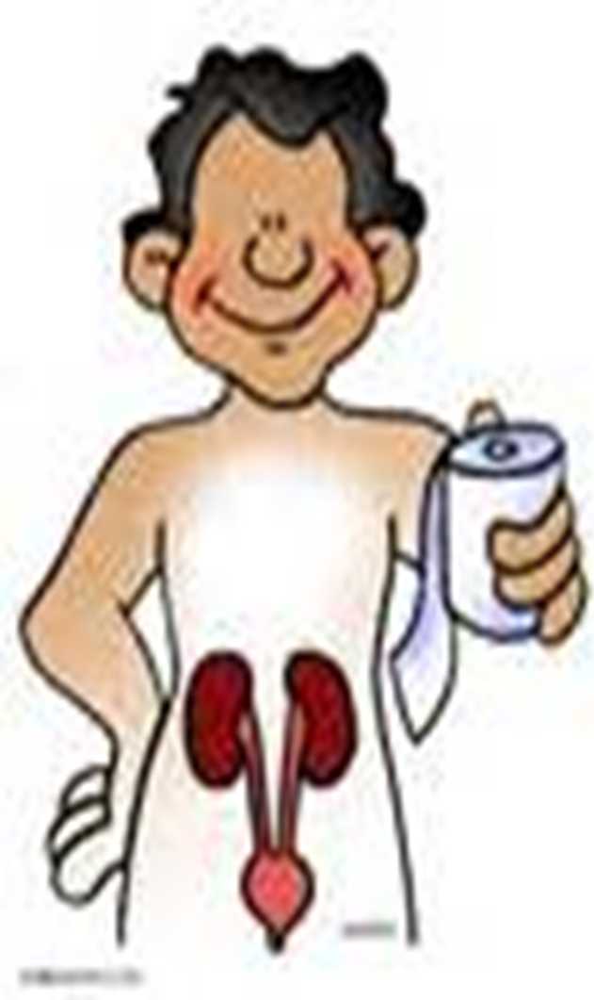
7th Grade LO
We will compare / contrast the structures and functions of the excretory system through completion of a foldable.
7.12(B) identify the main functions of the systems of the human organism, including the circulatory, respiratory, skeletal, muscular, digestive, excretory, reproductive, integumentary, nervous, and endocrine systems

Slide 5
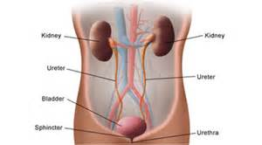
7th Grade DOL
I will complete written staar type questions over the excretory system via a dol quiz.

Slide 6
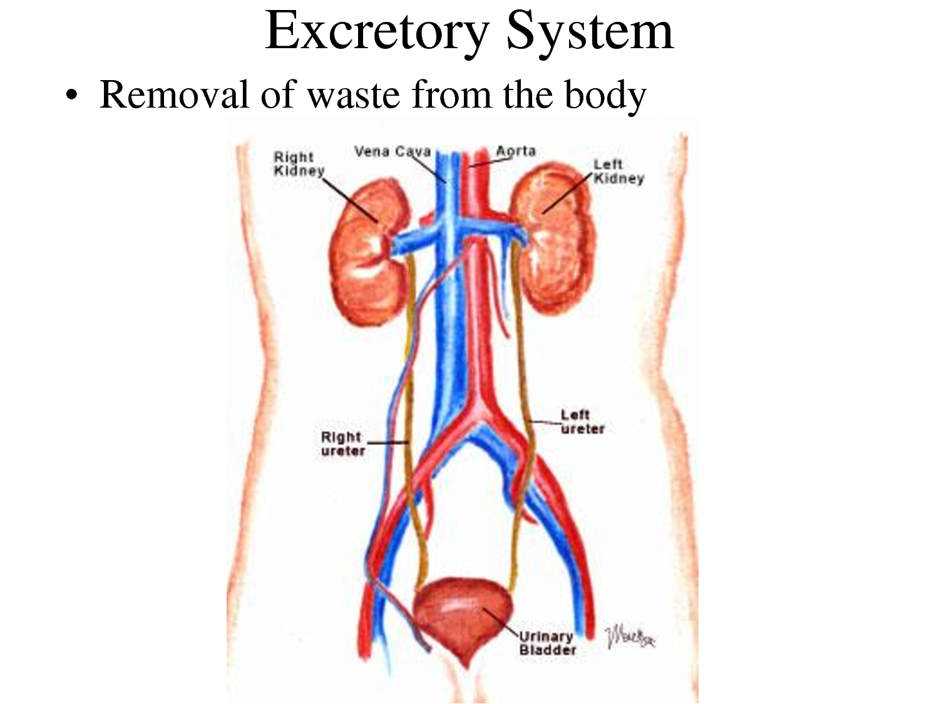
7th Grade Excretory System
Excretory System Video Clip:
https://www.youtube.com/watch?v=TZMJeZL-BVg
Kids Health Website Link:
http://kidshealth.org/en/kids/pee.html

Slide 7
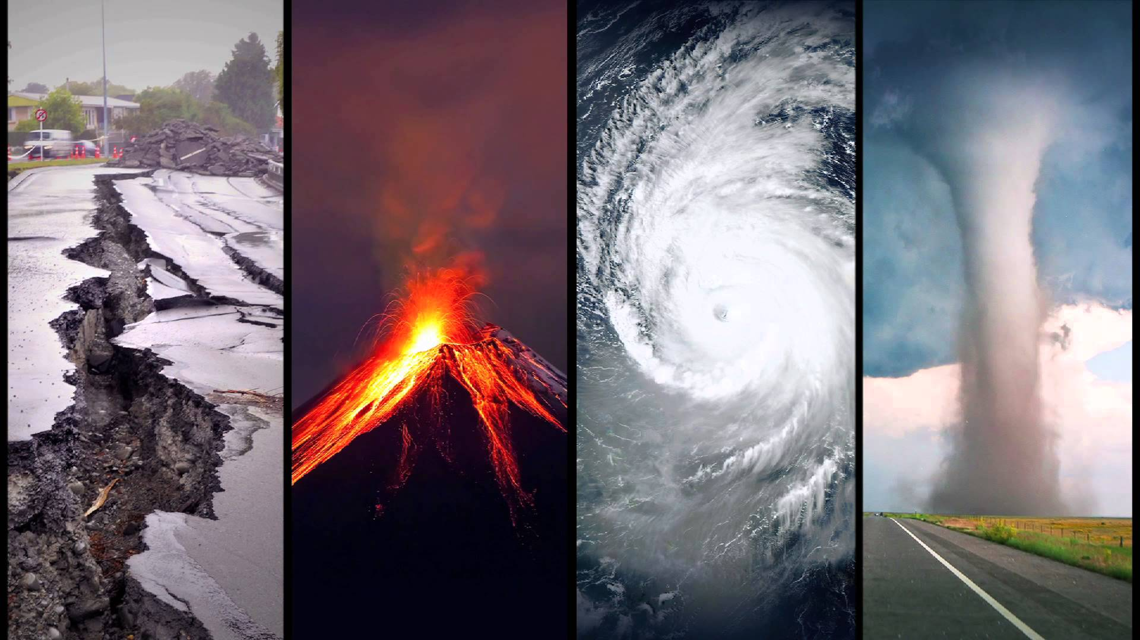
6th Grade Agenda
1. PDN
2. Catastrophic Events Foldable
3. DOL Quiz

Slide 8
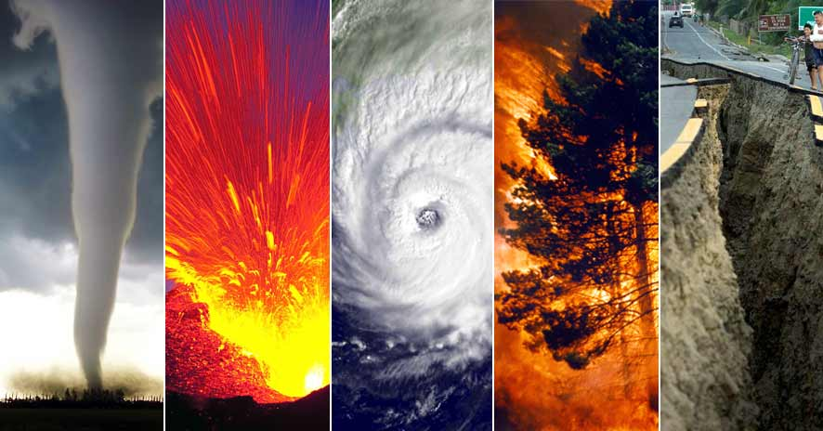
6th Grade TEKS
7.8(A) predict and describe how different types of catastrophic events impact ecosystems such as floods, hurricanes, or tornadoes

Slide 9
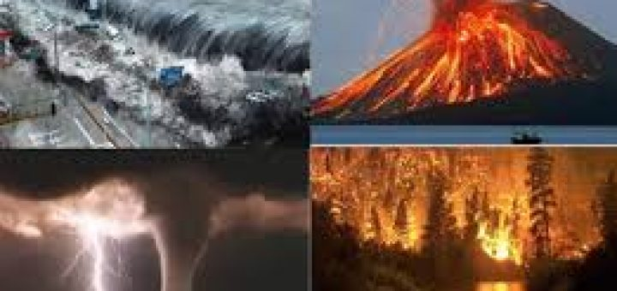
6th Grade LO:
We will compare / contrast different types of catastrophic events and the destruction they cause through completion of a foldable.
7.8(A) predict and describe how different types of catastrophic events impact ecosystems such as floods, hurricanes, or tornadoes

Slide 10
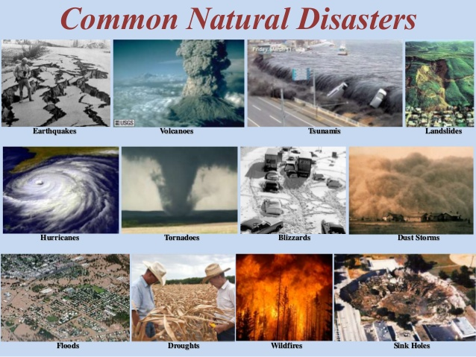
6th Grade DOL
I will complete written assessment questions over catastrophic events via a dol quiz.

Slide 11
6th Grade Catastrophic Events / Natural Disasters Links
www.coachpease.com (click on 5th 6 weeks, scroll to natural disasters power point)
www.coachpease.com (click on Links, scroll to natural disasters / catastrophic events, click on links below)

