Slide 1
April 27, 2016 Please Do Now
Sharpen Pencil
Collect Please Do Now from blue basket, chrome book, clicker, pen/pencil that works
Take out Heredity/Genetics Foldable from Friday, make sure name is on it and turn it in.
Take out TEXTBOOK, Open the book to pg. Use this information to complete the Please Do Now (Remember that Clicker Grades go directly into gradebook, so Don’t Guess!)

Slide 2
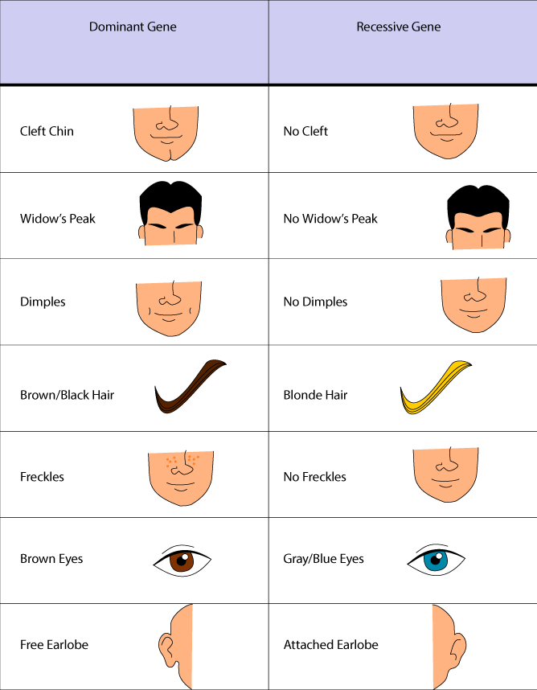
Agenda
Correct DOL from Yesterday
Please Do Now
Monster Babies Activity

Slide 3
DOL/Exit Slip: Punnett Squares
Directions: Complete the Punnett Square Below (pg. 231 in textbook)
Dominant=Green
Recessive= Yellow
Genotype: __________________________________
Phenotype: __________________________________
 | R | r
R
r
Genotype:
______________________
Phenotype:
______________________
Genotype: ______________
Phenotype: ______________
Genotype: ______________
Phenotype: ______________
Genotype: ______________
Phenotype: ______________
Genotype: ______________
Phenotype: ______________

Slide 4
Please Do Now: Punnett Square
Directions: Students will pick correct answer choice to answer the question/statement. Student will circle / click in correct answer. Pg. 230-237
# | Question / Statement To Answer | Answer Choice A | Answer Choice B
1 | How many alleles does each parent have for a particular gene? | 2 | 4
2 | How many allele’s does the offspring receive from each parent | 2 | 1
3 | When using a Punnett square how do you know which allele’s are dominant? | Dominant are Capital DD | Recessive are Lower Case dd
4 | When using a Punnett square how do you know which allele’s are recessive? | Dominant are Capital DD | Recessive are Lower Case dd
5 | ____________________can be used to predict sex-linked disorders. | Pedigrees | Traits

Slide 5
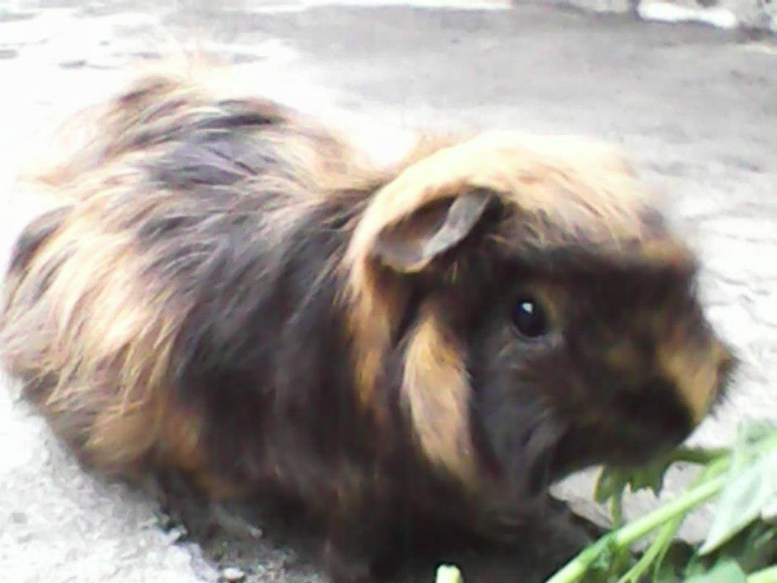
Essential Question
We are able to see both brown and black hair color on Sweetie. Based on her phenotype do you think her genotype is complete dominant, independent dominant or codominance for hair color? Explain

Slide 6
Video to assist with Essential Question
https://www.youtube.com/watch?v=YJHGfbW55l0
Students take notes as watch the video
Regroup and re-discuss question as a class

Slide 7
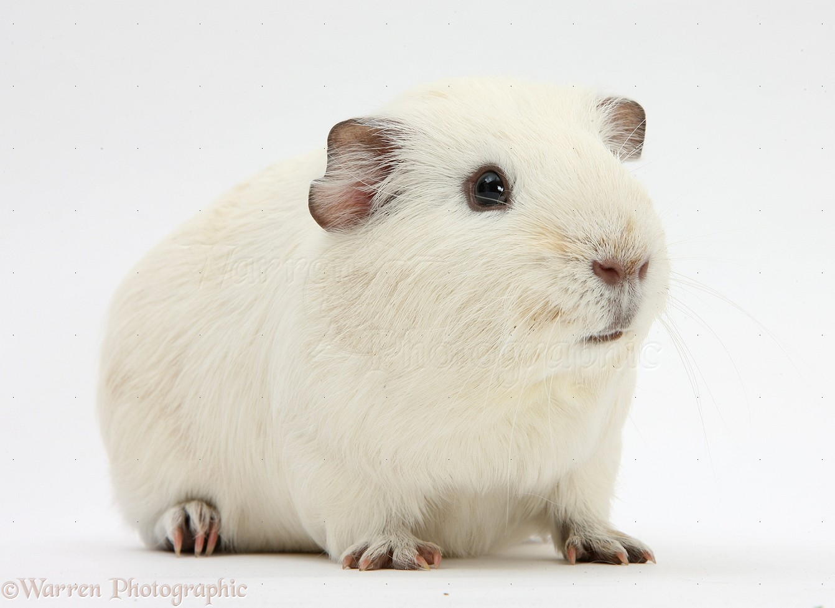
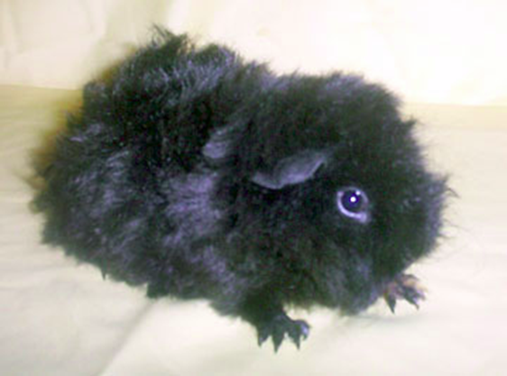
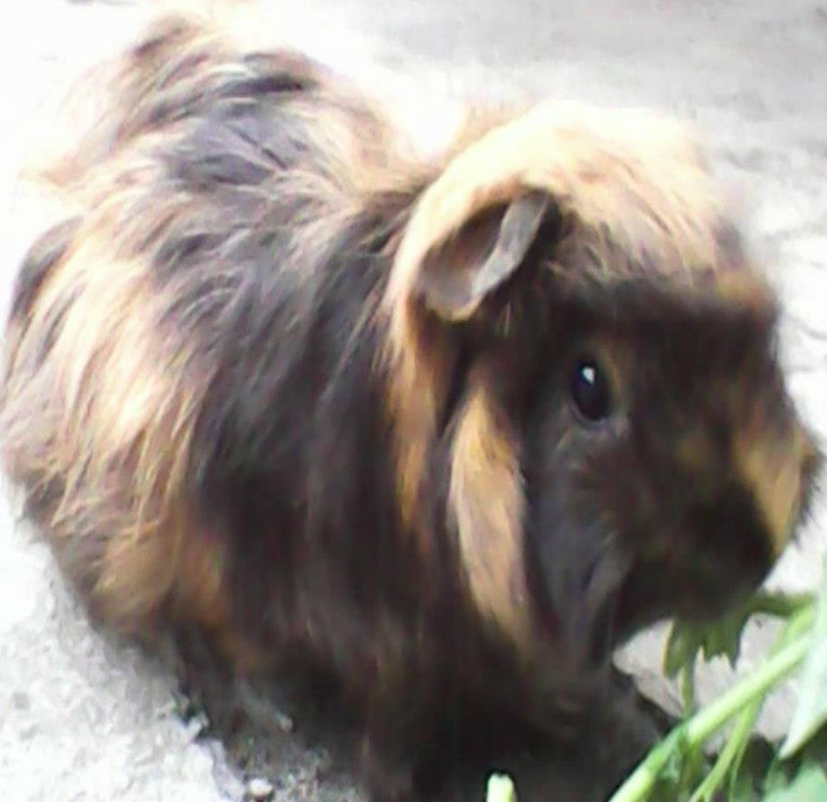
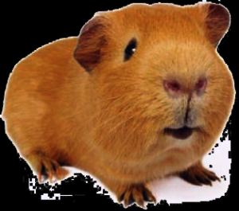
Sweetie who is codominant for hair color(BR) is bred with a Homozygous Recessive white Male (bb). What will the off springs genotype and phenotype be?
Phenotype
b
b
50
Black
Brown
50
B
b
B
b
B
Genotype
Bb
50
Rb
50
R
b
R
b
R
bb
o

Slide 8
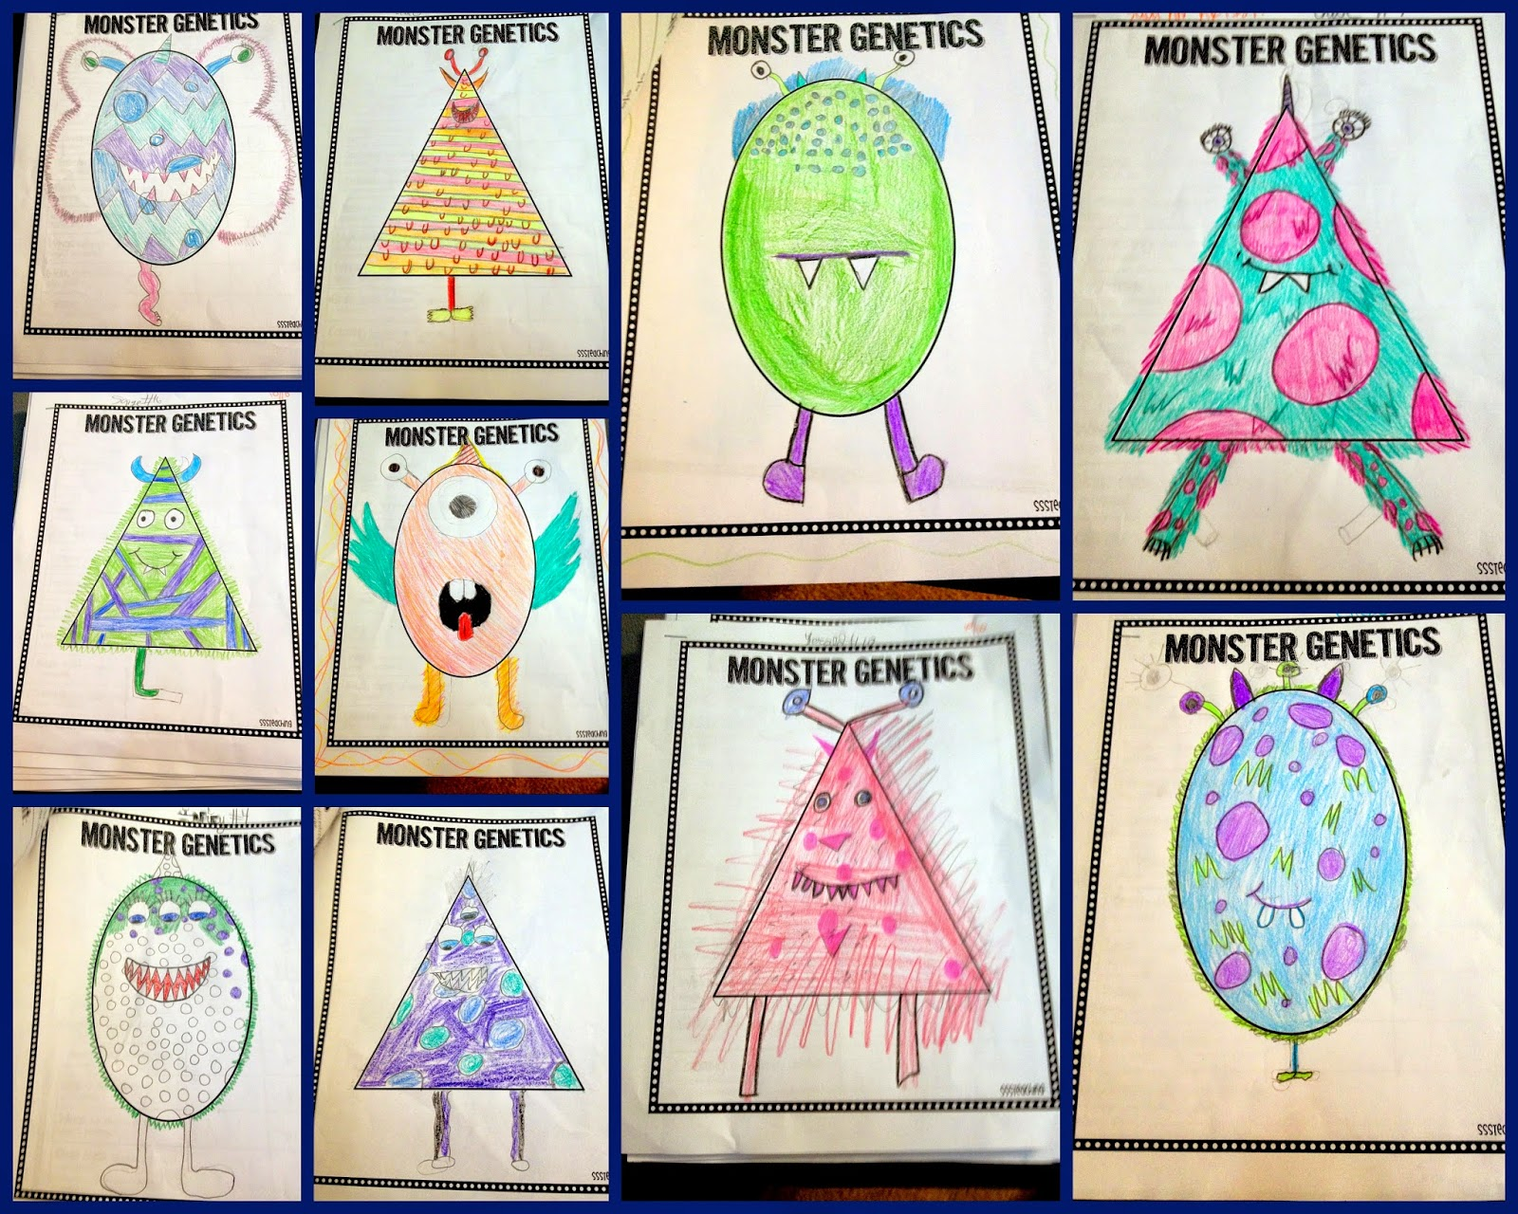
Monster Babies Activity
Teacher will pass out packet and explain directions to entire class as a whole

Slide 9
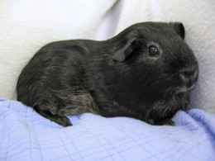
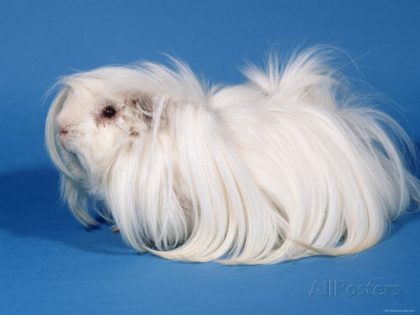
DOL/Exit Slip: Punnett Squares
Directions: Complete the Punnett Square Below
Dominant=Black
Recessive=White
Genotype: __________________________________
Phenotype: __________________________________
 | R | R
r
r
Genotype:
______________________
Phenotype:
______________________
Genotype: ______________
Phenotype: ______________
Genotype: ______________
Phenotype: ______________
Genotype: ______________
Phenotype: ______________
Genotype: ______________
Phenotype: ______________

